Slide 1
Integrating Knowledge and Learning

Slide 2
Neural-Symbolic Learning
According to LeCun one of the great challenges of artificial intelligence is to combine the robustness of connectionist systems(i.e., neural networks) with symbolic representation to perform complex reasoning tasks. While symbolic representation is highly recursive and declarative, neural networks encode knowledge implicitly by adjusting weights. For many decades exploring the fusion between connectionist and symbolic systems has been overlooked by the scientific community.
Yann LeCun, Yoshua Bengio, and Geoffrey Hinton. Deep learning. Nature, 521(7553):436–444, 2015.

Slide 3
Knowledge Representation Forms
Algebraic Equations
Differential Equations
Simulation Results
Spatial Invariances
Logic Rules
Knowledge Graphs
Probabilistic Relations
Human Feedback

Slide 4
How to Think?
Hypothesis Set
Objectiveness
Optimization
Training Data
Key Elements in Learning

Slide 5
Algebraic Equations based Approaches

Slide 6
Algebraic Equations
Algebraic equations represent knowledge as equality or inequality relations between mathematical expressions consisting of variables or constants.
Equations can be used to describe general functions or to constrain variables to a feasible set and are thus sometimes also called algebraic constraints.
Eg.,
the equation for the mass-energy equivalence
the inequality stating that nothing can travel faster than the speed of light in vacuum.

Slide 7
Approach 1: Improve the objectiveness
Algebraic equations are integrated into the learning algorithm through the formulation of the constraint problem.
Eg.
Prior knowledge in the form of multiple polyhedral sets, each of which is one of two categories, is introduced into the formulation of the linear support vector machine classifier.
The theorem of the alternative for convex functions converts nonlinear prior knowledge implications into linear inequalities without the need to kernelize these implications.

Slide 8
Knowledge-Based Support Vector Machine (SVM) Classifiers
Linear programming SVM:
Knowledge-based SVM:
Introducing prior information
belong to class A +
ensure that each of the knowledge sets lie on the appropriate side of the bounding planes
Fung el al., “Knowledge- based support vector machine classifiers,” , NIPS 2003.

Slide 9
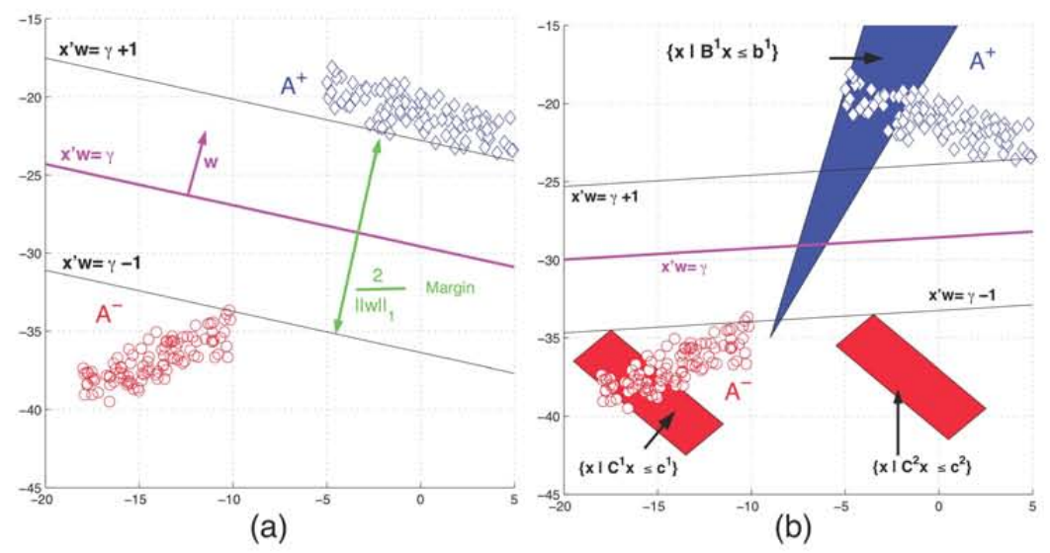
Knowledge-Based SVM Classifiers

Slide 10
Nonlinear Knowledge-Based Classification
Nonlinear Kernel Classifier:
Prior Knowledge:
Mangasarian and Wild, “Nonlinear knowledge-based classification,” Trans. Neural Networks, 2008.

Slide 11
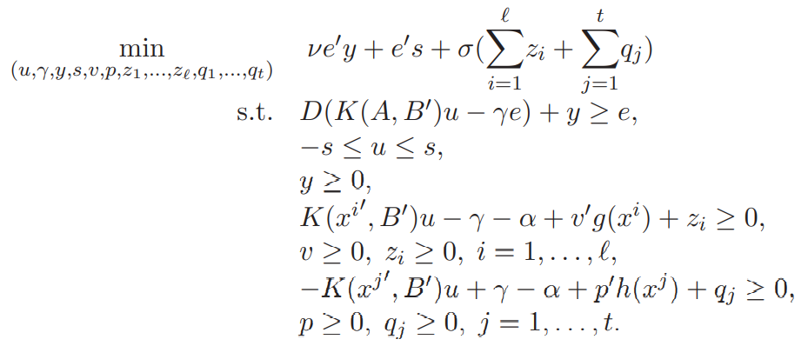
Nonlinear Knowledge-Based Classification

Slide 12
Approach 2: Improve the hypothesis set
The algebraic equations are included in the hypothesis set.
The algebraic equations can be transformed into the architecture of a neural network to rank predefined operations leading to functional decomposition.
Eg.
Using partial knowledge about the process mechanism, it is embedded in a neural network structure. Build a forward predictive model for the process of electrochemical micromachining..
Incorporating domain knowledge into policy learning to accelerate reinforcement learning. Approximating a strategy using a simple MMC network reduces the number of interactions required to approximate a suitable strategy.
Assuming a database of training data and programs, our main idea is to use Monte Carlo tree search or reinforcement learning to determine the sequence of operations that map the input to the desired output .

Slide 13
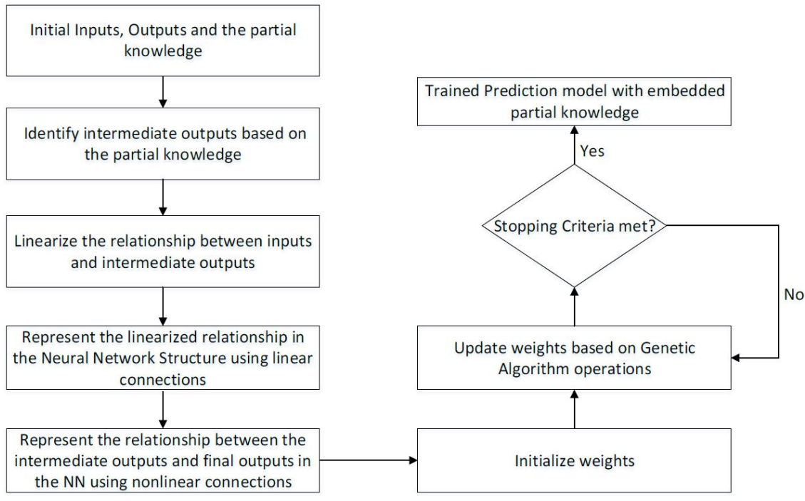
Physics-Embedded Machine Learning
Lu et al, “Physics-embedded machine learning: Case study with electrochemical micro- machining,” Machines, 2017.

Slide 14
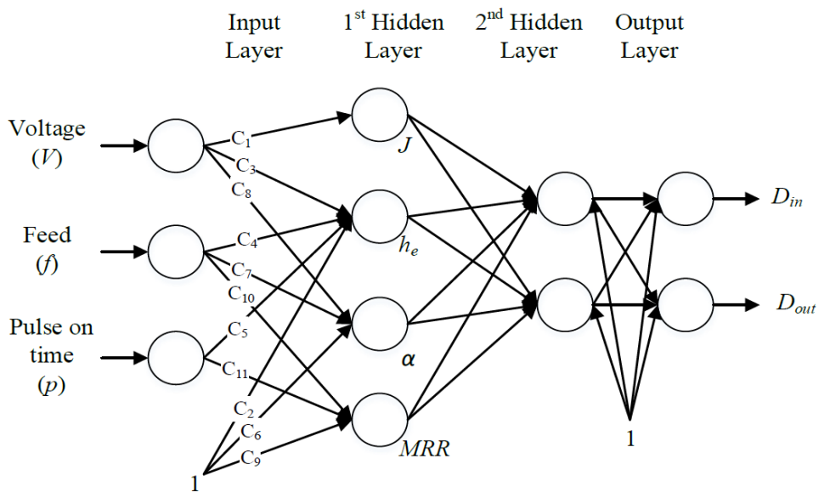
Physics-Embedded Machine Learning

Slide 15
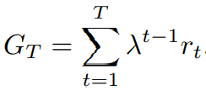
Leveraging Domain Knowledge for Reinforcement Learning using MMC Architectures
Designing policy architectures using domain knowledge
the policy π is often represented as a deep neural network πθ with weights θ
Agent
Policy
State
Reward
Action
Environment
Ramamurthy et al, “Leveraging domain knowledge for reinforcement learning using mmc architectures,” ICANN 2019.

Slide 16
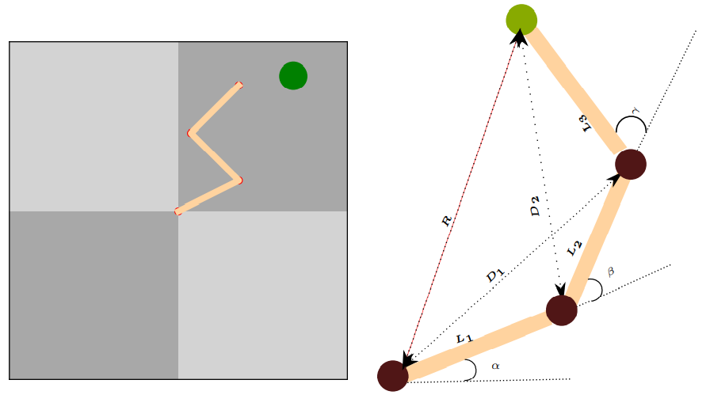
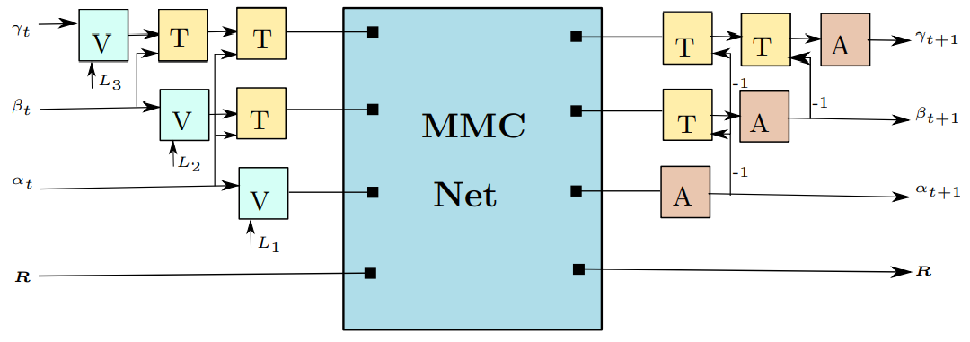
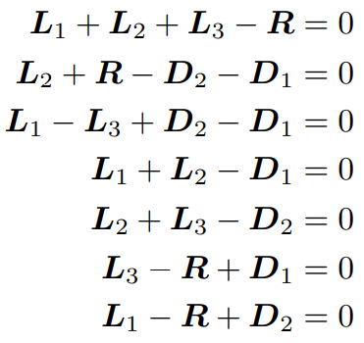
Leveraging Domain Knowledge for Reinforcement Learning using MMC Architectures
Reacher task: three-segmented robotic arm with end effector has to reach a target position.
the joint angles are first transformed to arm vectors
to compute the predicted arm vectors for the next time step
converted back to the corresponding arm orientations
mean of multiple computations (MMC)

Slide 17
Informed Machine Learning Through Functional Composition
Treat data driven learning not as a parameter estimation problem but as a problem of sequencing predefined operations
feed-forward neural network = composite function
Q1: When building a deep system, do the functions fl it consists of have to be of the form above or are there other basic building blocks?
Q2: When training a deep system, does it necessarily have to be a parameter estimation problem or are there other ways of adapting it to a task at hand?
Bauckhage et al. Informed Machine Learning Through Functional Composition, LWDA 2018.

Slide 18
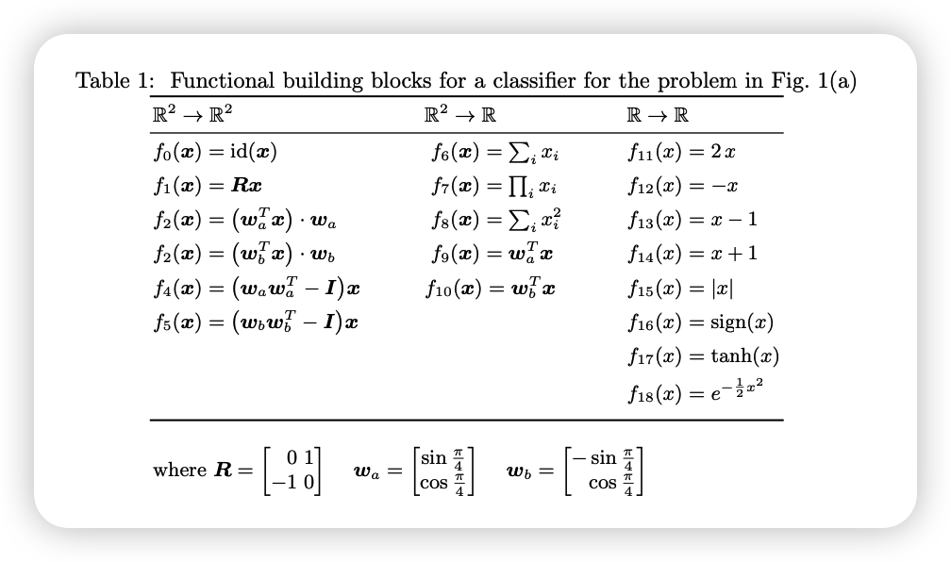
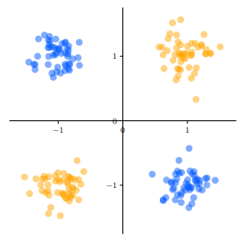
Example: Learning XOR function
compiled by a domain expert who —based on long term experience— supposes that there might be a sequence of operations y(x) = fiT ◦ . . . ◦ fi2 ◦ fi1 (x) that can solve the above problem

Slide 19
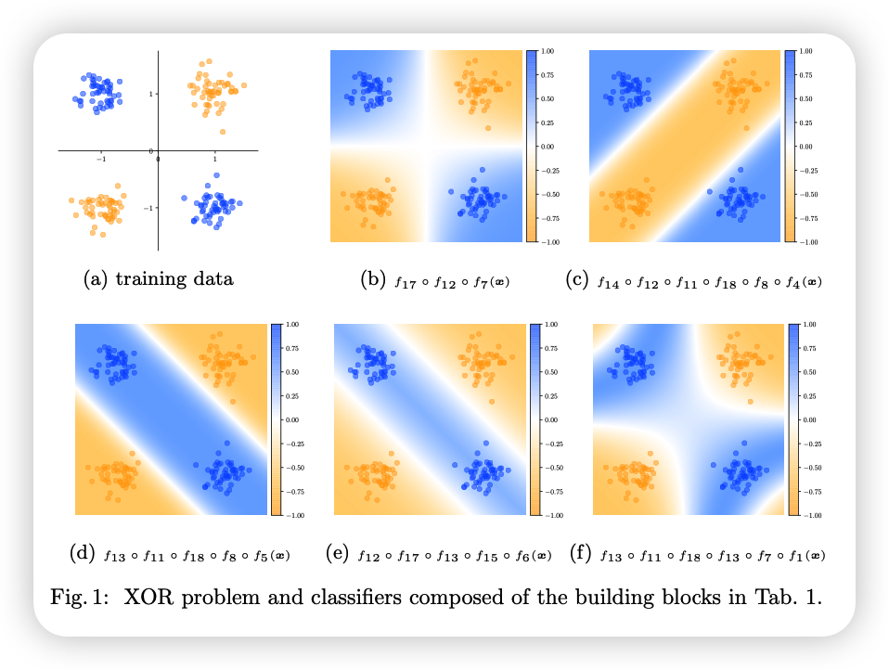
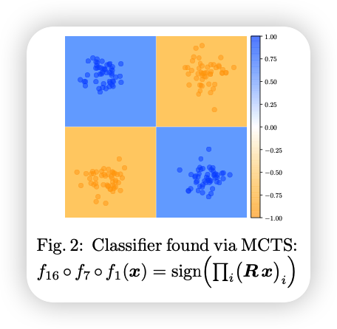
Monte Carlo tree search
Search for a sequence of states s 0 = f(s) = [f(s1), . . . , f(sn)] that eventually leads (close) to the target state sT = [y1, . . . , yn]

Slide 20
Differential Equations based Approaches

Slide 21
Differential Equations
Differential equations are a subset of algebraic equations, which describe relations between functions and their spatial or temporal derivatives.
Two famous examples:
the heat equation, which is a partial differential equation (PDE),
Newton‘s second law, which is an ordinary differential equation (ODE)
In both cases, there exists a (possibly empty) set of functions that solve the differential equation for given initial or boundary conditions.
Differential equations are often the basis of a numerical computer simulation.

Slide 22
Approach1: As objectiveness
A neural network can be trained to approximate the solution of the differential equation.
Probabilistic models can also be trained by minimizing the distance between the model conditional density and the Boltzmann distribution determined by the differential equation and the boundary conditions.
Eg.,
Combining the equations of the physical model and the likelihood function, the resulting physically constrained deep learning model is trained without any labeled data, while obeying the constraints of the existing problem.

Slide 23
Physics-constrained deep learning
FC-NN: The input to the network is coordinate s, the output is the predicted solution at s, and $\hat{u}$φ denotes a FC-NN with parameters φ. The spatial gradients can be evaluated exactly by automatic differentiation.
CNN decoder: y = [u(s1),··· , u(sns )] denotes the solution on pre-defined fixed grids s1,··· , sns that is generated by one pass of the latent variable z through the decoder
Zhu et al. Physics-constrained deep learning for high-dimensional surrogate modeling and uncertainty quantification without labeled data. Journal of Computational Physics 2019.

Slide 24
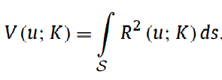
Partial Differential Equation (PDE)
Modeling of a physical system governed by PDEs:
where N is a general differential operator, u(s) are the field variables of interest, f(s) is the source field, and K(s) denotes an input property field defining the system’s constitutive behavior. B is the operator for boundary conditions defined on the boundary of the domain S.
Of particular interest are PDEs for which the field variables can be computed by appropriate minimization of a field energy functional (potential) V (u; K),
R: the residual norm of the PDE

Slide 25
Darcy flow problem

Slide 26
Deterministic surrogate model
Note that often the density p(x) is not known and needs to be approximated from the given data {x(i) }N i=1. When the density p(x) is given, the surrogate model can be defined without referring to the particular training data set.
A new type of machine learning task that falls between unsupervised learning due to the absence of labeled data (i.e. the y(i) corresponding to each x(i) is not provided) and (semi-)supervised learning because the objective involves discovering the map from the input x to the output y.

Slide 27
Deterministic surrogates without labeled data
Adding the realizations of stochastic input x as the input
Image-to-Image regression: prepending an encoder network to transform the high-dimensional input x to the latent variable z:
Trained by learning to solve the PDE with given boundary conditions,

Slide 28
Loss function for Darcy flow
Primal residual loss:
Mixed residual loss:
Mixed formulation introduces an additional (vector) variable, namely flux τ

Slide 29
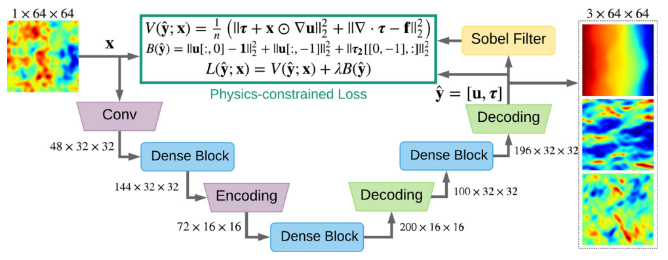
Dense convolutional encoder-decoder network as the deterministic surrogate

Slide 30
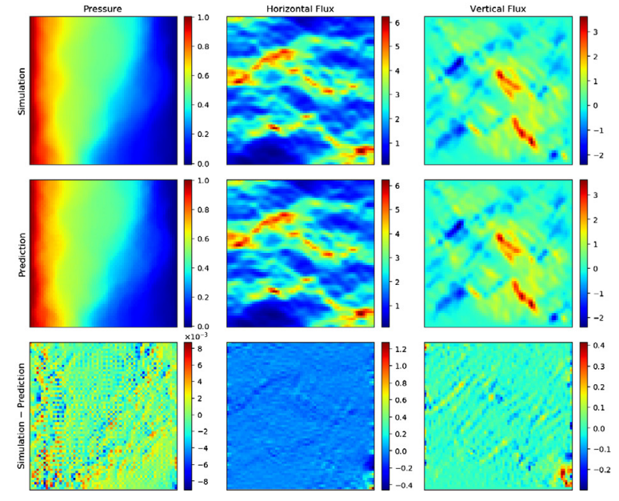
Example
Input dataset: The exponential of a Gaussian Random Field (GRF):

Slide 31
Approach 2: Improve the hypothesis set
The differential equations contain unknown time-and space-dependent parameters. Problems with unknown mappings from input data to quantities are governed by known differential equations, often referred to as system states.
Neural networks can model the behavior of such parameters, which then leads to hybrid architectures where the functional form of certain components is analytically derived from (partially) solving differential equations.
Neural networks can learn mappings from observed data to system states.
Eg.,
For the sea surface temperature prediction problem, the general background knowledge obtained from physics is used as a guideline for designing efficient deep learning models, and solutions related to differential equations are built.

Slide 32
Deep Lagrangian networks (DeLaN) are widely used as a deep network structure for Lagrangian mechanics. DeLaN can efficiently learn the equations of motion of mechanical systems (i.e., system dynamics) through a deep network, while ensuring that the results are physically sound.
A physical engine is integrated as a module into a deep neural network for end-to-end learning. The backpropagation method is performed analytically by performing exact simulations to match the observations. The system's ability to learn physical parameters from the data effectively matches and simulates the observed visual behavior and is easily controlled through a gradient-based planning approach.

Slide 33
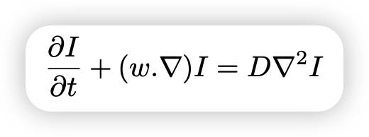
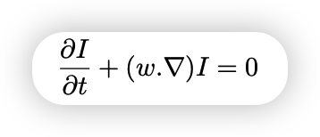
Sea surface temperature prediction
Conservation laws
a fluid transports some conserved quantity or material via bulk motion, i.e. small variations ∆x, ∆t.
Only consider the advection, there is a Brightness Constancy Constraint Equation (BCCE)
Both advection and diffusion are considered together.
∇ denotes the gradient operator, and w the motion vector $\frac{\text{∆}\text{x}}{\text{∆}\text{t}}$ . This equation describes the temporal evolution of quantity I for displacement w.
∇² denotes the Laplacian operator and D the diffusion coefficient. Note that when D → 0, we recover the BCCE.
E. de Bezenac et al., “Deep learning for physical processes: Incorporating prior scientific knowledge,” arxiv:1711.07970, 2017.

Slide 34
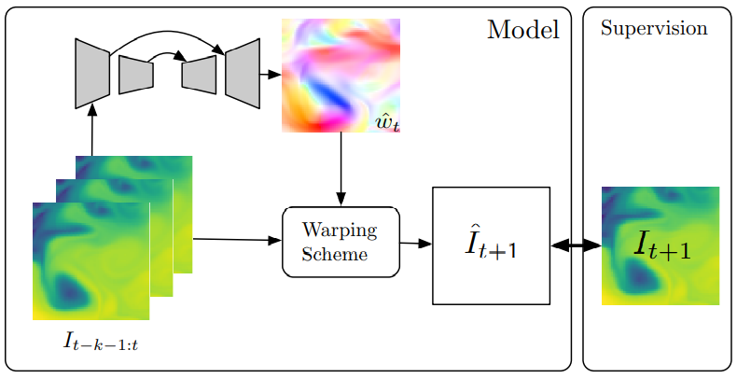
Prediction Model

Slide 35
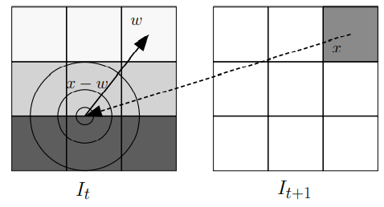
Warping Schema

Slide 36
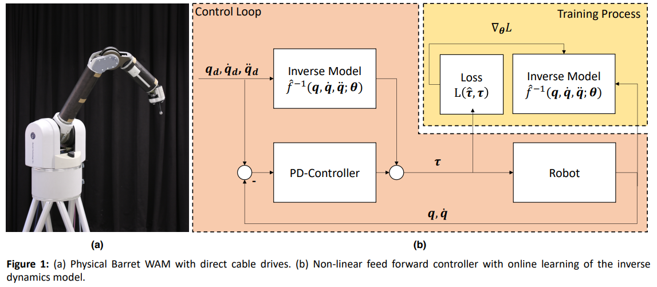
Deep Lagrangian networks (DeLaN)
Encode the differential equation governing the physical phenomena in the network topology
Lutter et al, “Deep lagrangian networks: Us- ing physics as model prior for deep learning,”, ICLR 2019

Slide 37
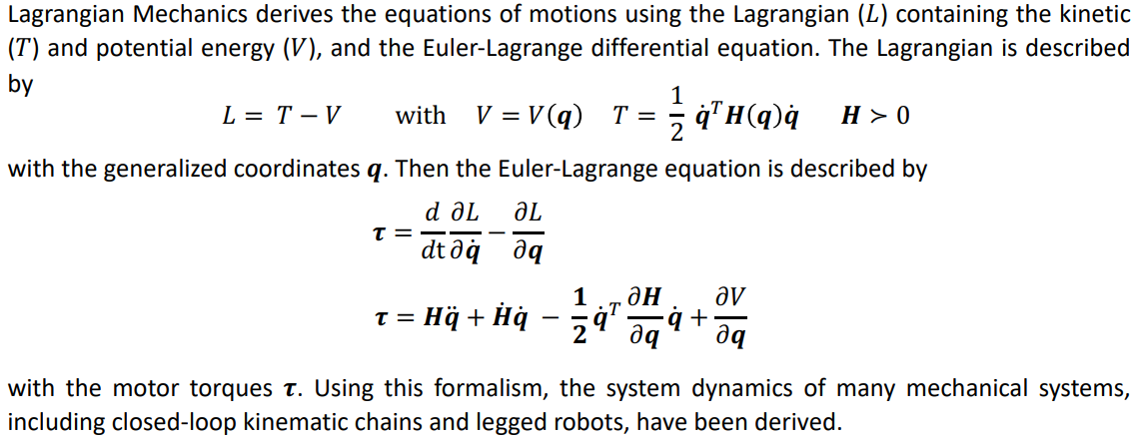
Lagrangian Mechanics

Slide 38
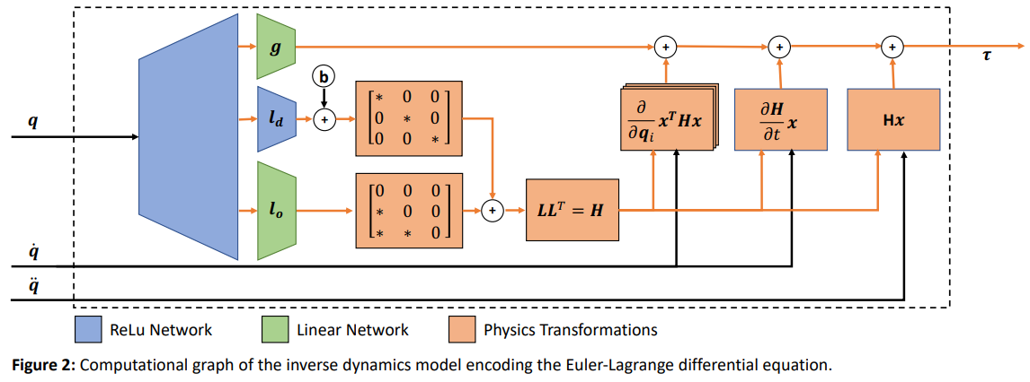
DeLaN Architecture

Slide 39
Model Learning

Slide 40
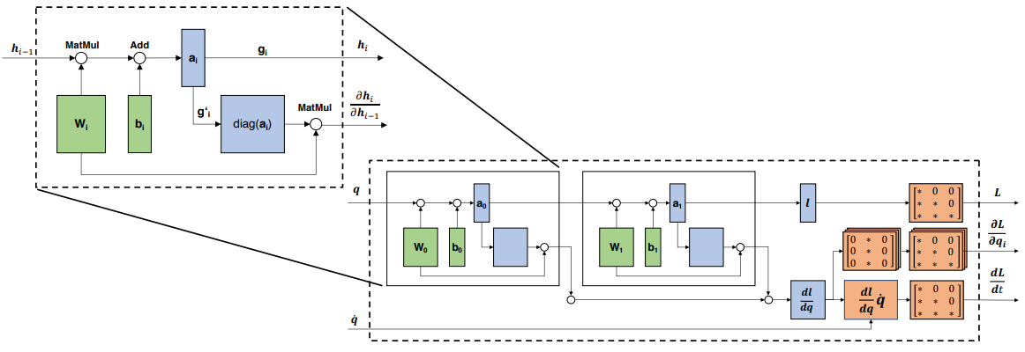
Achieving Real-Time Control

Slide 41
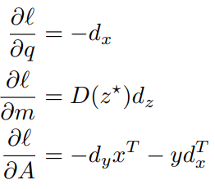
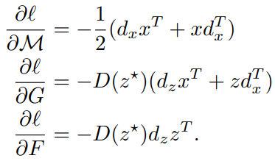
Differentiable Physics Engine (DPE)
Simulates rigid body dynamics via a linear complementarity problem (LCP): Rigid body dynamics are commonly formulated as a linear complementarity problem, with the different constraints on the movement of bodies (such as joints, interpenetrations, friction, etc.) represented as equality and inequality constraints.
de Avila Belbute-Peres F et al. End-to-end differentiable physics for learning and control, NIPS 2018.

Slide 42
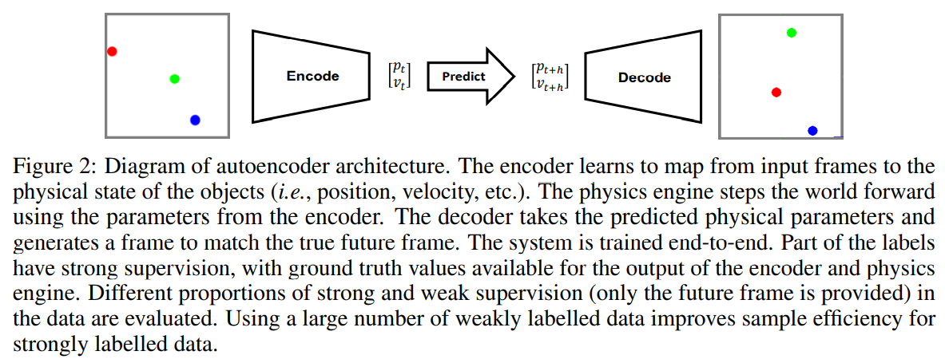
AutoEncoder integrating DPE for visual physical prediction

Slide 43
Simulation Results based Approaches

Slide 44
Simulation Results
Simulation results describe the numerical outcome of a computer simulation, which is an approximate imitation of the behavior of a real-world process.
A simulation engine typically solves a mathematical model using numerical methods and produces results for situation-specific parameters. Its numerical outcome is the simulation result that we describe here as the final knowledge representation.
Examples are the flow field of a simulated fluid or pictures of simulated traffic scenes.

Slide 45
Approach 1: Improve the training data
The integration of simulation results into training data depends on how the simulated, i.e. synthetic, data is combined with the real-world measurements:
additional input features are simulated and, together with real data, form input features.
additional target variables are simulated and added to the real data as another feature.
additional target variables are simulated and used as synthetic labels, which is of particular use when the original experiments are very expensive

Slide 46
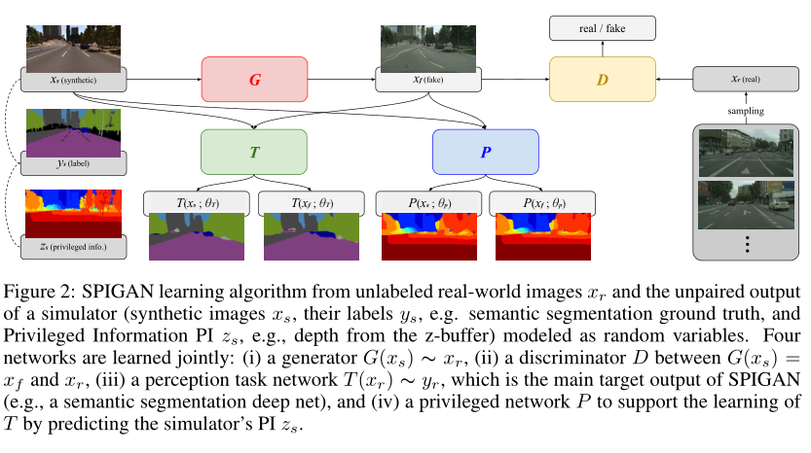
SPIGAN: Privileged Adversarial Learning from Simulation
The SPIGAN framework uses additional, privileged information (PI) (such as depth, optical flow, or physical properties) from internal data structures of the simulation in order to foster unsupervised domain adaption of deep networks.
a privileged network P trained on both synthetic images x and adapted ones G(x) to predict their associated privileged information z.
Lee et al. SPIGAN: Privileged Adversarial Learning from Simulation. ICLR, 2018.

Slide 47
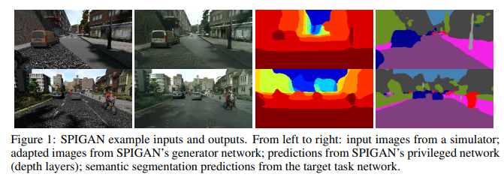
Adversarial loss
PI regularization
Task prediction loss
Perceptual regularization

Slide 48
Approach 2: Improve the learning
A simulation can directly be integrated into iterations of a learning algorithm.
Simulations can validate results of a trained model.
For example, a realistic positioning of objects in a 3D scene can be improved by incorporating feedback from a solid body simulation into learning. By means of reinforcement learning, this is even feasible if there are no gradients available from the simulation.

Slide 49
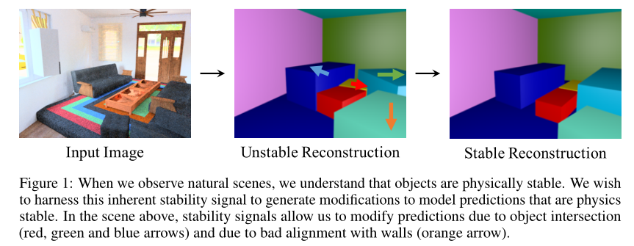
Learning to exploit stability for 3d scene parsing
Integrate the physical cue of stability into the learning process
Du et al. Learning to exploit stability for 3d scene parsing. NeurIPS 2018

Slide 50
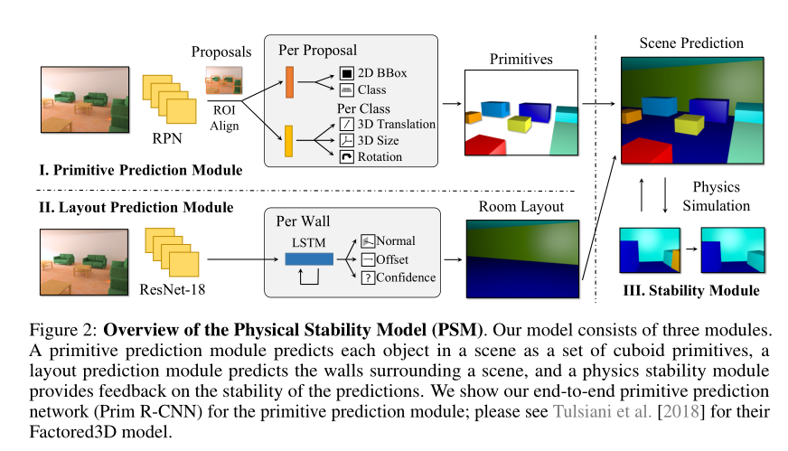
Learning to exploit stability for 3d scene parsing
Use a rigid body physics simulator, for estimating 3D object stability

Slide 51
Physics Stability Module
We use a rigid body physics simulator, Bullet, for estimating 3D object stability. Since the simulator is not differentiable, we train both layout prediction and primitive prediction modules jointly using a stability signal from multi-sample REINFORCE.
Given sampled values for primitives and layouts in a configuration $c$, we compute the overall probability of the configuration $P(c)$ as well as the corresponding stability score $S(c)$. Our overall loss for reinforce is then
$$L_{stab} = −\sum_{c}{\log\left(P \left(c\right)\right)\left(S\left(c\right)−\overline{S\left(C\right)}\right)},$$
where we subtract the average stability $\overline{S(C)}$ across different sampled configurations from each individual calculated stability score.

Slide 52
Spatial Invariances based Approaches

Slide 53
Spatial Invariances
Spatial invariances describe properties that do not change under mathematical transformations such as translations and rotations. If a geometric object is invariant under such transformations, it has a symmetry (for example,a rotationally symmetric triangle). A function can be called invariant, if it has the same result for a symmetric transformation of its argument. Connected to invariance is the property of equivariance.
Spatial invariances include Translation Invariance, Rotation/Viewpoint Invariance, Size Invariance, Illumination Invariance, et. al. For example, for image recognition tasks, no matter where a “dog” appears in the image, it should be recognized as that a “dog”.

Slide 54
Approach 1: Improve the training data
It has been shown that data augmentation through virtual examples is mathematically equivalent to incorporating prior knowledge via a regularizer.
A similar approach is the creation of meta-features.
Example Issue: Consider the images with the grayscale inverted, such that the digits are now roughly white on a black background. The inverted images still represent the same digits - the grayscale inversion transformation is therefore a symmetry of the problem. For the sake of simplicity, we will assume that our images are comprised of pixels with grayscale values scaled to the range [−1, +1]

Slide 55
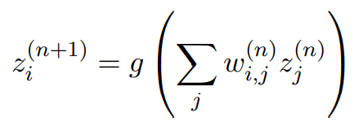
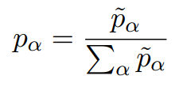
Symmetry constrained machine learning
Symmetry, a central concept in understanding the laws of nature.
Incorporating symmetry into the model reduces over-fitting, while at the same time reducing complexity, ultimately requiring less training data, and taking less time and resources to train.
If inputs are transformed into features that are invariant under the full symmetry group, then the model outputs will automatically be invariant as well.
Apply to Neural Network
Bergman. Symmetry constrained machine learning, Proceedings of SAI Intelligent Systems Conference, 2019.

Slide 56
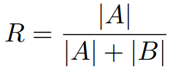
Symmetry constrained machine learning
Under the grayscale inversion symmetry, xi → −xi ,
the digit the model thinks has the highest probability to match the image, is also the digit with the lowest probability to match the inverted image
The accuracy rate over the dataset
The accuracy rate over the inverted dataset

Slide 57
Symmetry constrained machine learning
Map the inputs (the pixels of the image) xi onto features that are invariant under the inversion symmetry
Taylor Expansion:
inversion symmetry invariant features
A sample image (handwritten figure 6) from the dataset (left), the image after the inversion transformation (middle), and the gradient-like feature image symmetric under the inversion transformation (right).

Slide 58
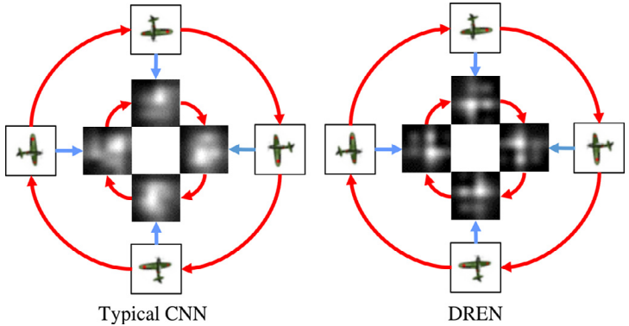
Approach 2: Improve the hypothesis Set
Learns representations that are equivariant to rotation transformations:
Fig. 1. Latent representations learnt by a CNN and a DREN (Proposed), where R stands for clockwise rotation. The left part is the result of a typical CNN while the right one is that of a DREN. In both parts, the outer cycles consist of the rotated images while the inner cycles consist of the learnt representations. Features produced by a DREN is equivariant to rotation while that produced by a typical CNN is not.
Li et al. Deep rotation equivariant network. Neurocomputing, 2018

Slide 59
Deep Rotation Equivariant Network (DREN)
A natural generalization of CNNs are group equivariant CNNs (G-CNNs). G-convolutions provide a higher degree of weight sharing and expressiveness. Simply put, the idea is to define filters based on a more general group-theoretic convolution.
Fig. 2. The framework of Deep Rotation Equivariant Network. The gray panels represent input, feature maps and output. Each square represents a weight kernel. The letter ‘T’ is utilized for distinguishing orientation clearly. The different colors of kernel background indicate that the kernel are not qualitatively equivalent.

Slide 60
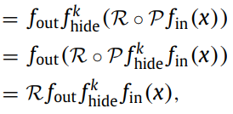
Deep Rotation Equivariant Network (DREN)
Informally, the utility of the cycle layers is to transform rotation of images into cyclic permutations of feature maps in each group. Then, the isotonic layers are used to preserve the order of permutations in each group. Finally, the decycle layer decodes permutations in each group to produce rotation equivariant representation.

Slide 61
Logic Rules based Approaches

Slide 62
Logic Rules
Logic provides a way of formalizing knowledge about facts and dependencies and allows for translating ordinary language statements(e.g., IF A THEN B) into formal logic rules(A $⟹$B). Generally, a logic rule consists of a set of Boolean expressions(A,B) combined with logical connectives($∧$, $∨$, $⟹$,...).
Logic rules can be also called logic constraints or logic sentences.

Slide 63
Approach 1: Improve the Hypothesis Set
Integration into the hypothesis set.
Use rules as the basis for the model structure, a revised rule set or also consider first-order logic.

Slide 64
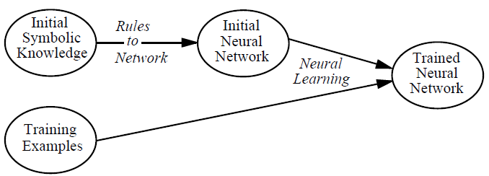
Knowledge-Based Artificial Neural Network (KBANN)
When building a machine learning model that reflects the actual, detailed behavior of a system, low-fidelity simulation results or a response surface (a data-driven model of the simulation results) can be built into the architecture of a knowledge-based artificial neural network (KBANN), e.g. by replacing one or more neurons.
KBANN is a hybrid learning system built on top of connectionist learning techniques.
It maps problem-specific "domain theories", represented in propositional logic, into neural networks and then refines this reformulated knowledge using backpropagation.
Towell et al. Knowledge-based artificial neural networks. Artificial intelligence 1994.

Slide 65
Rules-to-Network Translator
KBANN consists of two largely independent algorithms:a rules-to-network translator and a refiner (i.e.,a neural learning algorithm). Briefly, the rules-to-networks translation is accomplished by establishing a mapping between a rule set and aneural network.
This mapping, specified by the following table, defines the topology of networks created by KBANN as well as the initial link weights of the network.

Slide 66
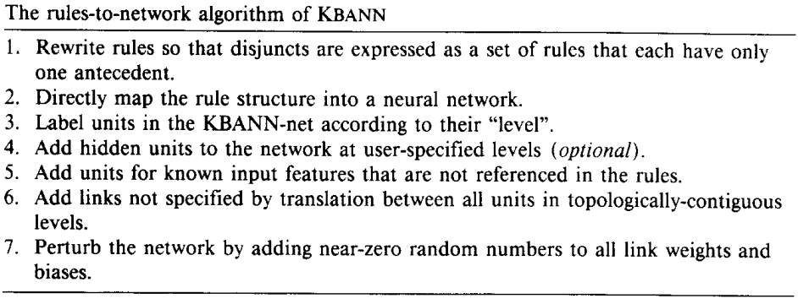
Rules-to-Network Translator

Slide 67
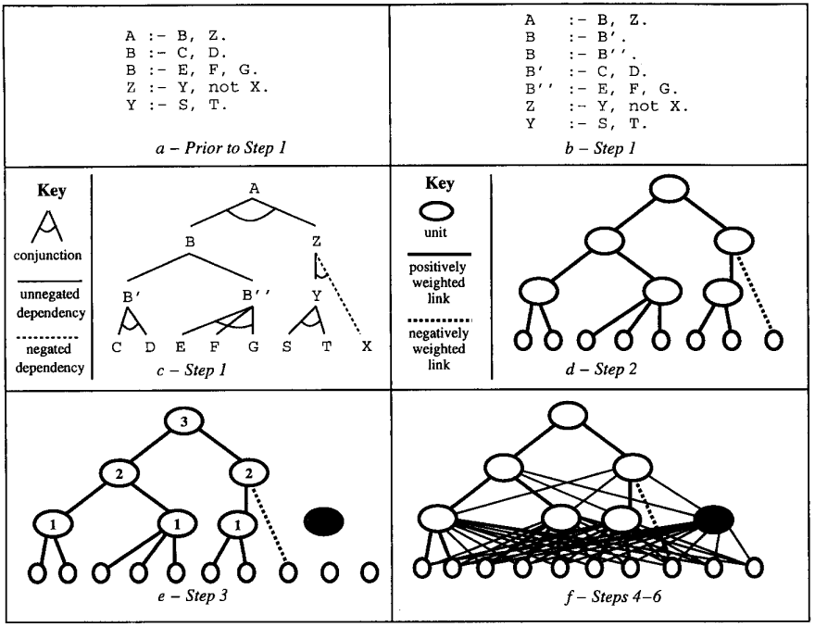
Rules-to-Network Translator
Step 1: Rewriting
Step 2: Mapping
Step 3: Numbering
Step 4: Adding hidden units
Step 5: Adding input units
Step 6: Adding links
Step 7: Perturbing

Slide 68
Harnessing Deep Neural Networks with Logic Rules
Combining deep neural networks with structured logic rules is desirable to harness flexibility and reduce uninterpretability of the neural models. We propose a general framework capable of enhancing various types of neural networks (e.g., CNNs and RNNs) with declarative first-order logic rules. Specifically, we develop an iterative distillation method that transfers the structured information of logic rules into the weights of neural networks. The authors show that taking this loss-based route of integrating rule-based domain-knowledge allows the flexibility of choosing a deep network architecture suitable for the intended task.
This work is achieved by forcing the network to emulate the predictions of a rule-regularized teacher, and evolving both models iteratively throughout training. The process is agnostic to the network architecture, and thus applicable to general types of neural models including CNNs and RNNs.
Hu et al. Harnessing deep neural networks with logic rules. arXiv: 1603. 06318 (2016).

Slide 69
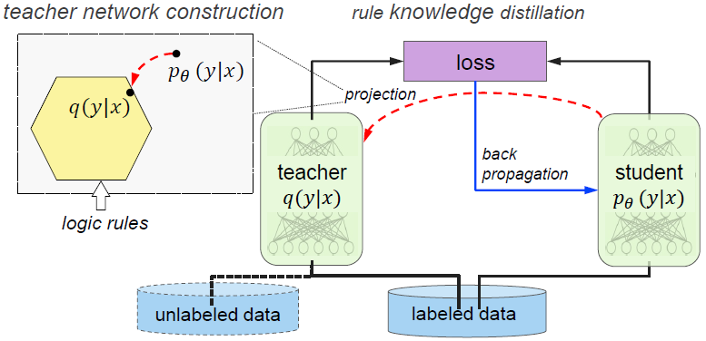
Harnessing Deep Neural Networks with Logic Rules
At each iteration, the teacher network is obtained by projecting the student network to a rule-regularized subspace (red dashed arrow); and the student network is updated to balance between emulating the teacher‘s output and predicting the true labels (black/blue solid arrows).

Slide 70
Rule Knowledge Distillation
To integrate the information encoded in the rules, train the network to also imitate the outputs of a rule-regularized projection of $p_{θ}(y|x)$, denoted as $q(y|x)$, which explicitly includes rule constraints as regularization terms.
In each iteration $q$ is constructed by projecting $p_{θ}$ into a subspace constrained by the rules, and thus has desirable properties. The prediction behavior of $q$ reveals the information of the regularized subspace and structured rules. Emulating the $q$ outputs serves to transfer this knowledge into $p_{θ}$. The new objective is then formulated as a balancing between imitating the soft predictions of $q$ and predicting the true hard labels:
$s_{n}^{(t)}$ is the soft prediction vector of $q$ on $x_{n}$ at iteration t

Slide 71
Teacher Network Construction
Our goal is to find the optimal q that fits the rules while at the same time staying close to pθ
imposes the rule constraints on q through an expectation operator
measure the closeness between q and pθ with KL-divergence, and wish to minimize it
Objectivenss:
Solution:

Slide 72
Logic attention based neighborhood aggregation for inductive knowledge graph embedding
Attention has been exploited to reason about knowledge graphs or memory structures to combine the learning of parameters and structures of logical rules.
Logic Attention Networks(LAN) facilitates inductive KG embedding and uses attention to aggregate information coming from graph neighbors with rules and attention weights.
To estimate the attention weights in LAN, we adopt two mechanisms to model relation-and neighbor-level information in a coarse-to-fine manner, At both levels, LAN is made aware of both neighborhood redundancy and query relation.
Wang et al. Logic attention based neighborhood aggregation for inductive knowledge graph embedding. AAAI 2019.

Slide 73
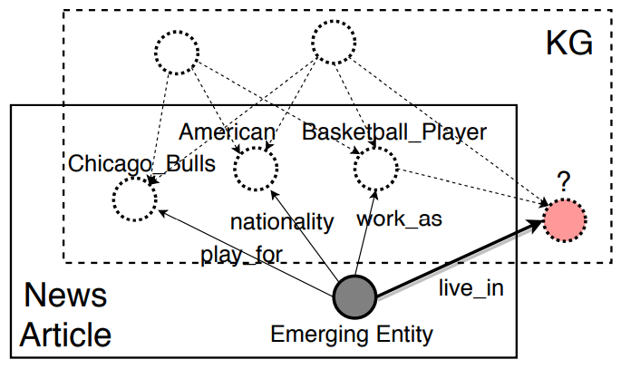
Knowledge Graph (KG)
Given a knowledge graph K, we would like to learn a neighborhood aggregator A that acts as follows:
For an entity ei on K, A depends on ei’s neighborhood NK(i) to embed ei as a low-dimensional vector ei ;
For an unknown triplet (s, r, o), the embeddings of s and o output by A suggest the plausibility of the triplet.

Slide 74
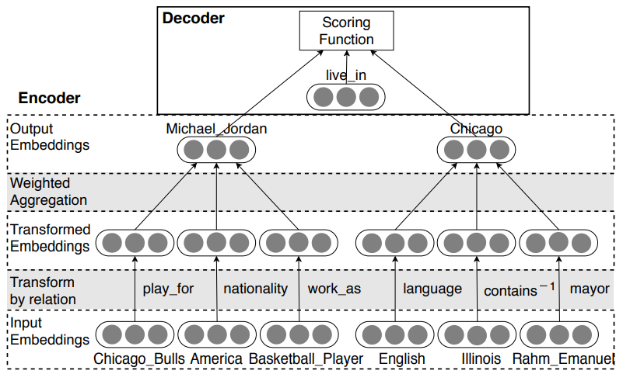
How to obtain such a neighborhood aggregator?

Slide 75
Logic Attention Network
a. Incorporating Neighborhood Attention. for an entity $e_{i}$, its neighbors $e_{j}$, should contribute differently to $e_{i}^{O}$ according to its importance in representing $e_{i}$. To consider the different contribution while preserving the permutation invariance property, we employ a weighted or attention-based aggregating approach on the transformed embeddings. The additional information in $N_{K}(i)$ and $q$ is then exploited when estimating the attention weights. Formally, we obtain $e_{i}^{O}$ by
Here $α_{j|i,q}$ is the attention weight specified for each neighbor $e_{j}$ given $e_{i}$ and the query relation $q$.

Slide 76
Logic Attention Network
b. Logic Rule Mechanism. Logic Rule Mechanism Relations in a KG are simply not independent of each other. For an entity $e$, one neighboring relation $r_{1}$ may imply the existence of another neighboring relation $r_{2}$ , though they may not necessarily connect $e$ to the same neighbor. For example, a neighboring relation play for may suggest the home city, i.e, live_in, of the current athlete entity. Following notations in logics, we denote potential dependency between $r_{1}$ and $r_{2}$ by a "logic rule“${ r}_{1}$ $⟹$ $r_{2}$. To measure the extent of such dependency, we define the confidence of a logic rule ${ r}_{1}$ $⟹$ $r_{2}$as follows:
We implement the logic rule mechanism of measuring neighboring relations' usefulness as follow:

Slide 77
Logic Attention Network
c. Neural Network Mechanism. With global statistics about relations, the logic rule mechanism guides the attention weight to be distributed at a coarse granularity of relations. However, it may be insufficient not to consult finer-grained information hidden in the transformed neighbor embeddings to determine which neighbor is important indeed. To take the transformed embeddings into consideration, we adopt an attention network

Slide 78
Logic Attention Network
d. Training objectiveness. To train the entire model in Figure 2, we need both positive triplets and negative ones. All triplets K from the knowledge graph naturally serve as positive triplets, which we denote by ∆. To make up for the absence of negative triplets, for each (s, q, o) ∈ ∆, we randomly corrupt the object or subject (but not both) by another entity in E, and denote the corresponding negative triplets by ∆ 0 (s,q,o) . Formally,
a margin-based ranking loss on each triplet (s, q, o)

Slide 79
Approach 2: Improve the Learning
Integration into the learning algorithm
Via additional, semantic loss terms.

Slide 80
Integrating prior knowledge into deep learning
Injecting prior knowledge into the learner is a principled way to reduce the amount of required training data, as the learner does not need to induce the knowledge from the data itself.
Semantic Based Regularization (SBR) is used as underlying framework to represent the prior knowledge, expressed as a collection of first-order logic clauses (FOL), and where each task to be learned corresponds to a predicate in the knowledge base. The knowledge base correlates the tasks to be learned and it is translated into a set of constraints which are integrated into the learning process via backpropagation.
Diligenti et al., “Integrating prior knowledge into deep learning,” in Int. Conf. on Machine Learning and Applications (ICMLA). IEEE, 2017.

Slide 81
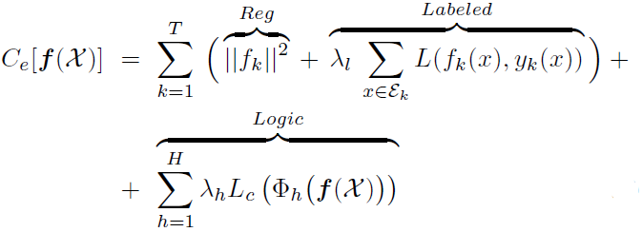
Integrating prior knowledge into deep learning
Semantic Based Regularization considers a multi-task problem where a set of T functions must be learned (query or unknown functions).
A set of H functionals Φh(f), 0 ≤ Φh(f) ≤1, h = 1,...,H describing the prior knowledge about the learning task are provided.

Slide 82
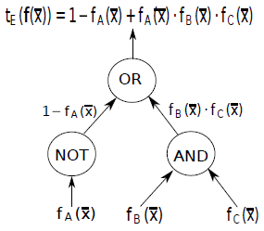
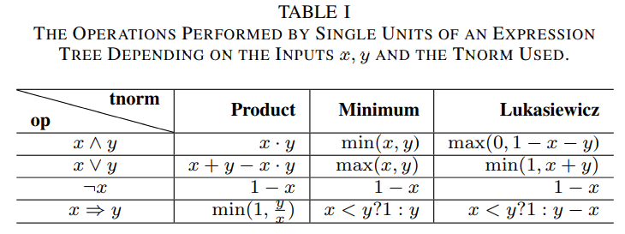
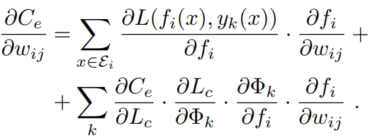
Constraints and Logic
How to convert a propositional logic expression into a continuous and differentiable form?

Slide 83
Knowledge Graphs based Approaches

Slide 84
Knowledge Graphs
A graph is a pair (V,E), where V are its vertices and E denotes edges.
In a knowledge graph, vertices(or nodes) usually describe concepts whereas edges represent(abstract) relations between them (such as "Man wears shirt"). In an ordinary weighted graph, edges quantify the strength and the sign of a relationship between nodes.

Slide 85
Approach: Integration into the Hypothesis Set
Inference about a particular object is facilitated by using relations to other objects in an image.
Graph neural networks operate on graphs and thus feature an object-and relation-centric bias in their architecture.
A graph reasoning layer can be inserted into any neural network: Enhance representations in a given layer by propagating through a given knowledge graph.

Slide 86
Symbolic Graph Reasoning Meets Convolutions
How to harness various external human knowledge for endowing the networks with the capability of semantic global reasoning?
Propose a new Symbolic Graph Reasoning (SGR) layer, which performs reasoning over a group of symbolic nodes whose outputs explicitly represent different properties of each semantic in a prior knowledge graph.
The SGR layer can be injected between any convolution layers and instantiated with distinct prior graphs.
Liang et al., “Symbolic graph reasoning meets convolutions,” in Neural Information Processing Systems (NIPS), 2018.

Slide 87
Symbolic Graph Reasoning
To leverage global graph reasoning to enhance local features with external structured knowledge
Consists of three modules:
local-to-semantic voting: local features that are correlated to a specific semantic meaning (e.g. cat) are aggregated to depict the characteristic of its corresponding symbolic node.
graph reasoning: leverage semantic constraints from human commonsense to evolve global representations of symbolic nodes.
semantic-to-local mapping: the evolved global representations of symbolic nodes can be used to further boost the capability of each local feature representation.

Slide 88
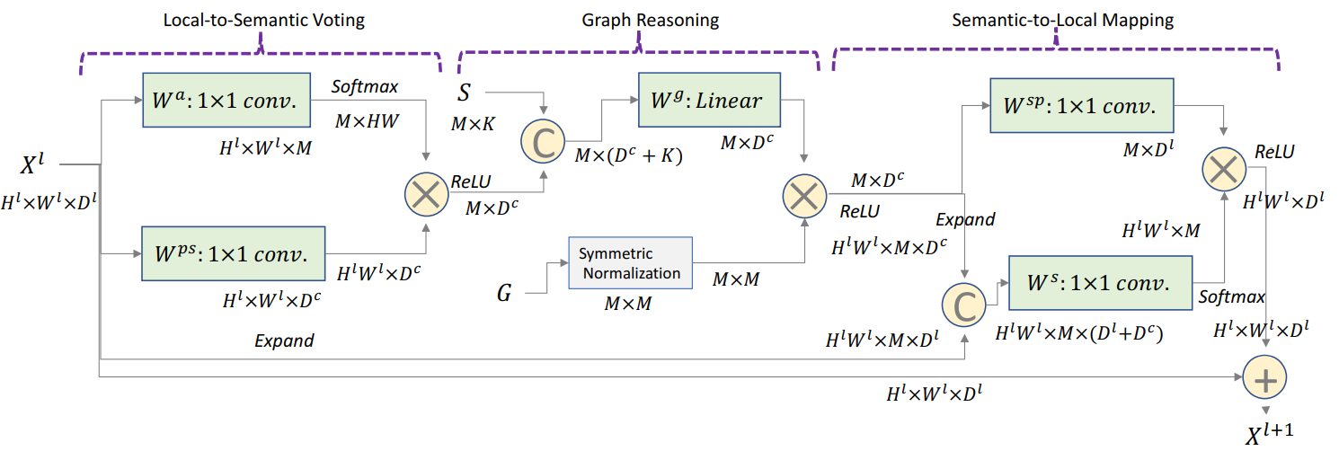
Symbolic Graph Reasoning
The SGR layer is instantiated by specific knowledge graph with different numbers of symbolic nodes and distinct node connections.
Combining multiple SGR layers with distinct knowledge graphs into convolutional networks can lead to hybrid graph reasoning behaviors.

Slide 89
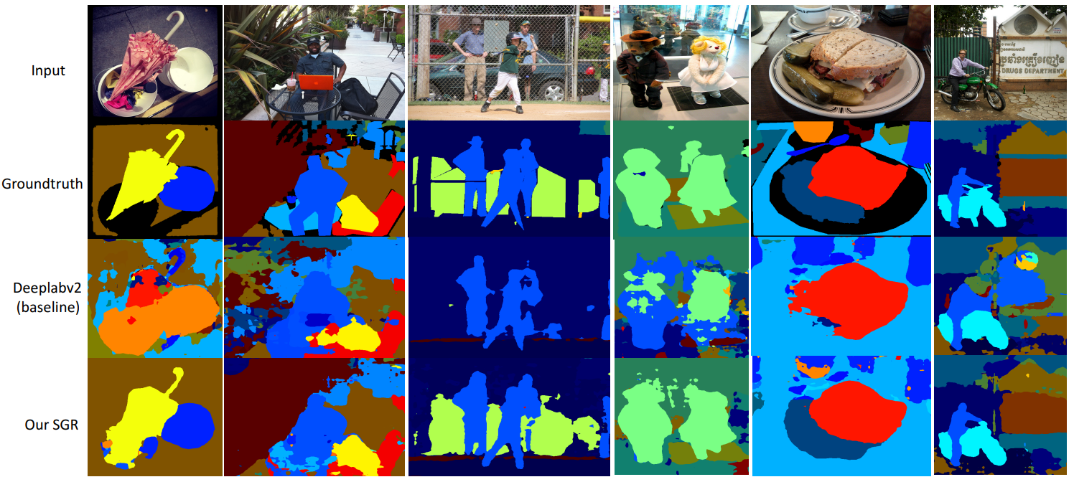
Example: Image Segmentation
Use a universal concept hierarchy: starting from the label hierarchy of COCO-Stuff that includes 182 concepts and 27 super-classes, we manually merge concepts from the rest two dataset together by using WordTree. It results in 340 concepts in the final concept graph.

Slide 90
Using knowledge graphs for image classification
Image classification through convolutional neural networks can be improved by using knowledge graphs that reflect relations between detected objects.
Such relations form adjacency matrices in Gated Graph Neural Networks.
Marino et al., “The more you know: Using knowledge graphs for image classification,” CVPR. IEEE, 2017.

Slide 91
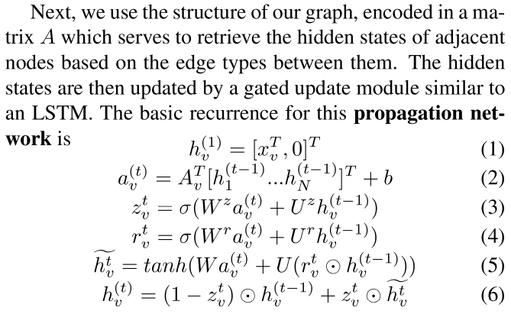
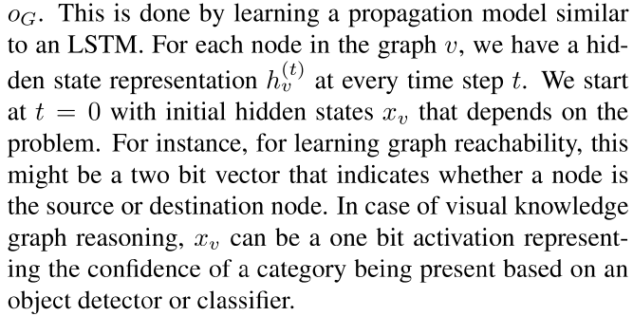
Graph Gated Neural Network (GGNN)
The biggest problem is computational scalability!

Slide 92
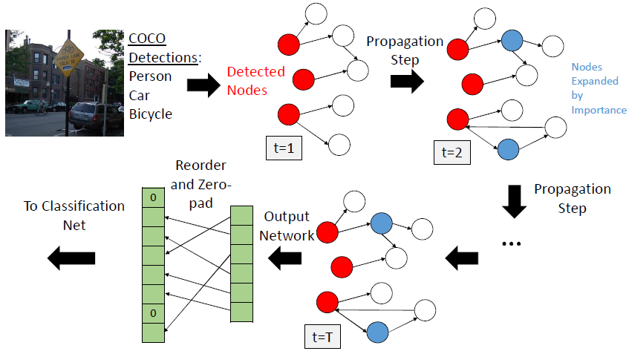
Graph Search Neural Network (GSNN)
Uses features from the image to efficiently annotate the graph, select a relevant subset of the input graph and predict outputs on nodes representing visual concepts.
These output states are then used to classify the objects in the image.
The idea is to start with some initial nodes based on our input and only choose to expand nodes which are useful for the final output.
Determine initial nodes in the graph based on likelihood of the concept being present as determined by an object detector or classifier.
Then propagate the beliefs through a learned per-node scoring function:
GSNN Expansion

Slide 93
GSNN architecture
Consists of three nets:
Propagation net
Importance Net
Ouput Net

Slide 94
Hybrid Knowledge Routed Modules (HKRM)
Idea: When humans watch a scene, each object is not identified individually. Different knowledge obtained by a human commonsense can help to make a correct identification by considering global semantic coherency.
Incorporates the reasoning routed by two kinds of knowledge forms:
An explicit knowledge module for structured constraints that are summarized with linguistic knowledge(e.g. shared attributes, relationships) about concepts;
An implicit knowledge module that depicts some implicit constraints (e.g. common spatial layouts).
Jiang et al., “Hybrid knowledge routed modules for large-scale object detection,” in Neural Information Processing Systems (NIPS), 2018.

Slide 95
HKRM Overview

Slide 96
Explicit Knowledge Module

Slide 97
Implicit Knowledge Module
Commonsense knowledge without explicit definitions or being summarized by the human
Eg., “the ceiling is always above all the other objects” and “the water is always below the ships, mountains and the sky”.
The analogous idea of multi-head attention, enables the module to catch multiple spatial relationships such as “up and down”, “left and right” and “corner and center”.

Slide 98
Probabilistic Relations based Approaches

Slide 99
Probabilistic Relations
The core concept of probabilistic relations is a random variable X from which samples x can be drawn according to an underlying probability distribution P(X).
Two or more random variables X,Y can be interdependent with joint distribution (x,y)~P(X,Y).
Prior knowledge could be assumptions on the conditional independence or the correlation structure of random varables or even a full description of the joint probability distributions.

Slide 100
Approaches
Integration into the hypothesis set : Knowledge and Bayesian inference are combined in more intricate ways , for instance, by learning network structures from knowledge and from data.
Integration into the learning algorithm: Human knowledge can also be used to define an informative prior, which affects the learning algorithm as is has a regularizing effect.

Slide 101
Integrating expert knowledge with data in bayesian networks
Focuses on the problem whereby the distribution of some continuous variable in a Bayesian networks (BNs) is known from data, but where we wish to explicitly model the impact of some additional expert variable (for which there is expert judgment but no data).
Here $X$ is an expert supplied variable with m states $X_{1},…,X_{m}$. We assume the expert provides the prior probabilities for$X$, i.e. $P\left(X_{j} | D_{i}\right)=p_{ij}$ for each $i=1 , . . . ,n$and for each$j=1 , . . . ,m$. When $D$ and$X$ are not linked, then instead of $n×m$ priors we only need m priors $P(X_{j})=p_{j}$for each $j=1 , . . . ,m$.
Constantinou et al., “Integrating expert knowledge with data in bayesian networks: Preserving data- driven expectations when the expert variables remain unobserved,” Expert Systems with Applications, vol. 56, 2016.

Slide 102
Worked Example

Slide 103
Real-World Examples

Slide 104
Probabilistic gap filling
Reconstructs missing values with probabilistic machine learning.
Utilizes Markov random fields (MRFs).
Extend the probabilistic framework to also consider empirical prior information, which allows to train even on highly incomplete data.
Fischer et al., “No cloud on the horizon: Probabilistic gap filling in satellite image series,” in DSAA, 2020.

Slide 105
Markov Random Field (MRF)
Gap filling is then the process of computing values for missing locations.
We reduce the gap filling problem to estimating values w.r.t. the state space of a Markov random field (MRF).
In any MRF, dependencies between components of X are represented by an undirected conditional independence structure (CIS) G.
The model parameters θ = (θ1,...θd) ∈ Rd are determined via regularized maximum likelihood (ML) estimation

Slide 106
Applying MRFs for spatio-temporal gap filling
Issues:
(I1) MRFs require knowledge about the underlying CIS G, which is a-priori unknown.
(I2) ML estimation requires a fully observed data set, but all available data is known to be incomplete.
(I3) The learned model needs to somehow predict reasonable data for the gaps

Slide 107
Spatio-Temporal Model Structures
Interchangeable CIS Assumption: Given a multivariate random variable X = (X1, X2,..., Xn) whose dimensions represent a spatio-temporal process, we assume that the CIS is locally interchangeable. More precisely, the Markov blanket of all Xi is isomorphic to a single local structure G∗.

Slide 108
Learning from Incomplete Data
Using Expectation-Maximization (EM)
A specific problem remains: Large gaps can lead to some MRF nodes being never observed during training.
Tackle this problem by incorporating prior knowledge about parameters:
Euclidean similarity (ES) prior: puts more probability mass on transitions between similar states
Transition probability (TP) prior: empirical log-probabilities of all observed state transitions

Slide 109
Predicting Values for Gaps
Maximum A Posterior
Problem: For heavily discretized data, restricting predictions to the discretization prototypes might not yield satisfactory results.
Superposition State (SUP): define as a mixture of states based on the corresponding marginal probability for the unobserved components:

Slide 110
Human Feedback based Approaches

Slide 111
Human Feedback
Transform knowledge via direct interfaces between users and machines.
The choice of input modalities detemines the way information is transmitted. Typical modalities include keyboard, mouse, and touchscreen, followed by speech and computer vision,e.g., tracking devices for motion capturing.
In theory, knowledge can also be transferred directly via brain signals using brain-computer interfaces.
Integration into the learning algorithm: In reinforcement learning, an agent observes an unknown environment and learns to act based on reward signals.

Slide 112
Deep reinforcement learning from human preferences
For sophisticated reinforcement learning (RL) systems to interact usefully with real-world environments, we need to communicate complex goals to these systems.
We explore goals defined in terms of (non-expert) human preferences between pairs of trajectory segments.
Can effectively solve complex RL tasks without access to the reward function, including Atari games and simulated robot locomotion, while providing feedback on less than 1% of our agent's interactions with the environment.
Christiano et al., “Deep reinforcement learning from human preferences,” in Neural Information Processing Systems (NIPS), 2017.

Slide 113
Method

Slide 114
Preference Elicitation
The human overseer is given a visualization of two trajectory segments, in the form of short movie clips.
We can interpret a reward function estimate $\hat{r}$ as a preference predictor if we view $\hat{r}$ as a latent factor explaining the human’s judgments and assume that the human’s probability of preferring a segment $σ^{i}$ depends exponentially on the value of the latent reward summed over the length of the clip:
We choose $\hat{r}$ to minimize the cross-entropy loss between these predictions and the actual human labels:

Slide 115
Summary
Hypothesis Set
Objectiveness
Optimization
Training Data

Slide 116
End

