Slide 1
Summary
Artificial Intelligence @ BIT
2024-25-01

Slide 2
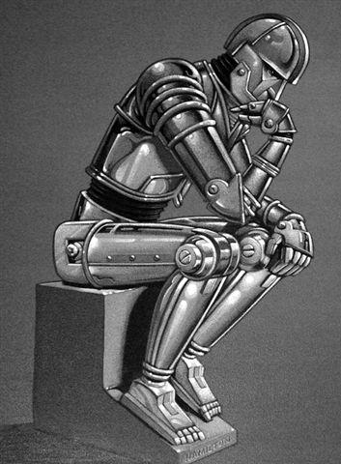
What is artificial intelligence?
Understand and BUILD intelligent entities
Two Views: Weak AI (Turing Test); Strong AI (Chinese Room Objection)
Six Approaches: Symbolic AI; Connectionism; Machine Learning; Nouvelle AI; Simulated Evolution; Swarm Intelligence

Slide 3
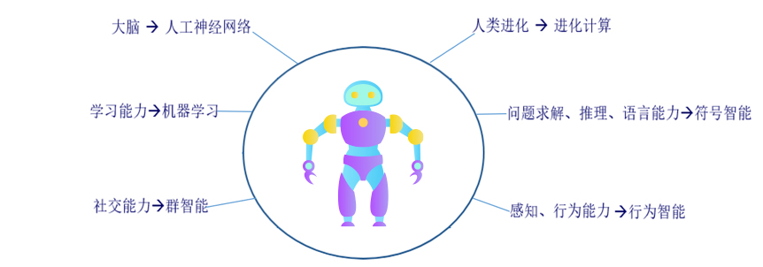
Why six approaches?

Slide 4
Cutting-Edge Researches
结构学习
元学习、小样本学习
知识与学习的结合

Slide 5
Meta-Learning Problem

Slide 6
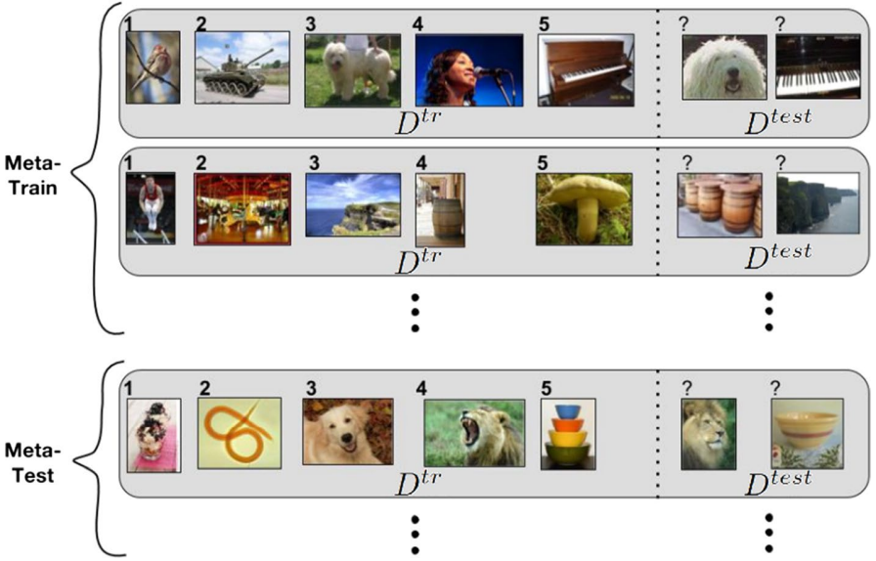
How to Meta-Learning？
1 meta-train stage: the base learner is optimized with the meta-train datasets (D^{tr} of Meta-Train). (inner-level)
2 meta-validation stage: the meta-validation datasets (D^{test} of Meta-Train) are used to evaluate the performance on unseen tasks. Effectively, this measures the meta-generalization ability, for tuning the meta model. (outer-level)
3 meta-test stage: give a final performance estimate of the meta-learning method.

Slide 7
Meta-Learning Methods
 | Metric- | Model- | Optimization-
Key idea | Input similarity | Internal task representation | Optimize for fast adaptation
Advantage | Simple and effective | Flexible | More robust generalizability
Classical Methods | Matching Network Prototypical Network Relation Network Etc. | MANN Meta Network SNAIL Etc. | LSTM optimizer RL optimizer MAML Meta-SGD Learned Loss Etc.

Slide 8
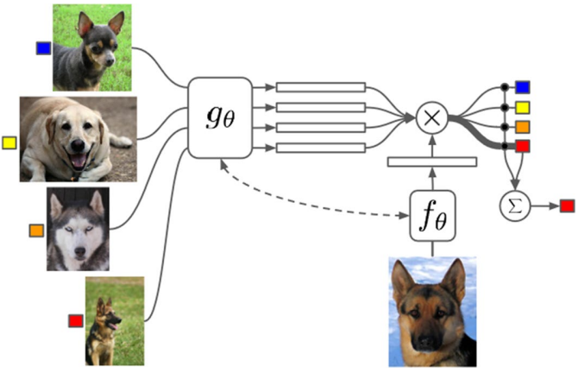
Metric-based Matching networks
Matching networks leverage pair-wise comparisons between the given support set $D_{𝒯_{j}}^{tr}={\{(x_{i},y_{i})\}}_{i=1}^{m}$(for a task $𝒯_{j}$), and new inputs $x∈D_{𝒯_{j}}^{test}$ from the query set which we want to classify.
They use a weighted combination of all example labels $y_{i}$ in the support set, based on the similarity of inputs $x_{i}$ to new input $x$. More specifically, predictions are computed as follows $\hat{y}=\sum_{i=1}^{m}{a(x, x_{i})y_{i}}$, where $a$ is a non-trainable similarity kernel.
The Matching networks training objectives:
$$θ=arg\max_{θ}{E_{L\sim T}[E_{S\sim L,B\sim L}[\sum_{(x,y)εB}{logP_{θ}(y|x,S)}]]}$$

Slide 9
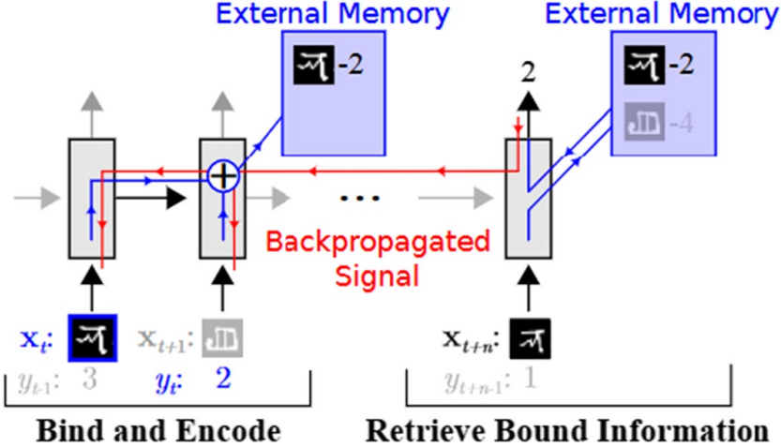
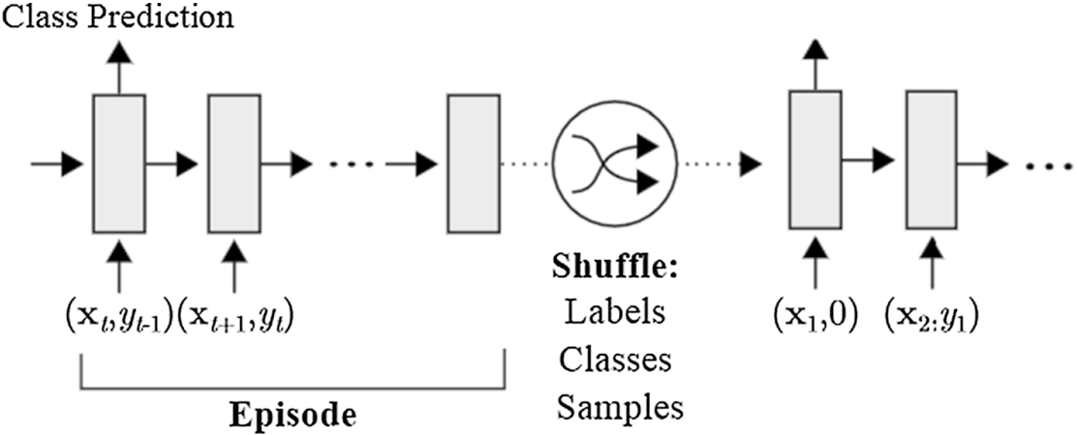
Model-based MANNs
The key idea of memory-augmented neural networks (MANNs) is to enable neural networks to learn quickly with the help of an external memory.
The data from a task is processed as a sequence, i.e., data are fed into the network one by one. The support set is fed into the memory-augmented neural network first. Afterwards, the query set is processed. During the meta-train phase, training tasks can be fed into the network in arbitrary order. At each time step, the model receives input $x_{t}$ with the label of the previous input, i.e., $y_{t−1}$.

Slide 10
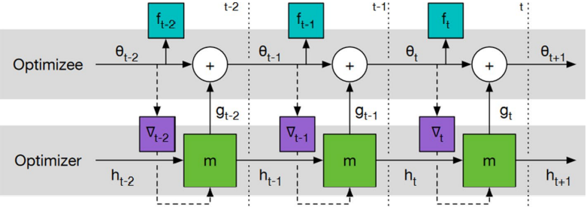
LSTM optimizer
Standard gradient update rules have the form $θ_{t+1}=θ_{t}−α∇_{θ_{t}}ℒ_{𝒯_{i}}(θ_{t})$. The key idea underlying LSTM optimizers is to replace the update term by an update proposed by an :$θ_{t+1}=θ_{t}+ℊ_{φ}(∇_{θ_{t}}ℒ_{𝒯_{i}}\left(θ_{t}\right))$. This new update allows the optimization strategy to be tailored to a specific family of tasks.
The loss function used to train an LSTM optimizer is: $ℒ\left(φ\right)=E_{ℒ_{𝒯_{i}}}[\sum_{t=1}^{T}{w_{t}}ℒ_{𝒯_{i}}(θ_{t})]$, where T is the number of parameter updates that are made, and $w_{t}$ are weights indicating the importance of performance after t steps.

Slide 11
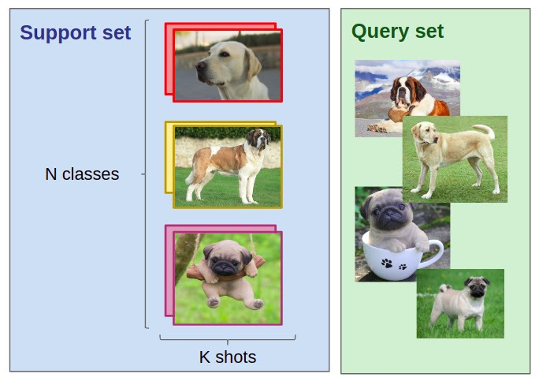
Few Shot Learning Problem
One impressive hallmark of human intelligence is the ability to rapidly establish cognition to novel concepts from just a single or a handful of examples. Humans can recognize visual objects through very few images and even children can remember a novel word by a single encounter.
N-Way K-Shot

Slide 12
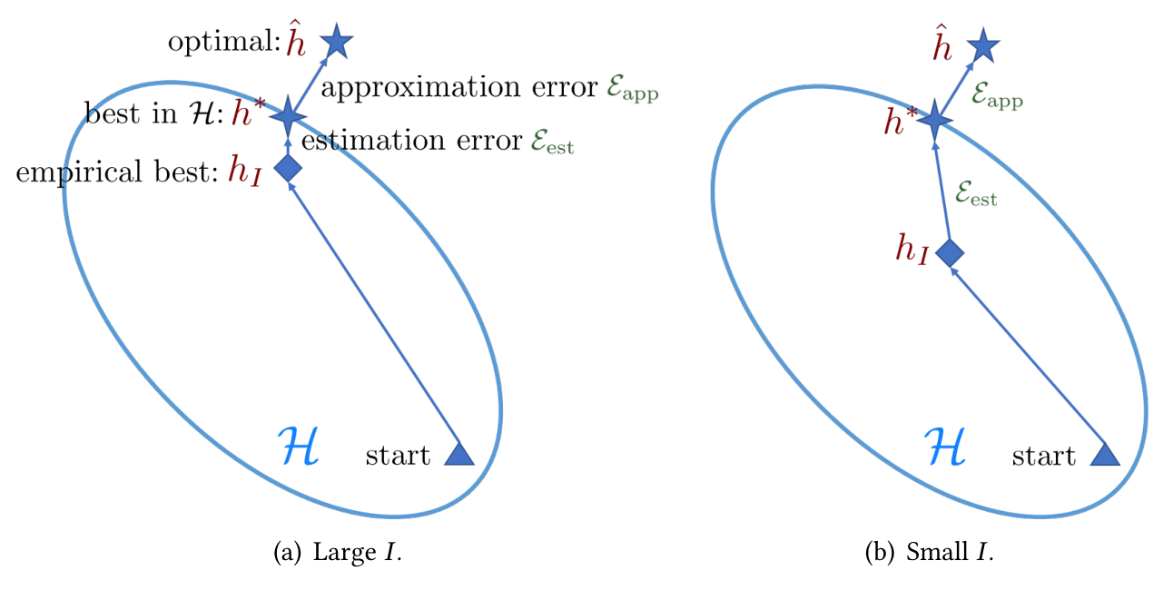
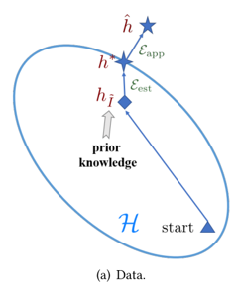
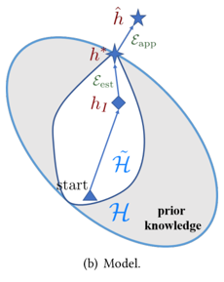
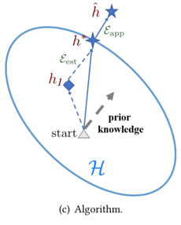
Core Issue and Solutions
Key information: prior knowledge

Slide 13
How to obtain prior knowledge?
 | Meta-Learning based | Transfer Learning
Key idea | Overlapped with meta-learning methods | Transfer of knowledge from a related task
Advantage | More flexible | More explainable
Classical Methods | Matching Network Prototypical Network Relation Network MANN MAML Etc. | Meta-Baseline Transductive Propagation Network Etc.

Slide 14
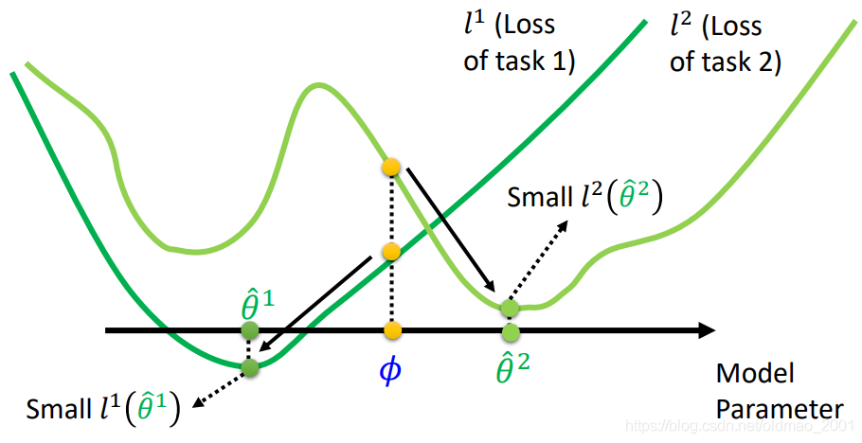
Meta-Learning based Example
Model-Agnostic Meta-Learning (MAML)
A good initialization point

Slide 15
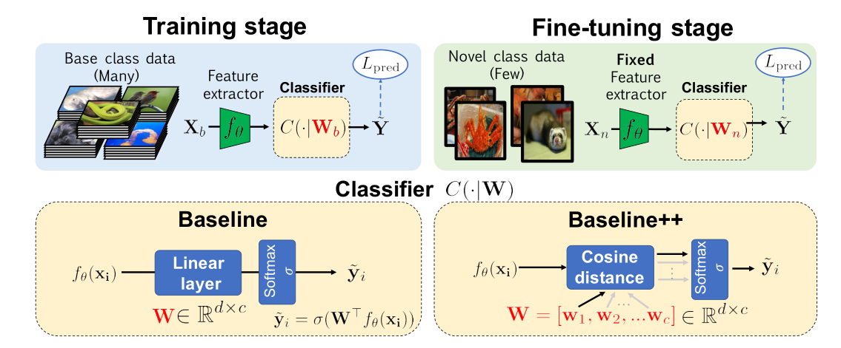
Transfer Learning based Example
A closer look at few-shot classification (BASELINE & BASELINE++)

Slide 16
Network Structure Learning Problem and Approaches
Optimize network structures automatically.
Neural Architecture
Search
Bayesian Network Structure Learning
Knowledge Distillation
Network Compression in Learning Objective

Slide 17
Neural Architecture Search
Global Space
Cell-based Space
Reinforcement
Evolutionary
Bayesian
Training giving architectures
Low-fidelity approximations
Learning curve extrapolation

Slide 18
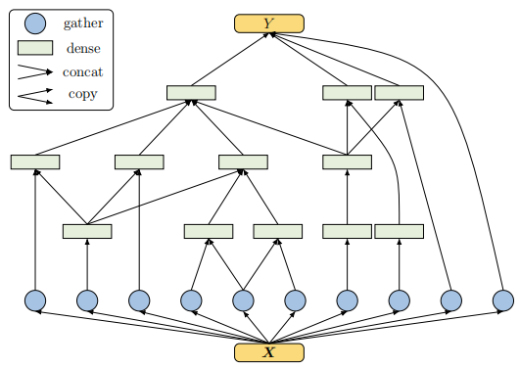
Bayesian Network Structure Learning
Casts the problem of neural network structure learning as a problem of Bayesian network structure learning. Then, instead of directly learning the discriminative structure, it learns a generative graph, constructs its stochastic inverse, and then constructs a discriminative graph.

Slide 19
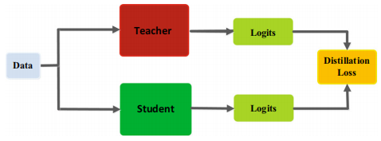
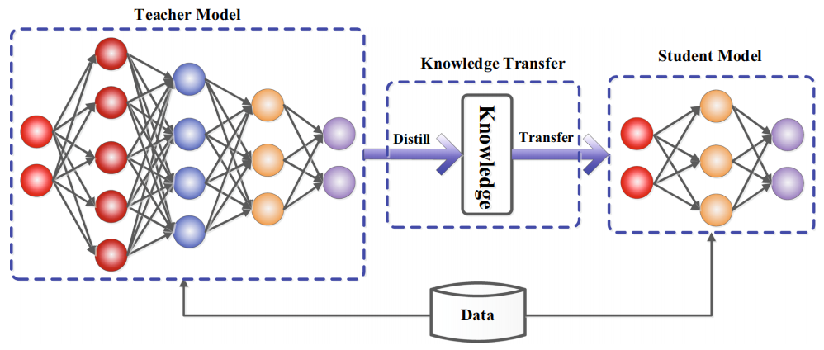
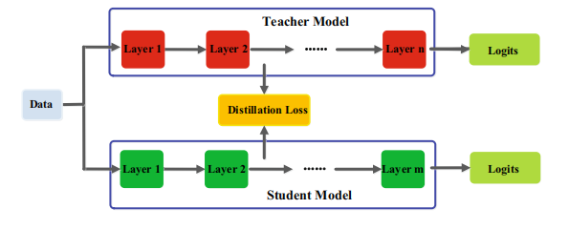
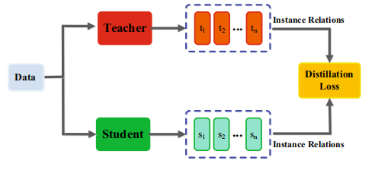
Knowledge Distillation

Slide 20
Network Compression Based on Optimization Objective
Bring the objective of network simplification into the original learning objective and increase the regularization to simplify the network. After learning, we can get a sparse network.

Slide 21
Integrating Knowledge and Learning
Knowledge Representation
Key Elements in Learning
Hypothesis Set
Objectiveness
Optimization
Training Data

Slide 22
Algebraic Equations
Algebraic equations represent knowledge as equality or inequality relations between mathematical expressions consisting of variables or constants.
Equations can be used to describe general functions or to constrain variables to a feasible set and are thus sometimes also called algebraic constraints.
Eg.,
the equation for the mass-energy equivalence
the inequality stating that nothing can travel faster than the speed of light in vacuum.

Slide 23
Differential Equations
Differential equations are a subset of algebraic equations, which describe relations between functions and their spatial or temporal derivatives.
Two famous examples:
the heat equation, which is a partial differential equation (PDE),
Newton‘s second law, which is an ordinary differential equation (ODE)
In both cases, there exists a (possibly empty) set of functions that solve the differential equation for given initial or boundary conditions.
Differential equations are often the basis of a numerical computer simulation.

Slide 24
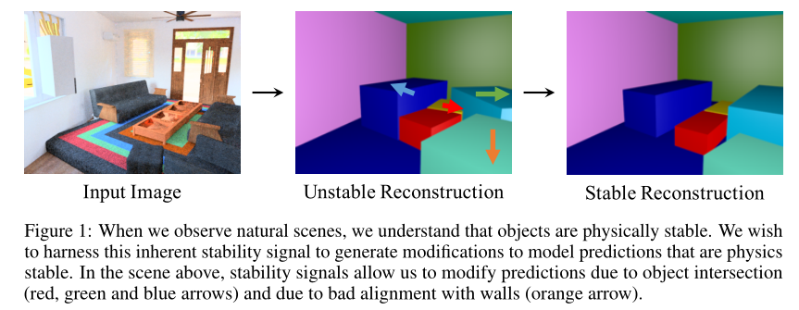
Simulation Results
Simulation results describe the numerical outcome of a computer simulation, which is an approximate imitation of the behavior of a real-world process.
A simulation engine typically solves a mathematical model using numerical methods and produces results for situation-specific parameters. Its numerical outcome is the simulation result that we describe here as the final knowledge representation.
Examples are the flow field of a simulated fluid or pictures of simulated traffic scenes.

Slide 25
Spatial Invariances
Spatial invariances describe properties that do not change under mathematical transformations such as translations and rotations. If a geometric object is invariant under such transformations, it has a symmetry (for example,a rotationally symmetric triangle). A function can be called invariant, if it has the same result for a symmetric transformation of its argument. Connected to invariance is the property of equivariance.
Spatial invariances include Translation Invariance, Rotation/Viewpoint Invariance, Size Invariance, Illumination Invariance, et. al. For example, for image recognition tasks, no matter where a “dog” appears in the image, it should be recognized as that a “dog”.

Slide 26
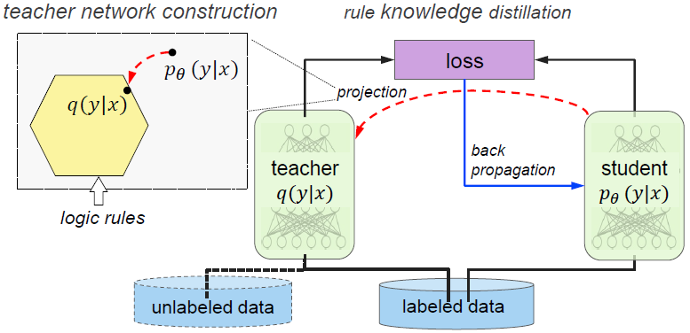
Logic Rules
Logic provides a way of formalizing knowledge about facts and dependencies and allows for translating ordinary language statements(e.g., IF A THEN B) into formal logic rules(A $⟹$B). Generally, a logic rule consists of a set of Boolean expressions(A,B) combined with logical connectives($∧$, $∨$, $⟹$,...).
Logic rules can be also called logic constraints or logic sentences.

Slide 27
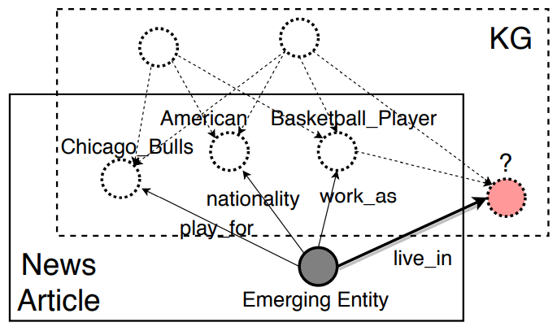
Knowledge Graphs
A graph is a pair (V,E), where V are its vertices and E denotes edges.
In a knowledge graph, vertices(or nodes) usually describe concepts whereas edges represent(abstract) relations between them (such as "Man wears shirt"). In an ordinary weighted graph, edges quantify the strength and the sign of a relationship between nodes.

Slide 28
Probabilistic Relations
The core concept of probabilistic relations is a random variable X from which samples x can be drawn according to an underlying probability distribution P(X).
Two or more random variables X,Y can be interdependent with joint distribution (x,y)~P(X,Y).
Prior knowledge could be assumptions on the conditional independence or the correlation structure of random varables or even a full description of the joint probability distributions.
Integration into the hypothesis set : Knowledge and Bayesian inference are combined in more intricate ways , for instance, by learning network structures from knowledge and from data.
Integration into the learning algorithm: Human knowledge can also be used to define an informative prior, which affects the learning algorithm as is has a regularizing effect.

Slide 29
Human Feedback
Transform knowledge via direct interfaces between users and machines.
The choice of input modalities detemines the way information is transmitted. Typical modalities include keyboard, mouse, and touchscreen, followed by speech and computer vision,e.g., tracking devices for motion capturing.
In theory, knowledge can also be transferred directly via brain signals using brain-computer interfaces.
Integration into the learning algorithm: In reinforcement learning, an agent observes an unknown environment and learns to act based on reward signals.

Slide 30
END OF THE COURSE
See you !

