Slide 1
Few-Shot Learning

Slide 2

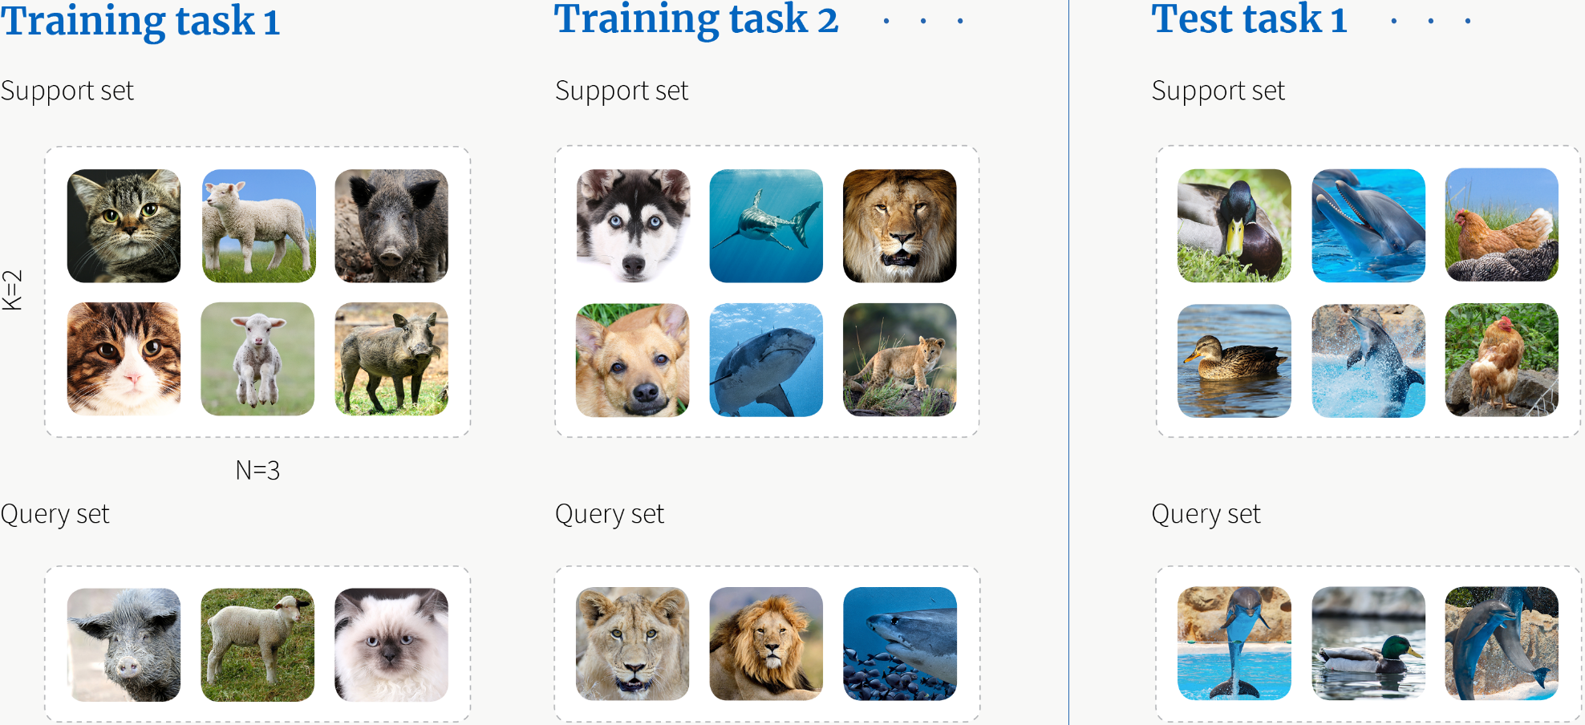
Recognize new object classes from very few instances

Slide 3
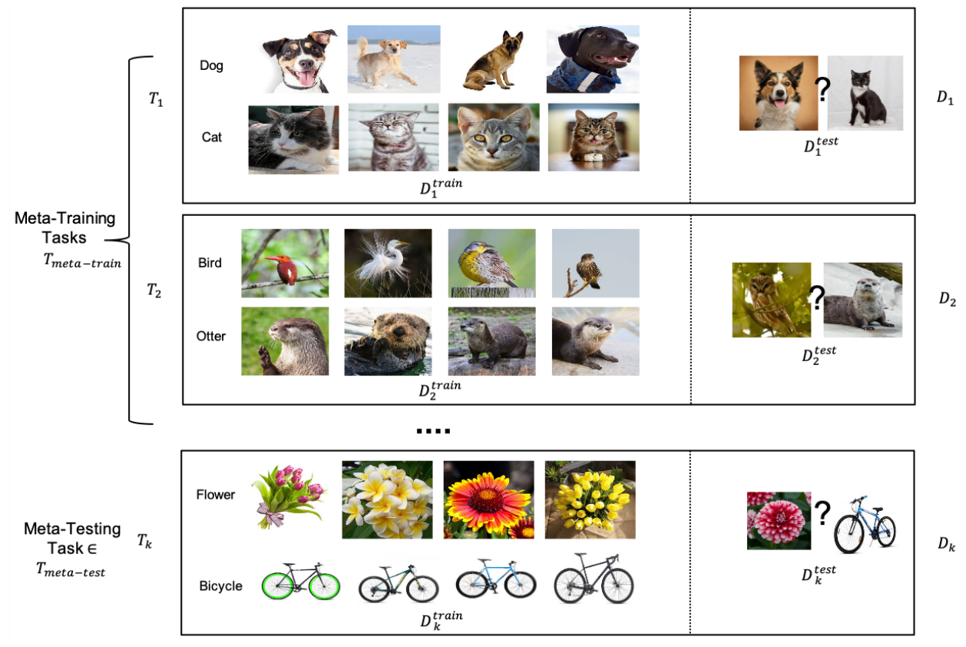
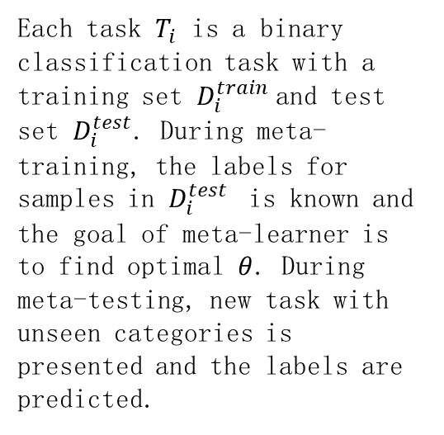
Meta-Learning for FSC: Example Setup
Each task $T_{i}$ is a binary classification task with a training set $D_{i}^{train}$and test set $D_{i}^{test}$. During meta-training, the labels for samples in $D_{i}^{test}$ is known and the goal of meta-learner is to find optimal $θ$. During meta-testing, new task with unseen categories is presented and the labels are predicted.

Slide 4
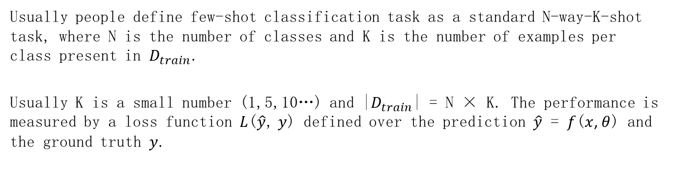
N-way-K-shot
Usually people define few-shot classification task as a standard N-way-K-shot task, where N is the number of classes and K is the number of examples per class present in $D_{train}$.
Usually K is a small number (1,5,10…) and |$D_{train}$| = N × K. The performance is measured by a loss function $L$($\hat{y}$, $y$) defined over the prediction $\hat{y}$ = $f$($x$, $θ$) and the ground truth $y$.

Slide 5
1. What is Few-Shot Learning

Slide 6
Background
One impressive hallmark of human intelligence is the ability to rapidly establish cognition to novel concepts from just a single or a handful of examples. Humans can recognize visual objects through very few images and even children can remember a novel word by a single encounter.
By contrast, most cutting-edge machine learning algorithms are data-hungry, especially the most widely known deep learning that has pushed artificial intelligence to a new climax.
In order to learn from a limited number of examples with supervised information, a new machine learning paradigm called Few-Shot Learning (FSL) is proposed.

Slide 7
What is Few-Shot Learning?
Def 1. classification
Few-Shot Learning is a sub-area of machine learning. It’s about classifying new data when you have only a few training samples with supervised information.
Def 2. More general
Few-shot learning (FSL), also referred to as low-shot learning (LSL) in few sources, is a type of machine learning method where the training dataset contains limited information.

Slide 8
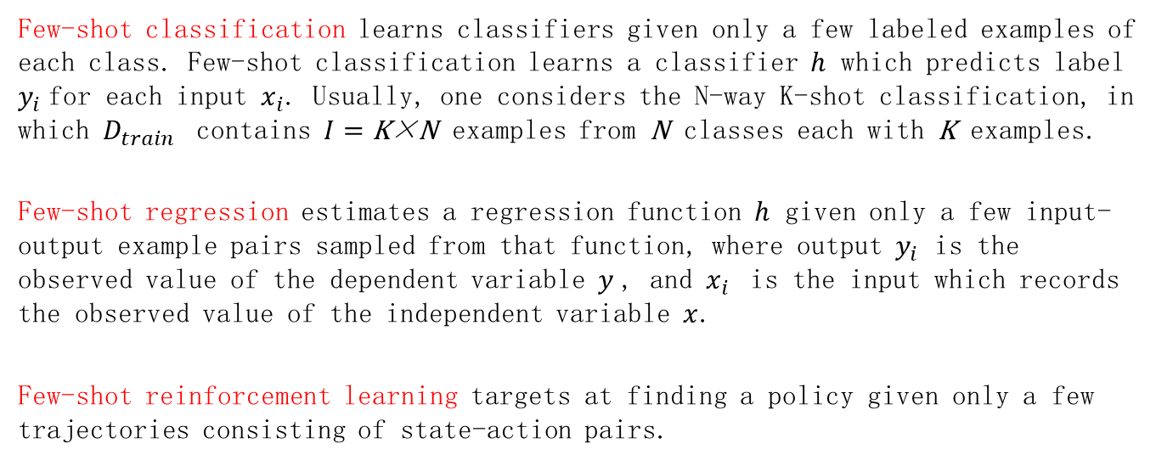
Formal definition on FSL
Few-shot classification learns classifiers given only a few labeled examples of each class. Few-shot classification learns a classifier $h$ which predicts label $y_{i}$for each input $x_{i}$. Usually, one considers the N-way K-shot classification, in which $D_{train}$ contains $I=\text{K}\text{×}\text{N}$ examples from $\text{N}$ classes each with $\text{K}$ examples.
Few-shot regression estimates a regression function $h$ given only a few input-output example pairs sampled from that function, where output $y_{i}$ is the observed value of the dependent variable $y$, and $x_{i}$ is the input which records the observed value of the independent variable $x$.
Few-shot reinforcement learning targets at finding a policy given only a few trajectories consisting of state-action pairs.

Slide 9
The value of FSL
Acting as a test bed for learning like human.
Learning for rare cases
Reducing data gathering effort and computational cost.

Slide 10
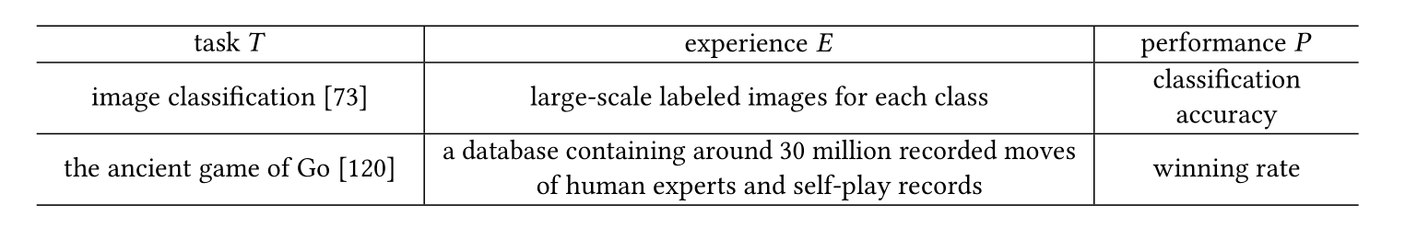
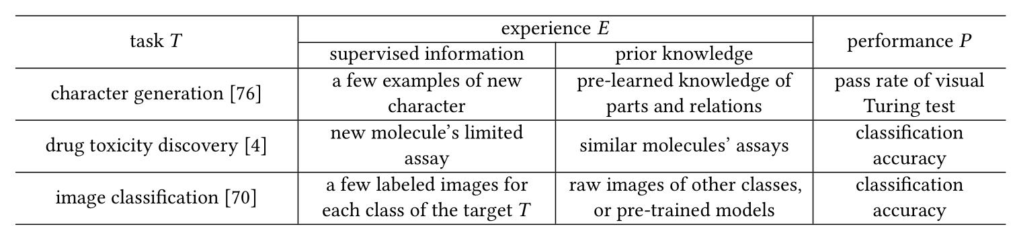
Comparison between traditional ML and FSL

Slide 11
Comparison between traditional ML and FSL
As E only contains a few examples with supervised information directly related to T, it is natural that common supervised learning approaches often fail on FSL problems. Therefore, FSL methods make the learning of target T feasible by combining the available supervised information in E with some prior knowledge, which is “any information the learner has about the unknown function before seeing the examples".
One typical type of FSL methods is Bayesian learning. It combines the provided training set D train with some prior probability distribution which is available before D train is given.

Slide 12
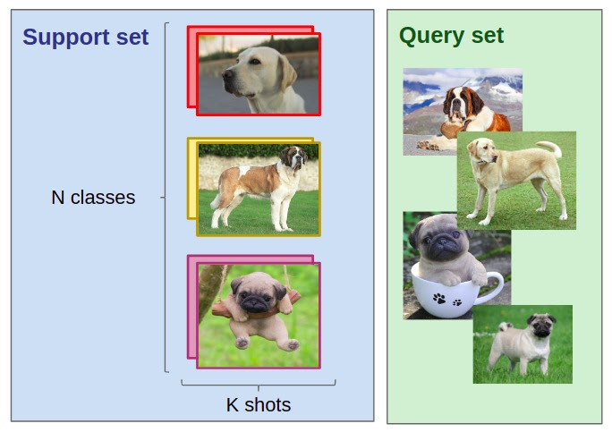
Few-Shot variations
N-Shot Learning (NSL)
Few-Shot Learning
One-Shot Learning (OSL)
Less than one or Zero-Shot Learning (ZSL)
When we’re talking about FSL, we usually mean N-way-K-Shot-classification.
N stands for the number of classes, and K for the number of samples from each class to train on.

Slide 13
Few-Shot variations
One-Shot Learning (OSL)
When there is only one example with supervised information in E, FSL is called one-shot learning.
Zero-Shot Learning (ZSL)
When E does not contain any example with supervised information for the target T, FSL becomes a zero-shot learning problem.
As the target class does not contain examples with supervised information, ZSL requires E to contain information from other modalities (such as attributes, WordNet, and word embeddings used in rare object recognition tasks), so as to transfer some supervised information and make learning possible.

Slide 14
2. Relevant Learning Problems

Slide 15
Relevant Learning Problems
Weakly supervised learning
Weakly supervised learning learns from experience E containing only weak supervision (such as incomplete, inexact, inaccurate or noisy supervised information).
Relatedness:
The most relevant problem to FSL is weakly supervised learning with incomplete supervision where only a small amount of samples have supervised information.
Difference:
By definition, weakly supervised learning with incomplete supervision includes only classification and regression, while FSL also includes reinforcement learning problems.

Slide 16
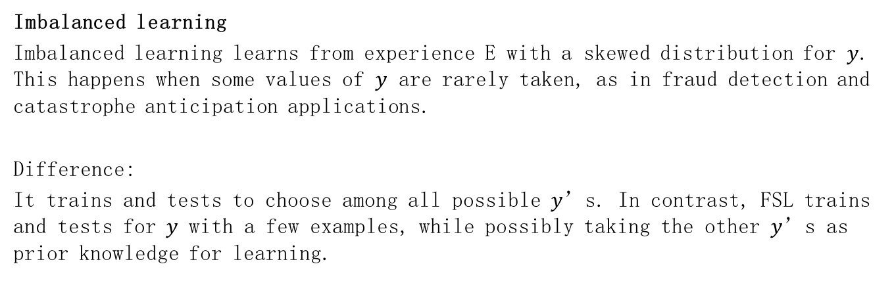
Relevant Learning Problems
Imbalanced learning
Imbalanced learning learns from experience E with a skewed distribution for $y$. This happens when some values of $y$ are rarely taken, as in fraud detection and catastrophe anticipation applications.
Difference:
It trains and tests to choose among all possible $y$’s. In contrast, FSL trains and tests for$y$ with a few examples, while possibly taking the other $y$’s as prior knowledge for learning.

Slide 17
Relevant Learning Problems
Transfer learning
Transfer learning transfers knowledge from the source domain/task, where training data is abundant, to the target domain/task, where training data is scarce.
Domain adaptation is a type of transfer learning in which the source/target tasks are the same but the source/target domains are different.
Relatedness:
Transfer learning methods are popularly used in FSL, where the prior knowledge is transferred from the source task to the few-shot task.

Slide 18
Relevant Learning Problems
Meta-learning
Meta-learning improves P of the new task T by the provided data set and the meta-knowledge extracted across tasks by a meta-learner. Specifically, the meta-learner gradually learns generic information (meta-knowledge) across tasks, and the learner generalizes the meta-learner for a new task T using task-specific information.
Relatedness:
Meta-learning methods can be used to deal with the FSL problem. The meta-learner is taken as prior knowledge to guide each specific FSL task.

Slide 19
3. Core Issue

Slide 20
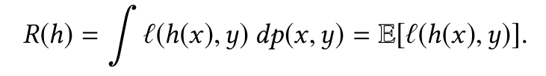
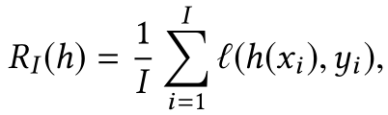

Core Issue
Empirical Risk Minimization
Given a hypothesis $h$, we want to minimize its expected risk $R$, which is the loss measured with respect to $p(x, y)$.
As $p(x, y)$ is unknown, the empirical risk (which is the average of sample losses over the training set $D_{train}$ of $I$ samples) is usually used as a proxy for R(h).

Slide 21
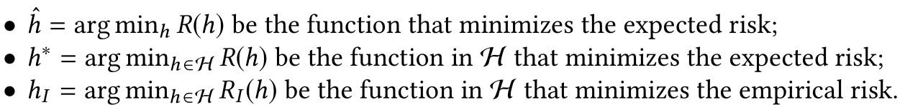
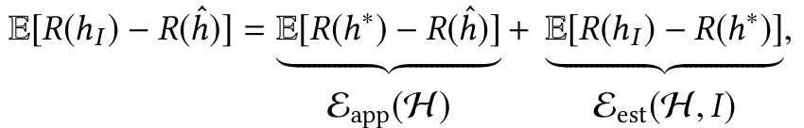
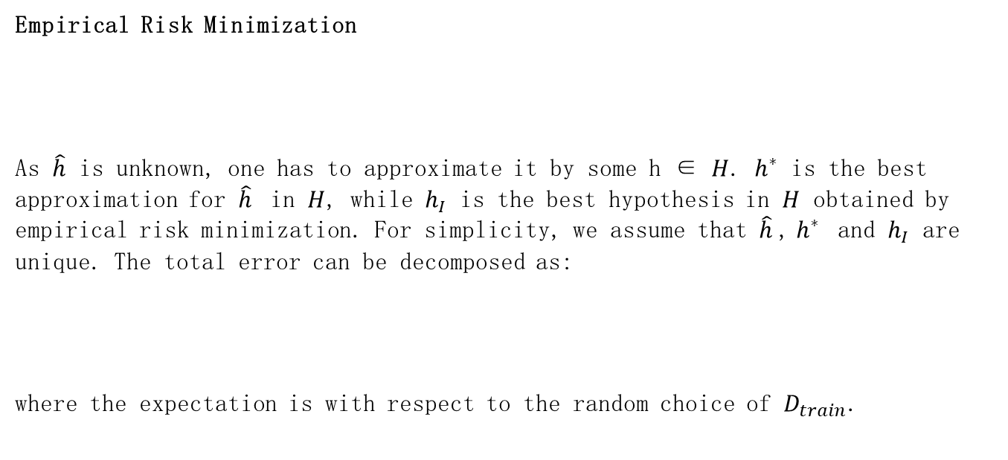
Core Issue
Empirical Risk Minimization
As $\hat{h}$ is unknown, one has to approximate it by some h ∈ $H$. $h^{∗}$ is the best approximation for $\hat{h}$ in $H$, while $h_{I}$ is the best hypothesis in $H$ obtained by empirical risk minimization. For simplicity, we assume that $\hat{h}$, $h^{∗}$ and $h_{I}$ are unique. The total error can be decomposed as:
where the expectation is with respect to the random choice of $D_{train}$.

Slide 22
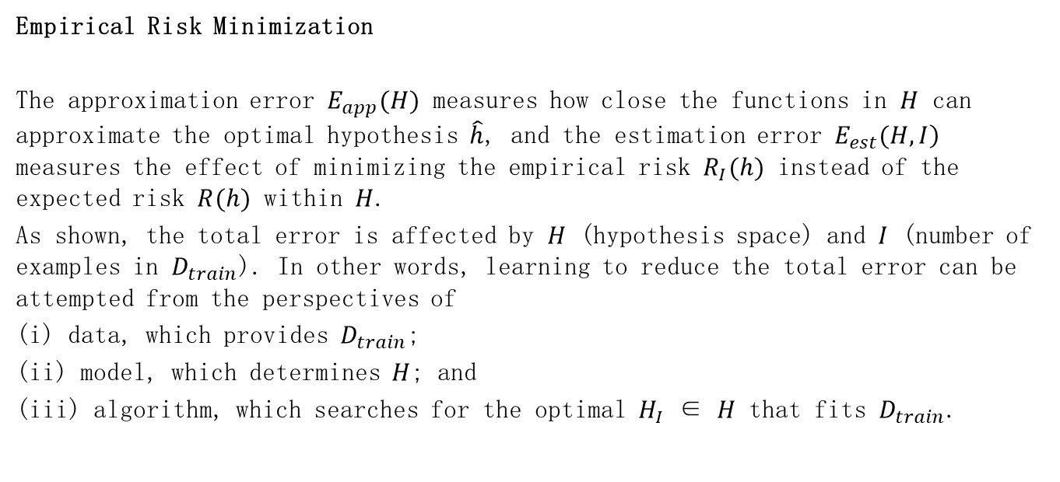
Core Issue
Empirical Risk Minimization
The approximation error $E_{app}(H)$ measures how close the functions in $H$ can approximate the optimal hypothesis $\hat{h}$, and the estimation error $\left.E_{est}(H,I\right)$ measures the effect of minimizing the empirical risk $R_{I}(h)$ instead of the expected risk $R(h)$ within $H$.
As shown, the total error is affected by $H$ (hypothesis space) and $I$ (number of examples in $D_{train}$). In other words, learning to reduce the total error can be attempted from the perspectives of
(i) data, which provides $D_{train}$;
(ii) model, which determines $H$; and
(iii) algorithm, which searches for the optimal $H_{I}$ ∈ $H$ that fits $D_{train}$.

Slide 23
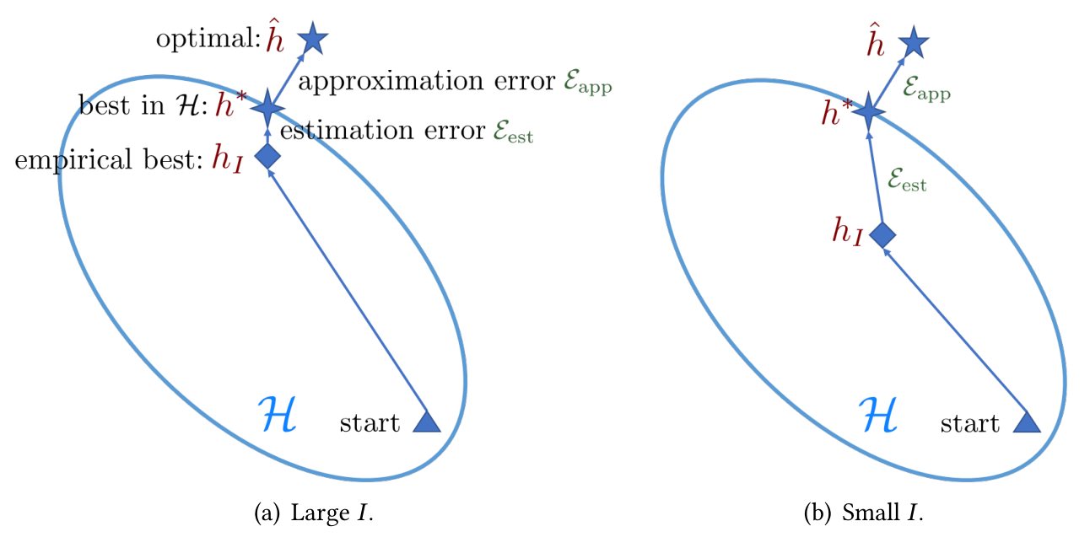

Core Issue
Empirical Risk Minimization
In FSL, the number of available examples $I$ is small. The empirical risk $R_{I}(h)$ may then be far from being a good approximation of the expected risk $R(h)$ , and the resultant empirical risk minimizer $h_{I}$ overfits.

Slide 24
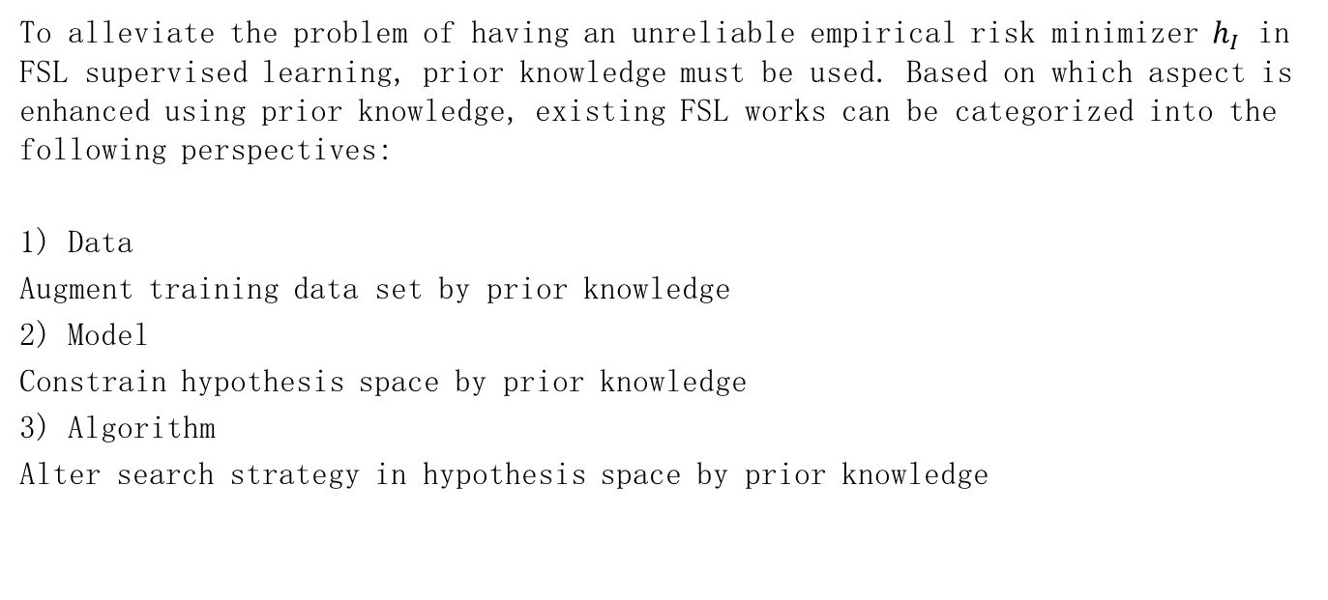
Taxonomy
To alleviate the problem of having an unreliable empirical risk minimizer $h_{I}$ in FSL supervised learning, prior knowledge must be used. Based on which aspect is enhanced using prior knowledge, existing FSL works can be categorized into the following perspectives:
1) Data
Augment training data set by prior knowledge
2) Model
Constrain hypothesis space by prior knowledge
3) Algorithm
Alter search strategy in hypothesis space by prior knowledge

Slide 25
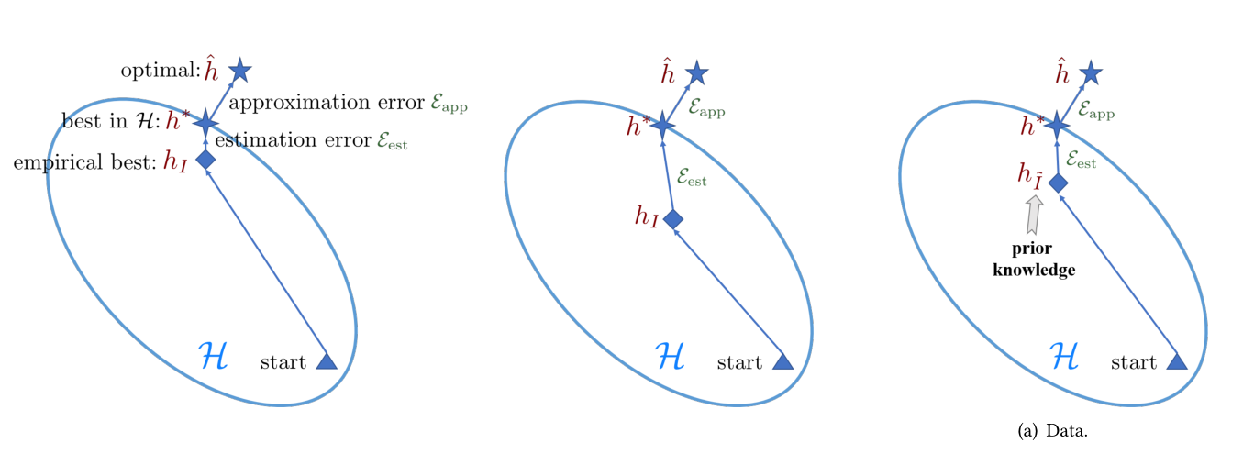

Taxonomy
Data
These methods use prior knowledge to augment $D_{train}$, and increase the number of samples from $I$ to $\tilde{I}$, where $\tilde{I}$ ≫ $I$ . Standard machine learning models and algorithms can then be used on the augmented data, and a more accurate empirical risk minimizer $h_{\tilde{I}}$ can be obtained.

Slide 26
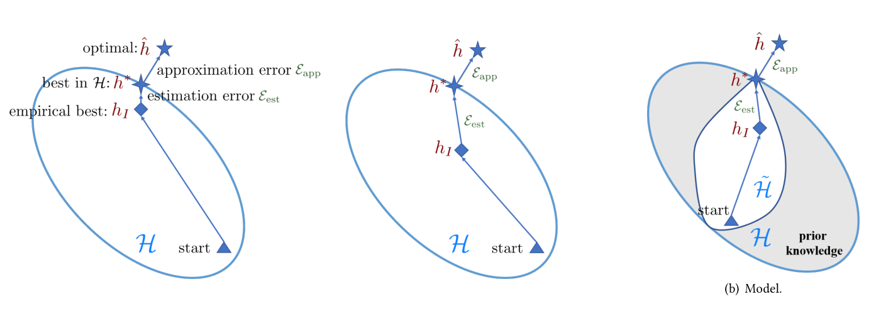

Taxonomy
Model
These methods use prior knowledge to constrain the complexity of $H$, which results in a much smaller hypothesis space $\tilde{H}$. The gray area is not considered for optimization as they are known to be unlikely to contain the optimal $h^{∗}$ according to prior knowledge. For this smaller $\tilde{H}$, $D_{train}$ is sufficient to learn a reliable $h_{I}$.

Slide 27
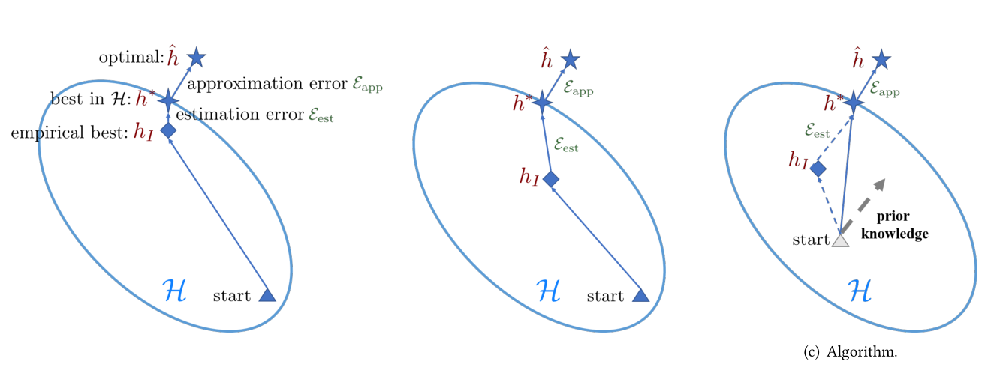

Taxonomy
Algorithm
These methods use prior knowledge to search for the $θ$ which parameterizes the best hypothesis $h^{∗}$ in $H$. Prior knowledge alters the search strategy by providing a good initialization (gray triangle), or guiding the search steps (the gray dotted lines). For the latter, the resultant search steps are affected by both prior knowledge and empirical risk minimizer.

Slide 28
4. Meta-Learning-based Few-Shot Learning

Slide 29
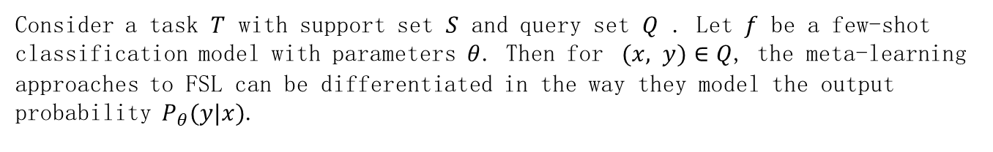
Meta-Learning-based Few-Shot Learning
Consider a task $T$ with support set $S$ and query set $Q$ . Let $f$ be a few-shot classification model with parameters $θ$. Then for $(x, y)∈Q$, the meta-learning approaches to FSL can be differentiated in the way they model the output probability $P_{θ}(y|x)$.

Slide 30
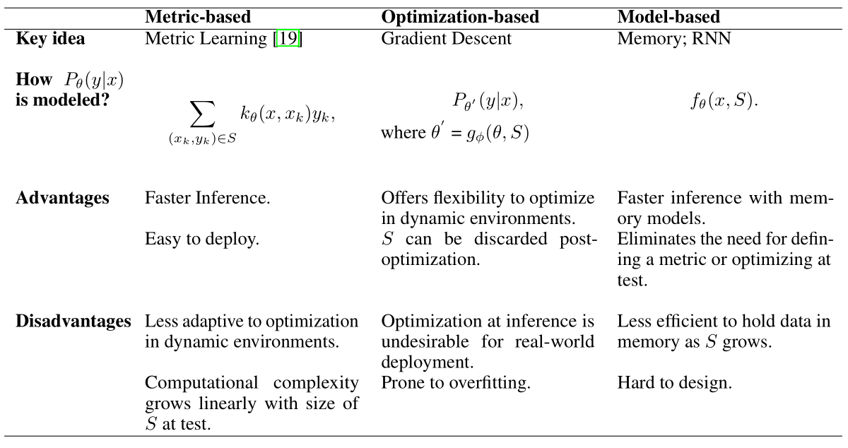
Main Approaches

Slide 31

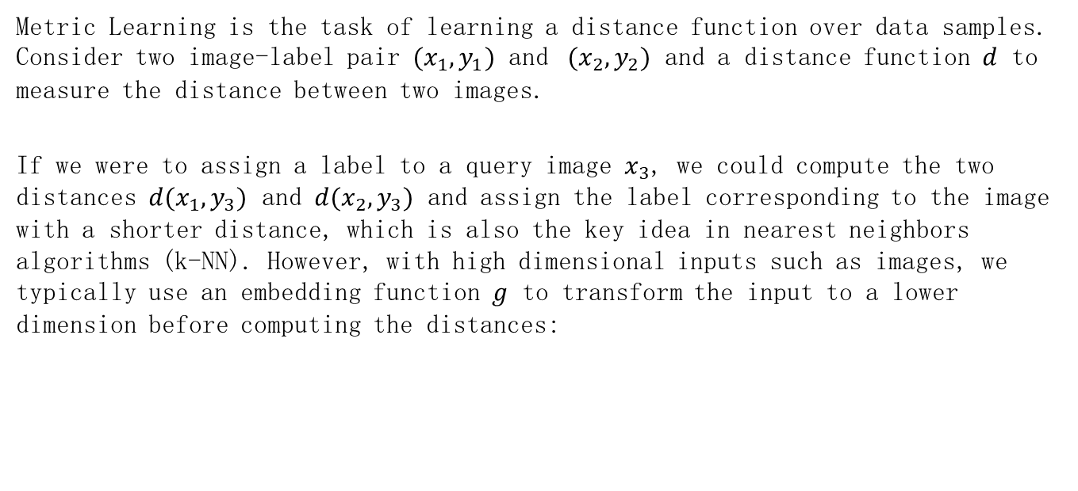
Metric-based Meta-Learning
Metric Learning is the task of learning a distance function over data samples. Consider two image-label pair $(x_{1},y_{1})$ and $(x_{2},y_{2})$ and a distance function $d$ to measure the distance between two images.
If we were to assign a label to a query image $x_{3}$, we could compute the two distances $d(x_{1},y_{3})$ and $d(x_{2},y_{3})$ and assign the label corresponding to the image with a shorter distance, which is also the key idea in nearest neighbors algorithms (k-NN). However, with high dimensional inputs such as images, we typically use an embedding function $g$ to transform the input to a lower dimension before computing the distances:

Slide 32
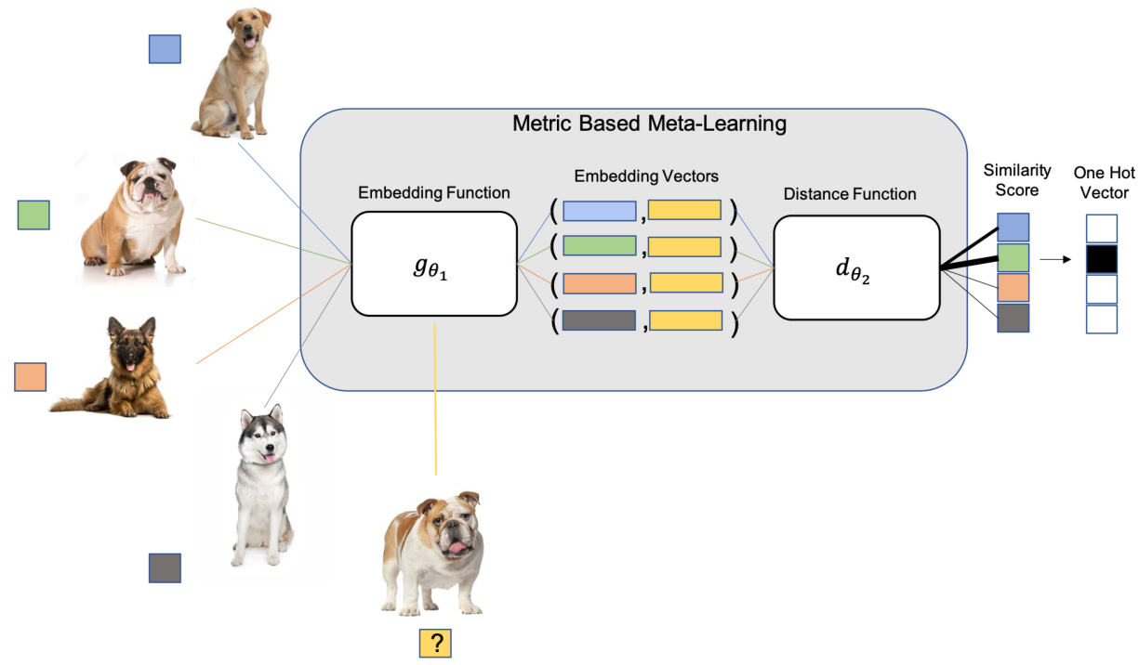
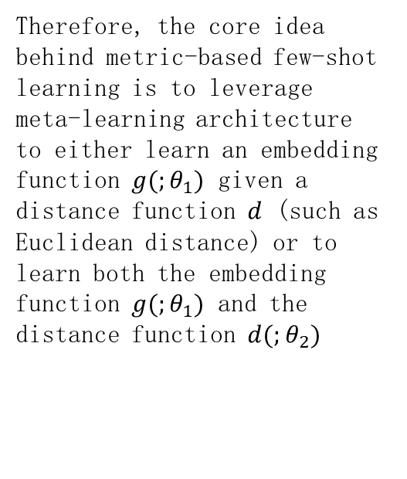
Metric-based Meta-Learning
Therefore, the core idea behind metric-based few-shot learning is to leverage meta-learning architecture to either learn an embedding function $g(;θ_{1})$ given a distance function $d$ (such as Euclidean distance) or to learn both the embedding function $g(;θ_{1})$ and the distance function $d(;θ_{2})$

Slide 33
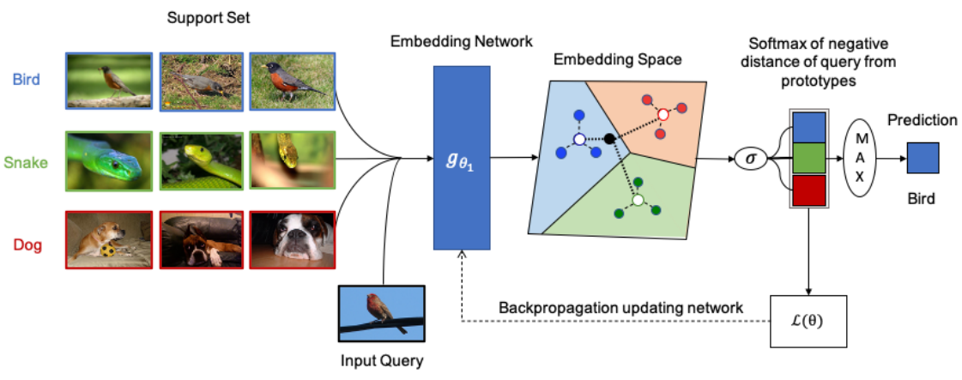

Metric-based Meta-Learning
Prototypical Networks (ProtoNet)
Prototypical Networks use a 4-layer-CNN as an embedding function $g_{θ_{1}}$. A prototype for each class is defined by taking an average of embedding vectors obtained from the support images belonging to that class.

Slide 34
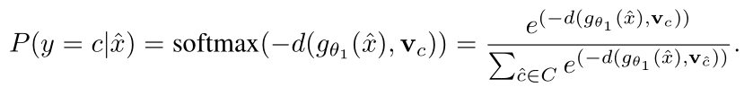

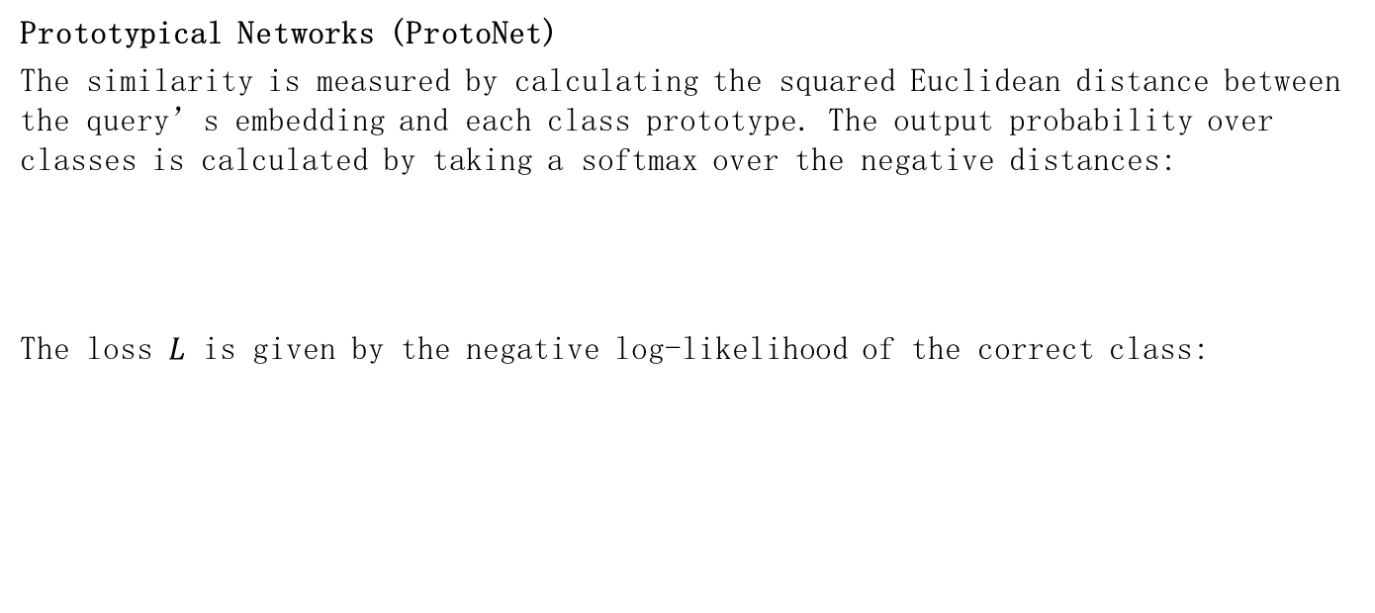
Metric-based Meta-Learning
Prototypical Networks (ProtoNet)
The similarity is measured by calculating the squared Euclidean distance between the query’s embedding and each class prototype. The output probability over classes is calculated by taking a softmax over the negative distances:
The loss $L$ is given by the negative log-likelihood of the correct class:

Slide 35
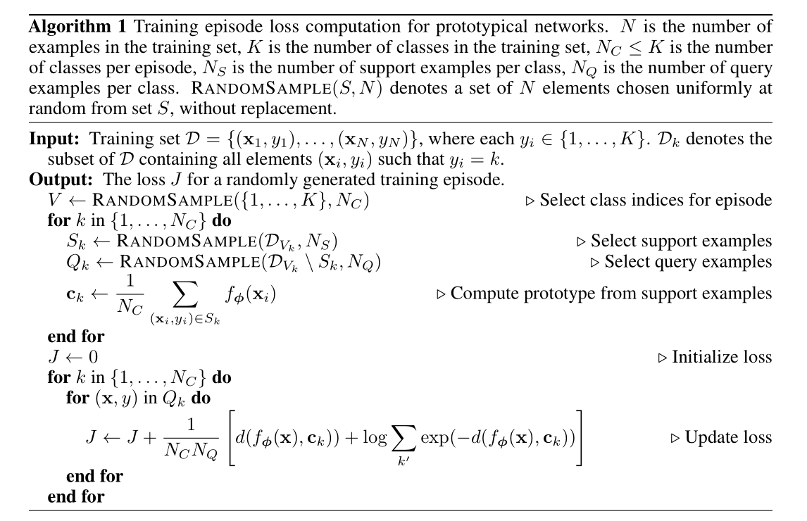
Metric-based Meta-Learning
Prototypical Networks (ProtoNet)

Slide 36
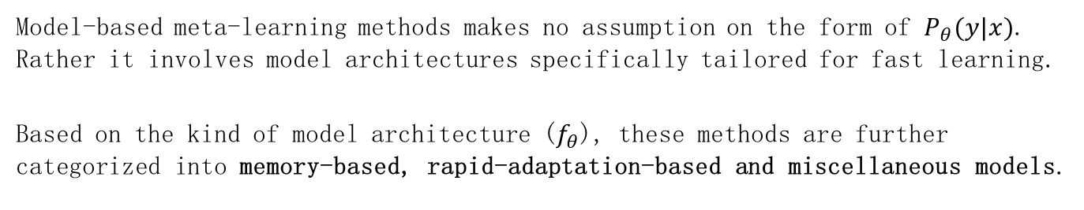
Model-based Meta-Learning
Model-based meta-learning methods makes no assumption on the form of $P_{θ}(y|x)$. Rather it involves model architectures specifically tailored for fast learning.
Based on the kind of model architecture ($f_{θ}$), these methods are further categorized into memory-based, rapid-adaptation-based and miscellaneous models.

Slide 37
Model-based Meta-Learning - MANN
Memory Augmented Neural Networks (MANN)
Memory Augmented Neural Networks (MANN) use a modified Neural Turing Machine (NTM) to rapidly assimilate new data into memory and leverage this data to make accurate predictions after only a few samples.
Neural Turing Machine
A Neural Turing Machine (NTM) couples a controller neural network with external memory storage. Like most neural networks, the controller interacts with the external world via input and output vectors. Unlike standard networks, the controller also learns to read and write memory rows by soft attention, while the memory serves as a knowledge repository. The attention weights are generated by its addressing mechanism.

Slide 38
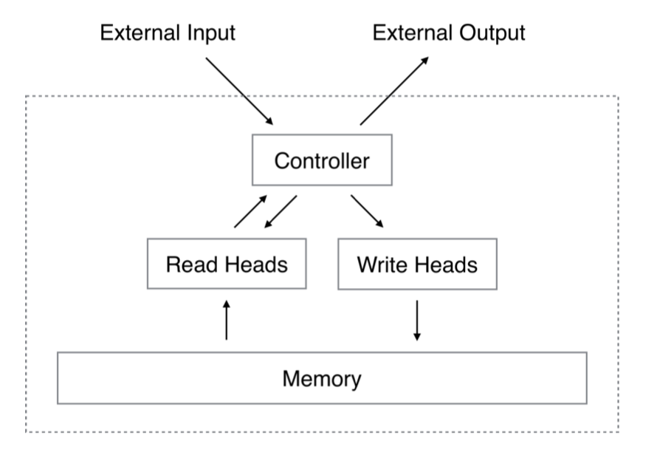
Model-based Meta-Learning - MANN
Neural Turing Machine

Slide 39
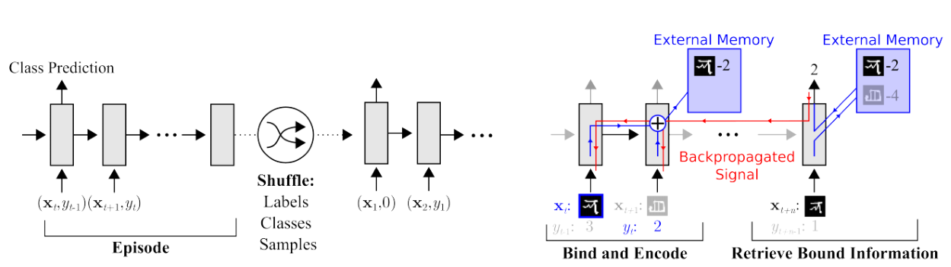

Model-based Meta-Learning - MANN
Meta-Learning Task Methodology
Omniglot images (or x-values for regression), $x_{t}$ , are presented with time-offset labels (or function values), $y_{t−1}$ , to prevent the network from simply mapping the class labels to the output. From episode to episode, the classes to be presented in the episode, their associated labels, and the specific samples are all shuffled.

Slide 40
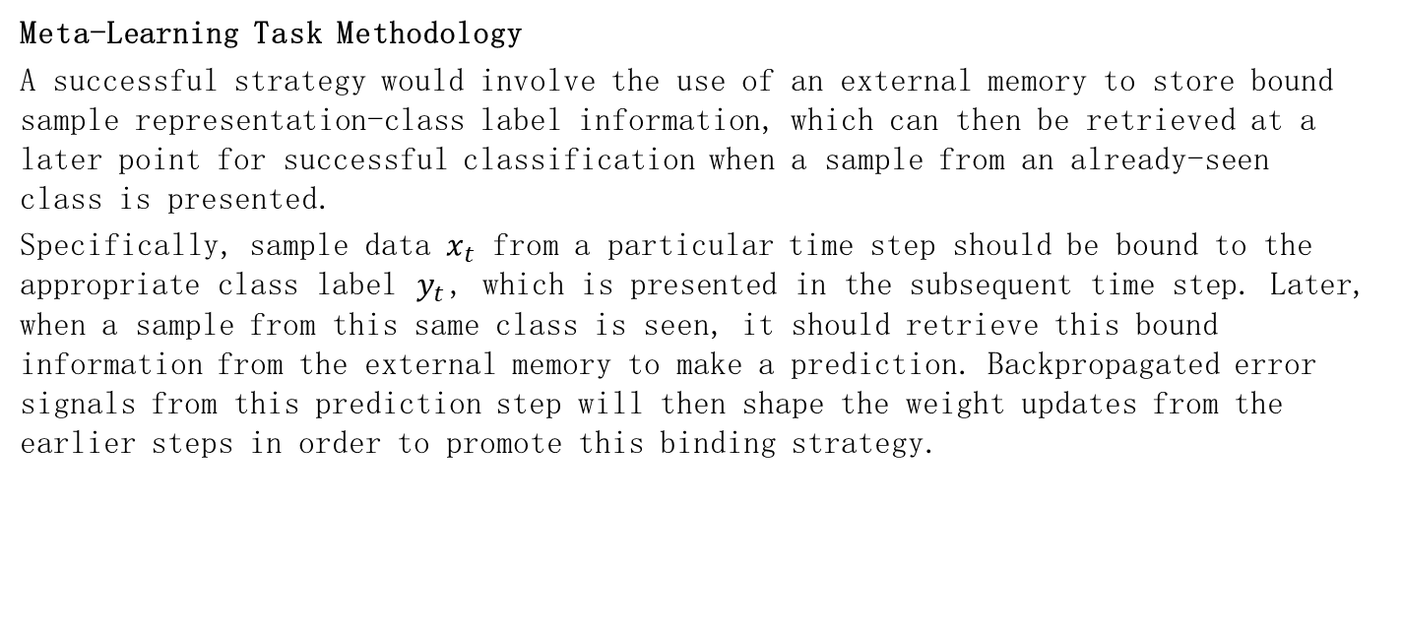
Model-based Meta-Learning - MANN
Meta-Learning Task Methodology
A successful strategy would involve the use of an external memory to store bound sample representation-class label information, which can then be retrieved at a later point for successful classification when a sample from an already-seen class is presented.
Specifically, sample data $x_{t}$ from a particular time step should be bound to the appropriate class label $y_{t}$, which is presented in the subsequent time step. Later, when a sample from this same class is seen, it should retrieve this bound information from the external memory to make a prediction. Backpropagated error signals from this prediction step will then shape the weight updates from the earlier steps in order to promote this binding strategy.

Slide 41

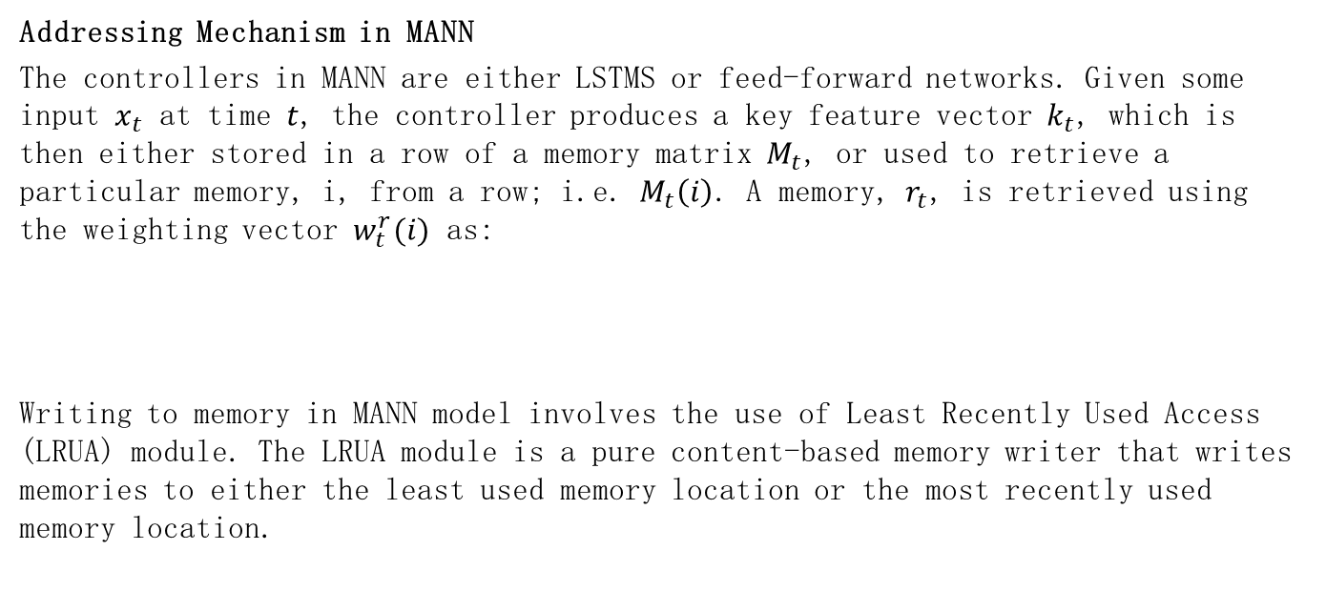
Model-based Meta-Learning - MANN
Addressing Mechanism in MANN
The controllers in MANN are either LSTMS or feed-forward networks. Given some input $x_{t}$ at time $t$, the controller produces a key feature vector $k_{t}$, which is then either stored in a row of a memory matrix $M_{t}$, or used to retrieve a particular memory, i, from a row; i.e. $M_{t}\left(i\right)$. A memory, $r_{t}$, is retrieved using the weighting vector $w_{t}^{r}(i)$ as:
Writing to memory in MANN model involves the use of Least Recently Used Access (LRUA) module. The LRUA module is a pure content-based memory writer that writes memories to either the least used memory location or the most recently used memory location.

Slide 42

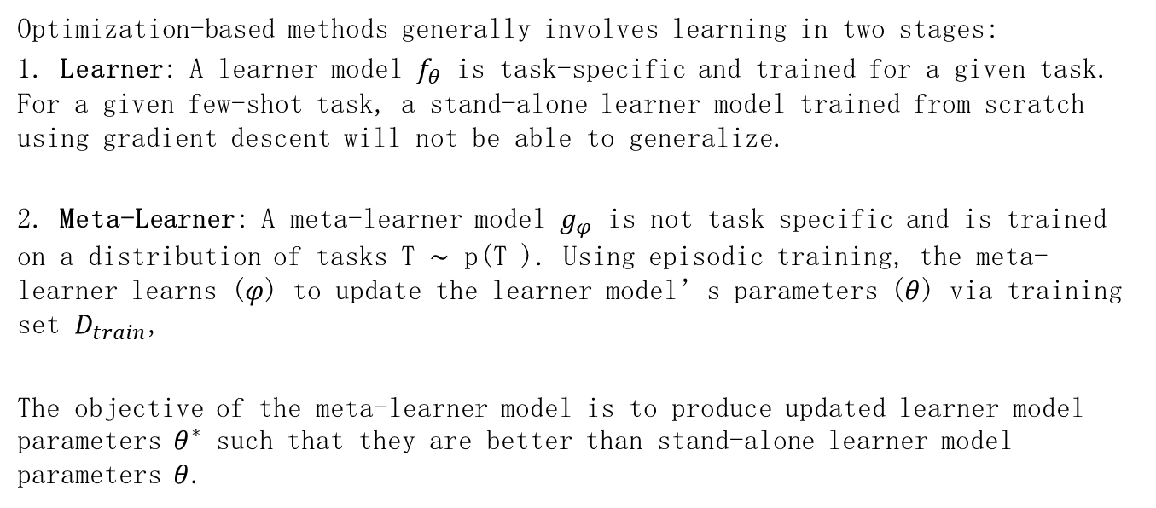
Optimization-based Meta-Learning
Optimization-based methods generally involves learning in two stages:
1. Learner: A learner model $f_{θ}$ is task-specific and trained for a given task. For a given few-shot task, a stand-alone learner model trained from scratch using gradient descent will not be able to generalize.
2. Meta-Learner: A meta-learner model $g_{φ}$ is not task specific and is trained on a distribution of tasks T ∼ p(T ). Using episodic training, the meta-learner learns ($φ$) to update the learner model’s parameters ($θ$) via training set $D_{train}$,
The objective of the meta-learner model is to produce updated learner model parameters $θ^{∗}$ such that they are better than stand-alone learner model parameters $θ$.

Slide 43
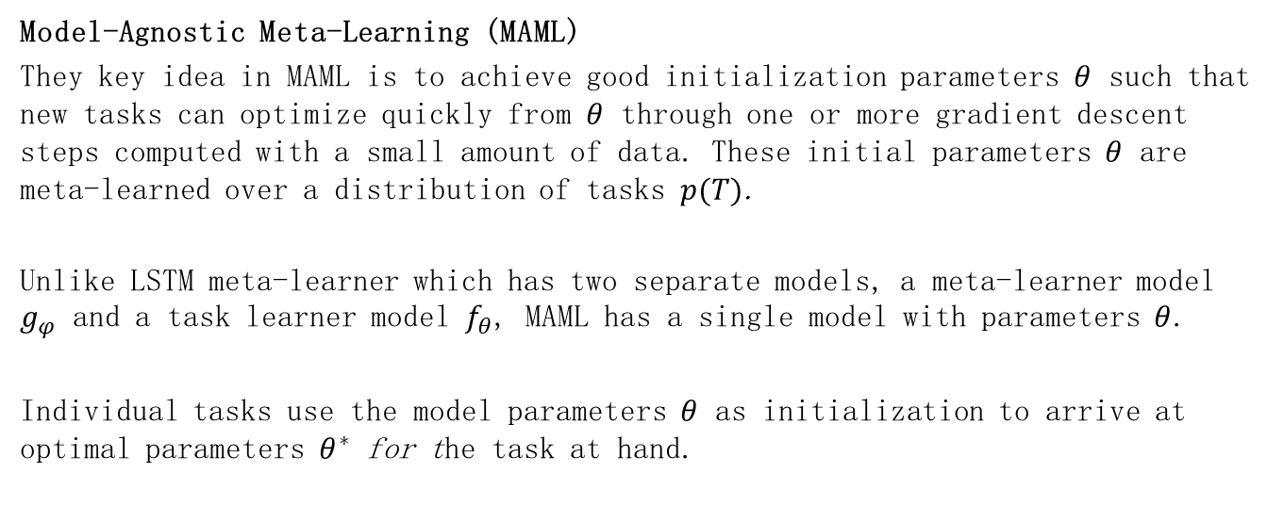
Optimization-based Meta-Learning
Model-Agnostic Meta-Learning (MAML)
They key idea in MAML is to achieve good initialization parameters $θ$ such that new tasks can optimize quickly from $θ$ through one or more gradient descent steps computed with a small amount of data. These initial parameters $θ$ are meta-learned over a distribution of tasks $p(T)$.
Unlike LSTM meta-learner which has two separate models, a meta-learner model $g_{φ}$ and a task learner model $f_{θ}$, MAML has a single model with parameters $θ$.
Individual tasks use the model parameters $θ$ as initialization to arrive at optimal parameters $θ^{∗}$ for the task at hand.

Slide 44
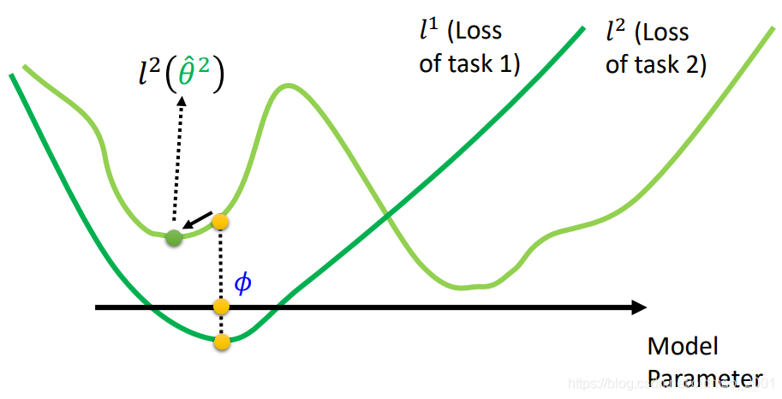
Optimization-based Meta-Learning
Model-Agnostic Meta-Learning (MAML)
A bad initialization point

Slide 45
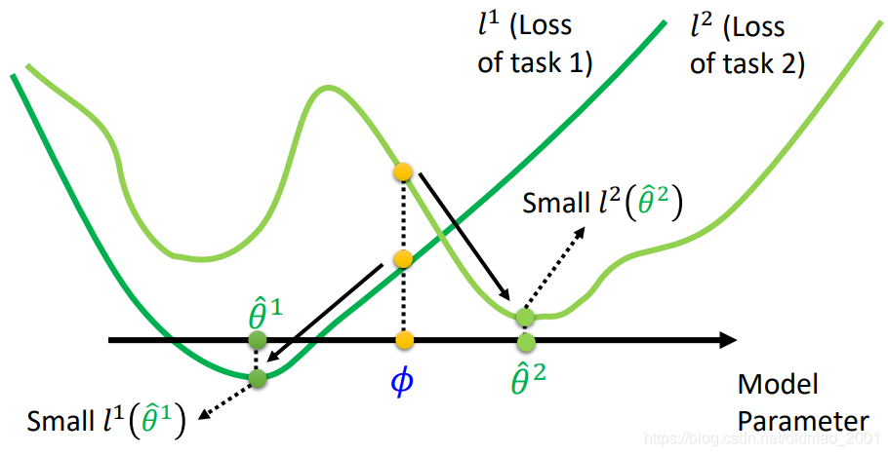
Optimization-based Meta-Learning
Model-Agnostic Meta-Learning (MAML)
A good initialization point

Slide 46
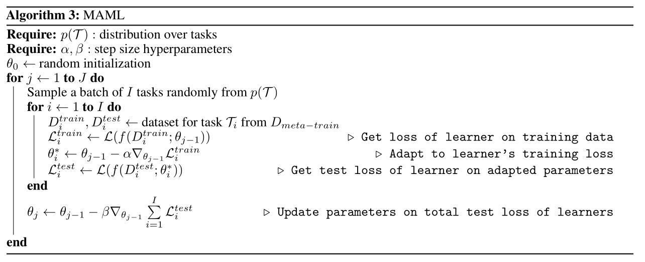
Optimization-based Meta-Learning
Model-Agnostic Meta-Learning (MAML)
Algorithm

Slide 47
5. Non-Meta-Learning based Few-Shot Learning

Slide 48
Transfer Learning
Transfer Learning is the improvement of learning in a new task through the transfer of knowledge from a related task that has already been learned. In few-shot learning scenario where the data is too limited to train a deep network from scratch, transferring knowledge from another network can be a viable option. For a classification task, this knowledge transfer is achieved by pretraining a deep network on large amounts of training data on base classes (seen) and then fine-tuning it on a new few-shot classes (unseen).
Key Issue
Naive fine-tuning using just few example can lead to overfitting and thus poor generalization performance on the few-shot task.

Slide 49
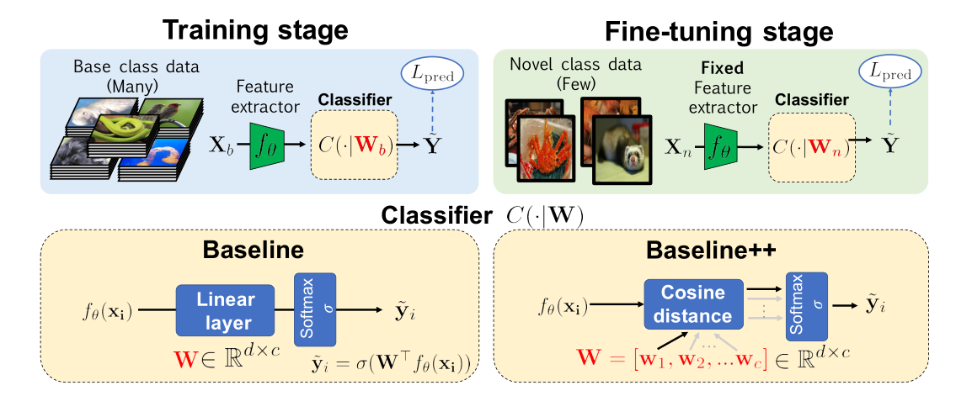
Transfer Learning - BASELINE & BASELINE++
A closer look at few-shot classification (BASELINE & BASELINE++)

Slide 50
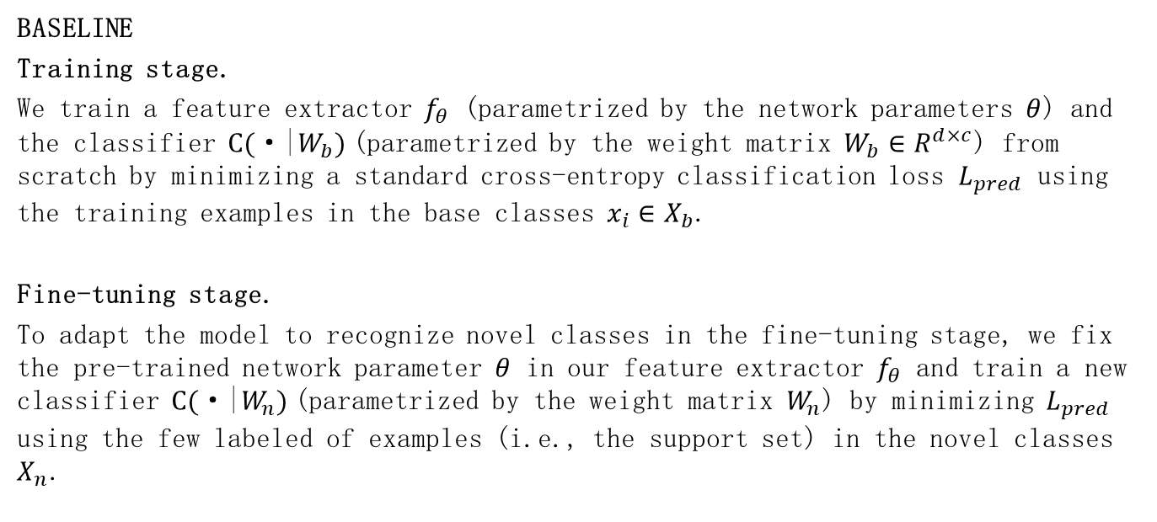
Transfer Learning - BASELINE & BASELINE++
BASELINE
Training stage.
We train a feature extractor $f_{θ}$ (parametrized by the network parameters $θ$) and the classifier $C(\text{·}\text{|}W_{b})$(parametrized by the weight matrix $W_{b}∈R^{d×c}$) from scratch by minimizing a standard cross-entropy classification loss $L_{pred}$ using the training examples in the base classes $x_{i}∈X_{b}$.
Fine-tuning stage.
To adapt the model to recognize novel classes in the fine-tuning stage, we fix the pre-trained network parameter $θ$ in our feature extractor $f_{θ}$ and train a new classifier $C(\text{·|}W_{n})$(parametrized by the weight matrix $W_{n}$) by minimizing $L_{pred}$ using the few labeled of examples (i.e., the support set) in the novel classes $X_{n}$.

Slide 51
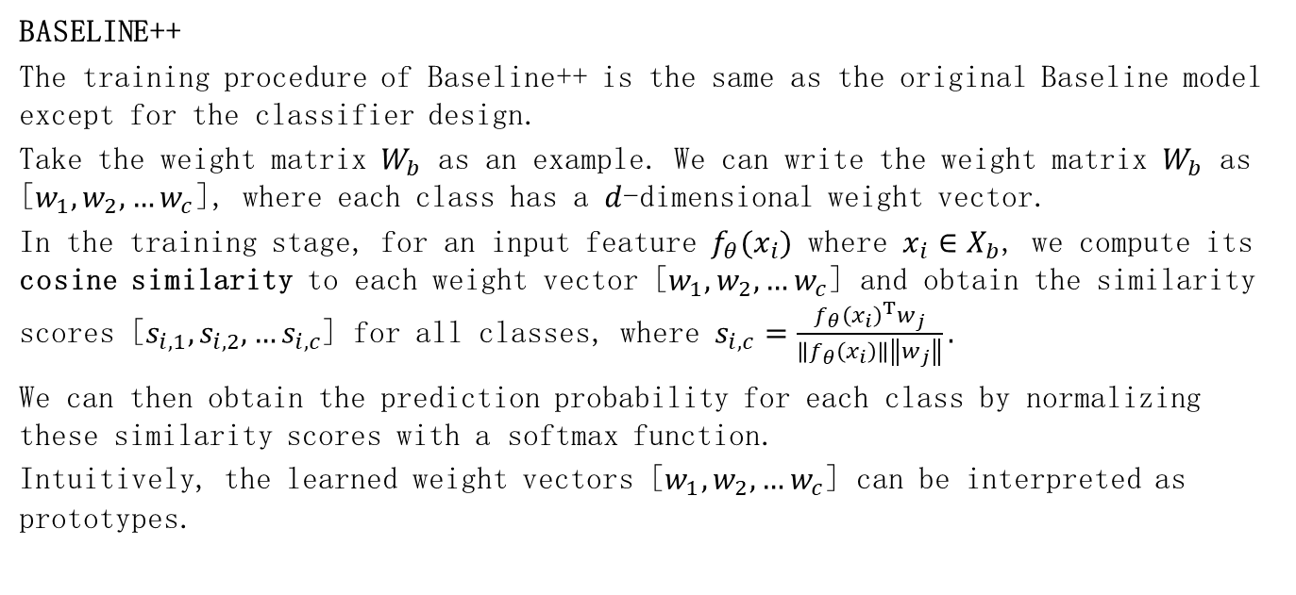
Transfer Learning - BASELINE & BASELINE++
BASELINE++
The training procedure of Baseline++ is the same as the original Baseline model except for the classifier design.
Take the weight matrix $W_{b}$ as an example. We can write the weight matrix $W_{b}$ as [$w_{1},w_{2},…w_{c}$], where each class has a $d$-dimensional weight vector.
In the training stage, for an input feature $f_{θ}(x_{i})$ where $x_{i}∈X_{b}$, we compute its cosine similarity to each weight vector [$w_{1},w_{2},…w_{c}$] and obtain the similarity scores [$s_{i,1},s_{i,2},…s_{i,c}$] for all classes, where $s_{i,c}=\frac{{f_{θ}\left(x_{i}\right)}^{T}w_{j}}{\left\|f_{θ}\left(x_{i}\right)\right\|\left\|w_{j}\right\|}.$
We can then obtain the prediction probability for each class by normalizing these similarity scores with a softmax function.
Intuitively, the learned weight vectors [$w_{1},w_{2},…w_{c}$] can be interpreted as prototypes.

Slide 52
Transfer Learning - Meta-Baseline
Meta-Baseline: Exploring Simple Meta-Learning for Few-Shot Learning
Meta-learning has been the most common framework for few-shot learning. Some recent works report that by training for whole-classification, i.e. classification on the whole label-set, it can get comparable or even better embedding than many meta-learning algorithms. The edge between these two lines of works has yet been underexplored, and the effectiveness of meta-learning in few-shot learning remains unclear.
We explore a simple process: meta-learning over a whole-classification pre-trained model on its evaluation metric.

Slide 53
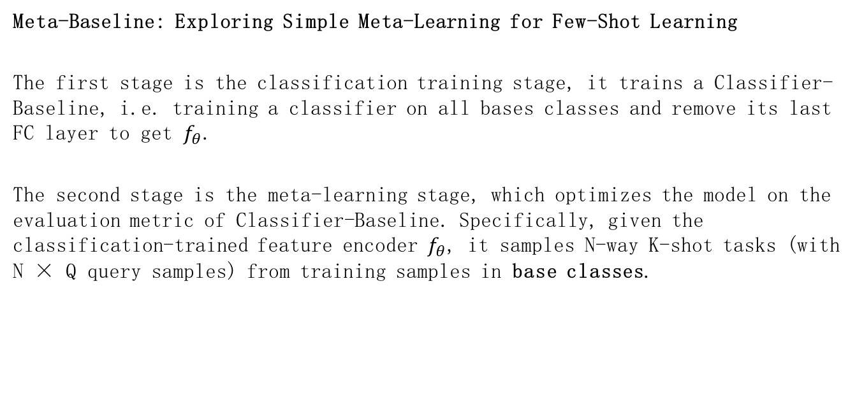
Transfer Learning - Meta-Baseline
Meta-Baseline: Exploring Simple Meta-Learning for Few-Shot Learning
The first stage is the classification training stage, it trains a Classifier- Baseline, i.e. training a classifier on all bases classes and remove its last FC layer to get $f_{θ}$.
The second stage is the meta-learning stage, which optimizes the model on the evaluation metric of Classifier-Baseline. Specifically, given the classification-trained feature encoder $f_{θ}$, it samples N-way K-shot tasks (with N × Q query samples) from training samples in base classes.

Slide 54

Transfer Learning - Meta-Baseline
Meta-Baseline: Exploring Simple Meta-Learning for Few-Shot Learning

Slide 55

Transductive Inference
Transductive Inference
Certain approaches attempt to exploit the structure of information present in the query set and collectively classify the examples in the query set. This is know as transductive inference.

Slide 56
Transductive Inference - TPN
Learning to propagate labels：Transductive Propagation Network for few-shot learning (TPN)
With meta-learning, the low-data problem in the novel classification task still remains. Liu, Yanbin, et al. propose Transductive Propagation Network (TPN), a novel meta-learning framework for transductive inference that classifies the entire test set at once to alleviate the low-data problem.

Slide 57

Transductive Inference - TPN
TPN consists of four components: feature embedding with a convolutional neural network; graph construction that produces example-wise parameters to exploit the manifold structure; label propagation that spreads labels from the support set S to the query set Q; a loss generation step that computes a cross-entropy loss between propagated labels and the ground-truths on Q to jointly train all parameters in the framework.

Slide 58


Transductive Inference - TPN
Graph construction
Manifold learning discovers the embedded low-dimensional subspace in the data, where it is critical to choose an appropriate neighborhood graph. A common choice is Gaussian similarity function:
where $d\left(∙, ∙\right)$ is a distance measure (e.g., Euclidean distance) and $σ$ is the length scale parameter.

Slide 59


Transductive Inference - TPN
Graph construction
To obtain a proper neighborhood graph in meta-learning, a graph construction module built on the union set of support set and query set: $S∪Q$is proposed. This module is composed of a convolutional neural network $g_{φ}$ which takes the feature map $f_{φ}(x_{i})$ for $x_{i}∈S∪Q$ to produce an example-wise length-scale parameter $σ_{i}=g_{φ}(f_{φ}\left(x_{i}\right))$.
Note that the scale parameter is determined example-wisely and learned in an episodic training procedure, which adapts well to different tasks and makes it suitable for few-shot learning. With the example-wise $σ_{i}$, our similarity function is then defined as follows:

Slide 60


Transductive Inference - TPN
Graph construction
We only keep the $k$-max values in each row of $W$ to construct a k-nearest neighbour graph. Then we apply the normalized graph Laplacians on $W$, that is, $S=D^{−1/2}WD^{−1/2}$, where $D$ is a diagonal matrix with its $(i,i)$-value to be the sum of the $i$-th row of $W$.

Slide 61


Transductive Inference - TPN
Label propagation
Let $F$ denote the set of $(N×K+T)×N$ matrix ($T$ is the number of query samples) with nonnegative entries. We define a label matrix $Y∈F$ with $Y_{ij}=1$ if $x_{i}$ is from the support set and labeled as $y_{i}=j$, otherwise $Y_{ij}=0$.
Starting from $Y$, label propagation iteratively determines the unknown labels of instances in the union set $S∪Q$ according to the graph structure using the following formulation:
here $F_{t}∈F$ denotes the predicted labels at the timestamp $t$, $S$ denotes the normalized weight, and $α∈(0,1)$ controls the amount of propagated information.

Slide 62
6. Few-Shot One-Class Classification

Slide 63

One-Class Classification Problem
One-Class Classification (OCC) is an extreme case of recognition, where data from only a single class (labeled positive) is present during training.
The objective of OCC is to determine whether a query object belongs to the class observed during training. In the absence of multiple-class data, both learning features and defining classification boundaries become more challenging in OCC compared to multi-class classification.

Slide 64
One-Way Prototypical Networks
One-Way Prototypical Networks
A challenge for the distance metric: Cosine or Euclidean distances are not bounded, we cannot set a threshold for class belonging. We need a basis for comparison. We implement this by introducing a “null class” that models the whole space of possible examples without explicitly being given those examples.
The question then becomes how to construct this class.

Slide 65

One-Way Prototypical Networks
As the model includes batch normalization layers, we can assume that the centroid of the whole latent space will be close to the zero point in all embedding dimensions.
A query’s distance to the centroid of the positive class is therefore compared to its norm (i.e. its distance to the zero centroid) to determine whether it is more likely to belong to the positive class or to the null class encompassing everything.

Slide 66
One-Way Prototypical Networks
One issue that arises is that in the state-of-the-art prototypical models, batch normalization is not performed at the end of the convolution blocks of the embedding network, but rather after the convolution layer and before the (ReLU) non-linearity and pooling layers. The final block is therefore not quite batch-normalized.
As there is some debate about the ordering of these layers anyway, we propose reordering the block layout to a structure of: Convolution - (Leaky) ReLU - Max Pooling - Batch Normalization.

Slide 67

Meta SVDD & One-Class Prototypical Networks
The Support Vector Data Description (SVDD) method computes the hypersphere of minimum volume that contains every point in the training set.
The idea is that only points inside the hypersphere belong to the target class, so we minimize the sphere’s volume to reduce the chance of including points that do not belong in the target class.

Slide 68


Meta SVDD & One-Class Prototypical Networks
Meta SVDD
Our goal is to learn $f_{θ}$ for the task

Slide 69




Meta SVDD & One-Class Prototypical Networks
Meta SVDD
Formally, the radius $R(X, c;θ)$ of the hypersphere centered at $c∈R^{d}$ covering the training set $X$ transformed by $f_{θ}$: $R^{D}\text{→}R^{d}$ is
The SVDD objective is to find the center $c^{∗}$ that minimizes the radius of such a hypersphere, i.e.,
Finally, the algorithm determines that a point $x′$ belongs to the target class if

Slide 70


Meta SVDD & One-Class Prototypical Networks
One-Class Prototypical Networks
Let center $c^{∗}$ be a simple average of the input features:
We call this method One-Class Prototypical Networks because the method can be cast as learning binary Prototypical Networks with a binary cross-entropy objective. We no longer require solving the quadratic program.

Slide 71
7. Progress in Few-Shot Learning

Slide 72

Progress in Few-Shot Learning
Accuracy for 5-way 1-shot classification task on miniImageNet.

Slide 73
Conclusions
Few-Shot Learning (FSL) targets at bridging the gap between AI and human learning. It can learn new tasks containing only a few examples with supervised information by incorporating prior knowledge. FSL acts as a test-bed for AI, makes the learning of rare cases possible, or helps to relieve the burden of collecting large-scale supervised date in industrial applications.
Though recent years have witnessed considerable progress of FSL in both methodology and applications, challenges still exist due to the intrinsic difficulty from sparse samples. In this section, we suggest four future directions of FSL.

Slide 74
Future Directions
1. Most of the current FSL studies are based on an ideal data hypothesis, but it is hard to hold true for all practical scenes. In many realistic applications, one may be faced with uncertain disturbances that destroy the ideal setting of FSL. Therefore, improving the robustness of FSL models against various potential disturbance factors is substantially meaningful.
2. For now, most of FSL approaches are excessively designed for the specific benchmark tasks and datasets, weakening their applicability to other more general tasks. An ideal FSL framework should be able to deal with various learning tasks with different data complexity and diverse data forms.
3. The surge and success of FSL in recent years mainly lie in deep learning technology, which is often criticized for its lack of interpretability. Model interpretability is a key issue for deep learning. Therefore, how to capitalize on the fusion of external prior knowledge and internal data knowledge to enhance the interpretability of FSL models could be a future research direction.

Slide 75
References
Wang, Yaqing, et al. "Generalizing from a few examples: A survey on few-shot learning." ACM computing surveys (csur) 53.3 (2020): 1-34.
Lu, Jiang, et al. "Learning from very few samples: A survey." arXiv preprint arXiv:2009.02653 (2020).
Parnami, Archit, and Minwoo Lee. "Learning from Few Examples: A Summary of Approaches to Few-Shot Learning." arXiv preprint arXiv:2203.04291 (2022).
Snell, Jake, Kevin Swersky, and Richard Zemel. "Prototypical networks for few-shot learning." Advances in neural information processing systems 30 (2017).
Boney, Rinu, and Alexander Ilin. "Semi-supervised few-shot learning with prototypical networks." CoRR abs/1711.10856 (2017).
Finn, Chelsea, Pieter Abbeel, and Sergey Levine. "Model-agnostic meta-learning for fast adaptation of deep networks." International conference on machine learning. PMLR, 2017.
Kruspe, Anna. "One-way prototypical networks." arXiv preprint arXiv:1906.00820 (2019).
Dahia, Gabriel, and Maurício Pamplona Segundo. "Meta learning for few-shot one-class classification." AI 2.2 (2021): 195-208.
Liu, Yanbin, et al. "Learning to propagate labels: Transductive propagation network for few-shot learning." arXiv preprint arXiv:1805.10002 (2018).

