Slide 1

Symbolic AI: Search and Problem Solving
Lecture 4

Slide 2
Outline
What is search?
Problem Representation
– State Space and And/Or Graph
– They embody two thoughts of problem solving!
Graph Search
– General graph search algorithm
– Blind (uninformed) search
– Heuristic (informed) search
Adversarial Search
– Minimax algorithm
– α-β pruning
- Monte Carlo Tree Search (MCTS)

Slide 3
PartⅠ: What is search?

Slide 4
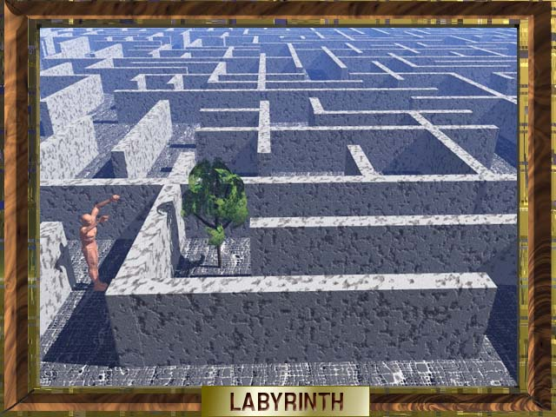
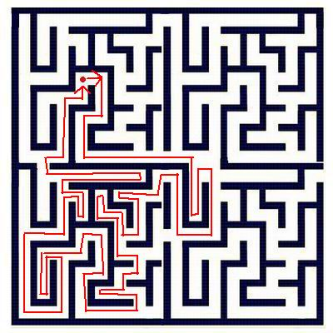
Theseus and the Minotaur
Ariadne’s clew:
How does Theseus find the way out of Minotaur's labyrinth?

Slide 5
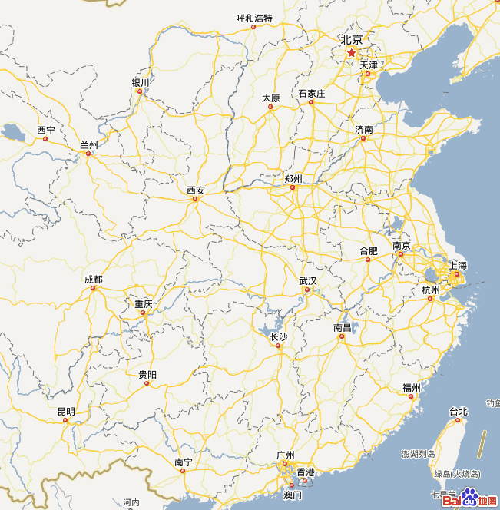
Search Problem Examples
2 | 8 | 3 | 7
10 | 5 | 14 | 1
15 |  | 9 | 6
4 | 11 | 14 | 12
1 | 2 | 3 | 4
8 | 7 | 6 | 5
9 | 10 | 11 | 12
 | 15 | 14 | 13
?
A
4
3
B
4
C
2
D
5
3
E

Slide 6
What is search ?
With acceptable costs, find out an optimal or feasible solution in all the possible solutions of the problem
Ideal search algorithm: find out the optimal solution as soon as possible.
Effectiveness and Efficiency are contradictions to one another
- Completeness, Optimality, Complexity
- Blind search vs. Heuristic search；Global search vs. Local search；Feasible solution vs. Optimal solution

Slide 7
Search Methods
Deterministic
  Calculus-based,
  Greedy,
  Hill-climbing
  ….
Stochastic
  Random,
  Simulated annealing,
  Evolutionary computing,
  Swarm intelligence,
  …..

Slide 8

Search Problem Illustration: How to solve 2-rank Hanoi problem?
Initial State
Goal State 1
Goal State 2
Rules:
1. Move only one plate each time
2. The bigger plate must not be placed on the smaller plate.

Slide 9
How to solve 2-rank Hanoi problem?
Step1 Represent the problem, here the state space method is used.
Step 1-1. Represent all the states, including initial states and goal states, and then find a way from initial states to goal states.
Initial state
Goal states

Slide 10
How to solve 2-rank Hanoi problem?
Step1-2 Represent the successor functions
Move plate A from pole i to pole j
Move plate B from pole i to pole j
All functions:

Slide 11
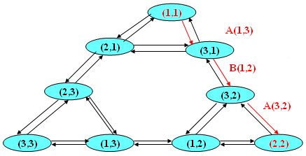
How to solve 2-rank Hanoi problem?
Step1-3 Construct the state space
Step2 Search the graph for the solution

Slide 12
How to solve 2-rank Hanoi problem?
Result:
A(1, 3)
B(1, 2)
A
B
B
A
1
2
3
1
2
3
S0=(1, 1)
S0=(3, 1)
A(3, 2)
A
B
A
B
1
2
3
1
2
3
S0=(3, 2)
S0=(2, 2)

Slide 13
Part Ⅱ: Problem Representation

Slide 14
2.1 State Space
S: the set of states
F: the set of successor functions (or actions)
used to transform states
C: the set of function costs (dispensable if the optimal solution is not concerned)
I: the set of initial states
G: the set of goal states
A state space is corresponding with a graph, in which a path from a initial state to a goal state is a solution to the problem

Slide 15
State Space based Problem Solving
Step1 Represent all states, in which the initial states and goal states are labeled.
Step2 Represent all successor functions
Step3 Take states as node and successor functions as edge to get the corresponding graph
Step4 Search the graph for optimal or feasible solution (path)

Slide 16
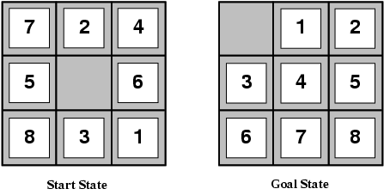
Example: The 8-puzzle
states?
actions?
Initial and goal states?
action costs?
Notes:
此处提问或做课堂练习

Slide 17
The 8-puzzle
states? locations of tiles
actions? move blank left, right, up, down
Initial and goal states? given
action costs? 1 per move
[Note: optimal solution of n-Puzzle family is NP-hard]

Slide 18
2.2 Problem Reduction
Solve the difficult problem through solving the equivalent but simpler problem(s).
Two methods of problem Reduction
P
P
“and”
“or”
P1
P2
P3
P1
P2
P3
Decomposition
Transformation

Slide 19
And/Or Graph
Data structure for problem reduction
- Each node is corresponding with a problem
- “And” node = decomposition
- “Or” node = transformation
- End nodes
+ Stop nodes = Primitive problems
+ Other end nodes = Unsolvable problems
- Solvable nodes and Unsolvable nodes

Slide 20
And/Or Graph based Problem-Solving
To find the solution graph which is a sub-graph representing the solution to the original problem
Step1. Represent each problem
Step2. Reduce the problem and represent the reduction process using and/or graph
Step3.Backtrack from end nodes to the root node, labeling nodes solvable or unsolvable
Step4. Output the corresponding solution graph if the root node is labeled solvable.

Slide 21
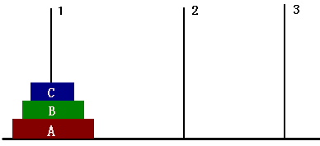
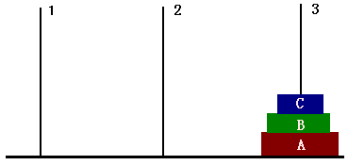
Example: 3-rank Hanoi problem
Initial State
Goal State

Slide 22
3-rank Hanoi problem
Step1. Represent problems
Problem states:
Original problem: (1,1,1)→(3,3,3)
Step2. Problem Reduction
Decompose the original problem into:
- sub-problem 1 = (1,1,1)→(1,2,2)
- sub-problem 2 = (1,2,2)→(3,2,2) √
- sub-problem 3 = (3,2,2)→(3,3,3)
Continue to decompose sub-problem 2 and 3 ……

Slide 23
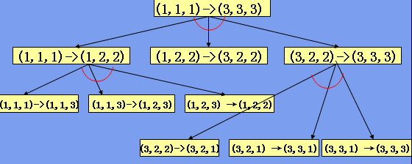
3-rank Hanoi problem
Step3. Search the graph to determine the root node solvable or unsolvable.
Step4. Output the whole graph as the solution. (how to explain it ?)

Slide 24
Part Ⅲ: Graph Search

Slide 25

3.1 General graph search
Basic idea
Gradually generate the graph through expanding nodes in the search process.
Basic data structure
– Open table: save those searched but unexpanded nodes
– Closed table: save expanded nodes

Slide 26
General graph search algorithm
Step1. Put the initial node into open table
Step2. Select a node from open table and put it into closed table
Step3. Expand the selected node: (blue: only for and/or graph)
– If the node can be expanded: put all the expanded nodes into open table and backtrack if needed
– If the node cannot be expanded: Backtrack for determining whether ancestor nodes are unsolvable.
Step4. Repeat Step2-3 until:
– the goal node is found out, or open table is empty (for state space)
– the initial node is labeled solvable or unsolvable, or open table is empty (for and/or graph)

Slide 27
An Illustration of Graph Search
OPEN
CLOSED
1. S
2. S
3. LO S
4. O SL
5. OMF2 SL
S
6. MF2 SLO
L
O
7. MF2PQ SLO
8. F2PQ SLOM
M
F2
P
Q
9. F2PQN SLOM
10. PQN SLOMF2
N
F3
F4
11. QN SLOMF2P
F1
12. QNF3 SLOMF2P
13. NF3 SLOMF2PQ
Width first
14. NF3F4 SLOMF2PQ
g
15. F3F4 SLOMF2PQN
16. F3F4F1 SLOMF2PQN

Slide 28
Key Factor
Selection method in Step 2 is the key difference between different search strategies:
Blind search vs. Heuristic search
Select the expanding node without or with consideration of the particularity of the problem

Slide 29
3.2 Blind search strategies
Breadth-first search (BFS)
First In First Out (FIFO)
Depth-first search (DFS)
Last In First Out (LIFO)
Depth-limited search (DLS)
Depth-first search with limited depth
Iterative deepening search (IDS)
Iterative depth-limited search with increased depth-limitation

Slide 30
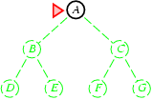
(1) Breadth-first search
Expand shallowest unexpanded node
Implementation:
  fringe is a FIFO queue, i.e., new successors go at end

Slide 31
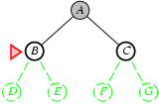
Breadth-first search
Expand shallowest unexpanded node
Implementation:
  fringe is a FIFO queue, i.e., new successors go at end

Slide 32
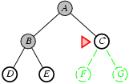
Breadth-first search
Expand shallowest unexpanded node
Implementation:
  fringe is a FIFO queue, i.e., new successors go at end

Slide 33
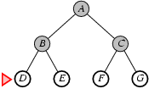
Breadth-first search
Expand shallowest unexpanded node
Implementation:
  fringe is a FIFO queue, i.e., new successors go at end

Slide 34
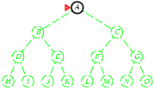
(2) Depth-first search
Expand deepest unexpanded node
Implementation:
  fringe = LIFO queue, i.e., put successors at front

Slide 35
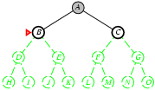
Depth-first search
Expand deepest unexpanded node
Implementation:
  fringe = LIFO queue, i.e., put successors at front

Slide 36
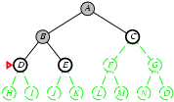
Depth-first search
Expand deepest unexpanded node
Implementation:
  fringe = LIFO queue, i.e., put successors at front

Slide 37
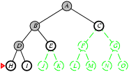
Depth-first search
Expand deepest unexpanded node
Implementation:
  fringe = LIFO queue, i.e., put successors at front

Slide 38
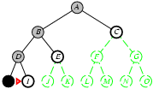
Depth-first search
Expand deepest unexpanded node
Implementation:
  fringe = LIFO queue, i.e., put successors at front

Slide 39
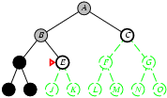
Depth-first search
Expand deepest unexpanded node
Implementation:
  fringe = LIFO queue, i.e., put successors at front

Slide 40
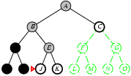
Depth-first search
Expand deepest unexpanded node
Implementation:
  fringe = LIFO queue, i.e., put successors at front

Slide 41
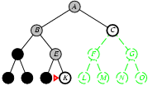
Depth-first search
Expand deepest unexpanded node
Implementation:
  fringe = LIFO queue, i.e., put successors at front

Slide 42
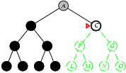
Depth-first search
Expand deepest unexpanded node
Implementation:
  fringe = LIFO queue, i.e., put successors at front

Slide 43
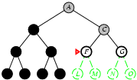
Depth-first search
Expand deepest unexpanded node
Implementation:
  fringe = LIFO queue, i.e., put successors at front

Slide 44
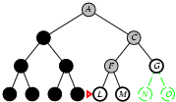
Depth-first search
Expand deepest unexpanded node
Implementation:
  fringe = LIFO queue, i.e., put successors at front

Slide 45
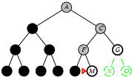
Depth-first search
Expand deepest unexpanded node
Implementation:
  fringe = LIFO queue, i.e., put successors at front

Slide 46
Blind Search Example: 8-puzzle
S0
Sg
2 8 3
4
7 6 5
1 2 3
8 4
7 6 5

Slide 47
BFS for 8-puzzle
S0
2 8 3
4
7 6 5
1
2
2 8 3
1 4
7 6 5
3
2 3
8 4
7 6 5
4
2 8 3
4
7 6 5
5
2 8 3
6 4
7 5
8
9 10
11 12
13
6
8 3
2 1 4
7 6 5
7
2 8 3
7 1 4
6 5
2 3
8 4
7 6 5
2 3
8 4
7 6 5
2 8
4 3
7 6 5
2 8 3
4 5
7 6
2 8 3
6 4
7 5
2 8 3
6 4
7 5
8 3
2 1 4
7 6 5
2 8 3
7 1 4
6 5
1 2 3
8 4
7 6 5
2 3 4
8
7 6 5
2 8
4 3
7 6 5
2 8 3
4 5
7 6
2 8 3
6 4
1 7 5
2 8 3
6
7 5 4
21
14
15
8 3
2 1 4
7 6 5
8 1 3
2 4
7 6 5
2 8 3
7 4
6 1 5
2 8 3
7 1 4
6 5
1 2 3
8 4
7 6 5
1 2 3 7 8 4
6 5
Solution path is ：
(S0)1 →3 → 8 → 16 → 26(Sg)
22
23
24
25
26
Sg
27

Slide 48
DFS for 8-puzzle
S0
2 8 3
4
7 6 5
1
2
2 8 3
1 4
7 6 5
3
1 8 4
7 6 5
2 8 3
1 4
7 6 5
2 8 3
1 6 4
7 5
3
2 8 3
1 6 4
7 5
2 8 3
1 6 4
7 5
2 8 3
1 6
7 5 4
4
2 8 3
6
7 5 4
2 8
1 6 3
7 5 4
5
8
1 6 3
7 5 4
6

Slide 49
DLS for 8-puzzle (depth limitation=4)
S0
2 8 3
4
7 6 5
1
2
2 8 3
1 4
7 6 5
11
2 3
8 4
7 6 5
2 8 3
4
7 6 5
2 8 3
6 4
7 5
12
3
8 3
2 1 4
7 6 5
7
2 8 3
7 1 4
6 5
2 3
8 4
7 6 5
2 3
8 4
7 6 5
2 8
4 3
7 6 5
2 8 3
4 5
7 6
2 8 3
6 4
7 5
2 8 3
6 4
7 5
13
4
8 3
2 1 4
7 6 5
8
2 8 3
7 1 4
6 5
1 2 3
8 4
7 6 5
2 3 4
8
7 6 5
2 8
4 3
7 6 5
2 8 3
4 5
7 6
2 8 3
6 4
1 7 5
2 8 3
6
7 5 4
8 3
2 1 4
7 6 5
8 1 3
2 4
7 6 5
2 8 3
7 4
6 1 5
2 8 3
7 1 4
6 5
1 2 3
8 4
7 6 5
1 2 3 7 8 4
6 5
Solution path is:
So：l →11 → 12 →13 → 14：Sg
5
6
9
10
14
Sg
Notes:
作业：迭代加深算法与A*算法的实验与比较

Slide 50
3.3 Heuristic Search
Review: The key difference between different search strategies is in the order of node expansion.
Idea: use an evaluation function f(n) to Estimate "desirability" of each node, and Expand most desirable unexpanded node.
Special cases:
  A* algorithm
  AO* algorithm

Slide 51
（1）A* algorithm
for State Space search
Evaluation function
f(n) = g(n) + h(n)
g(n) = cost so far to reach n
h(n) = estimated cost from n to goal (heuristic function)
f(n) = estimated total cost of path through n to goal

Slide 52
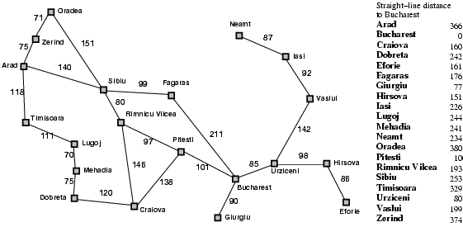
Example: Romania Problem
To find out an optimal path from the start city (e.g. Arad) to the destination (e.g. Bucharest) in the following map.

Slide 53

A* search for Romania problem
Use the straight-line distance between two cities as the heuristic function (h_{SLD}(n) )

Slide 54
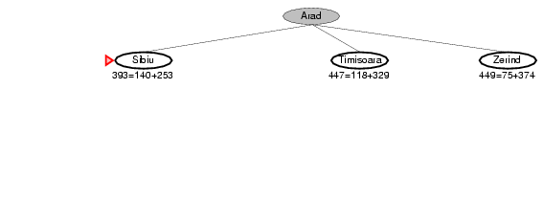
A* search for Romania problem
Use the straight-line distance between two cities as the heuristic function (h_{SLD}(n) )

Slide 55
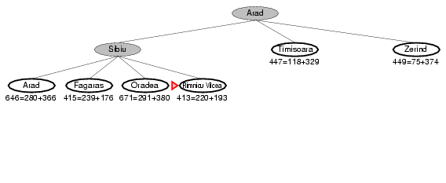
A* search for Romania problem
Use the straight-line distance between two cities as the heuristic function (h_{SLD}(n) )

Slide 56
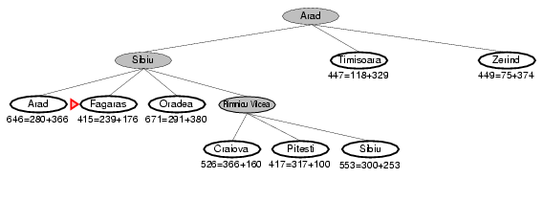
A* search for Romania problem
Use the straight-line distance between two cities as the heuristic function (h_{SLD}(n) )

Slide 57
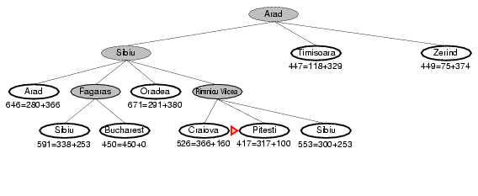
A* search for Romania problem
Use the straight-line distance between two cities as the heuristic function (h_{SLD}(n) )

Slide 58
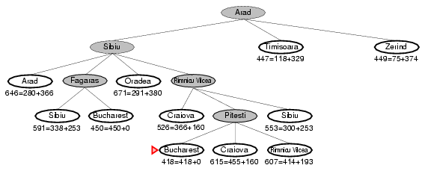
A* search for Romania problem
Use the straight-line distance between two cities as the heuristic function (h_{SLD}(n) )

Slide 59
Admissible heuristics
A heuristic h(n) is admissible if for every node n,
h(n) ≤ h*(n), where h*(n) is the true cost to reach the goal state from n.
An admissible heuristic never overestimates the cost to reach the goal, i.e., it is optimistic
Example: h_{SLD}(n) never overestimates the actual road distance.
Theorem: If h(n) is admissible, A* is optimal for tree search

Slide 60
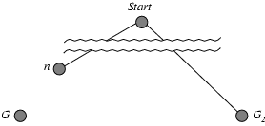
Optimality of A* (proof)
Suppose some suboptimal goal G₂ has been generated and is in the fringe. Let n be an unexpanded node in the fringe such that n is on a shortest path to an optimal goal G.
f(G₂) = g(G₂) since h(G₂) = 0
g(G₂) > g(G) since G₂ is suboptimal
f(G) = g(G) since h(G) = 0
f(G₂) > f(G) from above

Slide 61
Optimality of A* (proof)
Suppose some suboptimal goal G₂ has been generated and is in the fringe. Let n be an unexpanded node in the fringe such that n is on a shortest path to an optimal goal G.
f(G₂) > f(G) from above
h(n) ≤ h*(n) since h is admissible
g(n) + h(n) ≤ g(n) + h*(n)
f(n) ≤ f(G)
Hence f(G₂) > f(n), and A* will never select G₂ for expansion

Slide 62
A* Example: 8-puzzle
h₁(n) = number of misplaced tiles
h₂(n) = total Manhattan distance
(i.e., no. of squares from desired location of each tile)
h₁(S) = ?
h₂(S) = ?
S0
Sg
2 8 3
4
7 6 5
1 2 3
8 4
7 6 5

Slide 63
A* Example: 8-puzzle
h₁(n) = number of misplaced tiles
h₂(n) = total Manhattan distance
(i.e., no. of squares from desired location of each tile)
h₁(S) = ? 3
h₂(S) = ? 1+1+2 = 4
S0
Sg
2 8 3
4
7 6 5
1 2 3
8 4
7 6 5

Slide 64
A* for 8-puzzle (using h₂(n) )
S0
2 8 3
1 4
7 6 5
h=4, f=4
g=1
2 8 3
1 6 4
7 5
2 8 3
1 4
7 6 5
2 3
1 8 4
7 6 5
2 8 3
1 4
7 6 5
h=3, f=4
h=5, f=6
h=5, f=6
h=5, f=6
2 3
1 8 4
7 6 5
2 3
1 8 4
7 6 5
h=2, f=4
h=3, f=5
g=2
1 2 3
8 4
7 6 5
h=1, f=4
g=3
h=0, f=4
h=2, f=6
1 2 3
8 4
7 6 5
1 2 3
7 8 4
6 5
Sg
g=4

Slide 65
Design heuristic functions: Dominance
If h₂(n) ≥ h₁(n) for all n (both admissible), then h₂ dominates h₁ , and h₂ is better for search
Typical search costs (average number of nodes expanded):
d=12 IDS = 3,644,035 nodes
A*(h₁) = 227 nodes
A*(h₂) = 73 nodes
d=24 IDS = too many nodes
A*(h₁) = 39,135 nodes
A*(h₂) = 1,641 nodes
Notes:
作业：迭代加深算法与A*算法的实验与比较

Slide 66
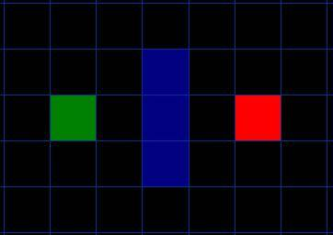
A* example: path finding in game Problem
How to get from point A to point B, which are separated by a wall ?

Slide 67
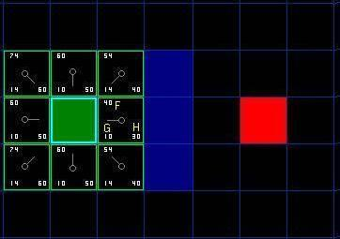
A* example: path finding in game Problem
Starting at point A, checking the adjacent squares and calculating the heuristic value F (F = G + H ) for each square.
H: the total number of squares moved horizontally and vertically to reach the target square from the current square
G: the movement cost to move from the starting point to the given square: A cost of 10 to each horizontal or vertical square moved, and a cost of 14 for a diagonal move.

Slide 68
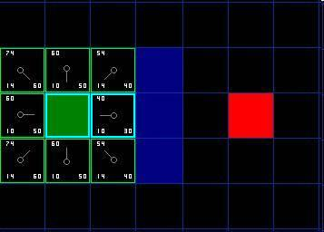
A* example: path finding in game Problem
Determining the square with minimum heuristic value F (F = G + H ) to follow.
choice is the immediate right of the starting square, with an F score of 40

Slide 69
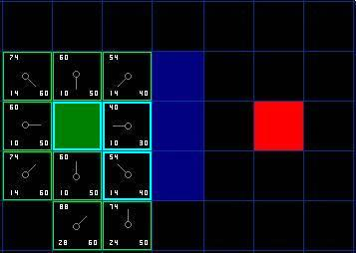
A* example: path finding in game Problem
Continue the step2 for the current square, ignoring the squares blocked by the wall.

Slide 70
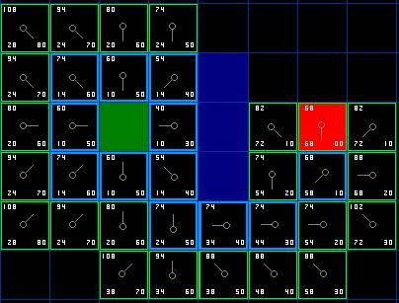
A* example: path finding in game Problem
repeat this process until we add the target square to the closed list.

Slide 71
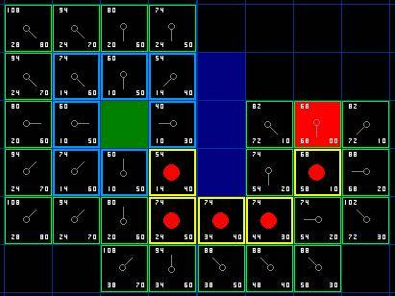
A* example: path finding in game Problem
Determine the path: start at the red target square, and work backwards moving from one square to its parent, following the arrows.

Slide 72
Summary of A* algorithm
Step1. Put the initial node into open table
Step2. Select a node from open table and put it into closed table according to heuristic function.
Step3. Expand the selected node. If the node can be expanded, put all the expanded nodes into open table.
Step4. Repeat Step2-3 until the goal node is selected in step2, or open table is empty.
Notes:
72

Slide 73
Part Ⅳ: Adversarial Search

Slide 74
4.1 Game tree
Data Structure representing game process
- 2-player (MAX vs. MIN)
- deterministic
- turn-taking
- zero-sum
- perfect information

Slide 75
Game Tree Example: Coins-Partition
Game State：(K1,K2,….,Kn, MIN or MAX)
Numbers of coins in stacks
turn
Each time MIN or MAX choose one stack and divide it into two stacks with different numbers of coins. When MIN or MAX cannot finish this task, he lose.
Firstly, n=1, k1 = 7, turn = MIN

Slide 76
Game tree for coins-partition
(7, MIN)
(6,1, MAX)
(5,2, MAX)
(4,3, MAX)
(5,1,1, MIN)
(4,2,1, MIN)
(3,2,2, MIN)
(3,3,1, MIN)
(4,1,1,1, MAX)
(3,2,1,1, MAX)
(2,2,2,1, MAX)
(3,1,1,1,1, MIN)
(2,2,1,1,1, MIN)
MAX win without fail?
(2,1,1,1,1,1, MAX)
Notes:
提问：MAX win without fail?

Slide 77
How to Solve?
MAX and MIN always try to take actions which are best for him in each step in the game.
In order to win, MAX should choose the best action in each turn, at the same time he should consider that MIN also choose the best (oppositely, worst for MAX) action for him in each turn.
best achievable payoff against best play
Game tree is And/Or Graph in structure!

Slide 78
Game tree as And/Or graph
(7, MIN)
(6,1, MAX)
(5,2, MAX)
(4,3, MAX)
(5,1,1, MIN)
(4,2,1, MIN)
(3,2,2, MIN)
(3,3,1, MIN)
(4,1,1,1, MAX)
(3,2,1,1, MAX)
(2,2,2,1, MAX)
(3,1,1,1,1, MIN)
(2,2,1,1,1, MIN)
(2,1,1,1,1,1, MAX)
Search as And/Or graph?
Notes:
提问：如何用之前的AO*算法求解？或作为课后练习

Slide 79
4.2 Minimax algorithm
Real Decision-Resource limits
E.g., China Chess: total number of states is 10¹⁶⁰. Suppose we explore 10³ nodes/sec，we need 10¹⁴⁵ years to find an optimal move.
(the age of universe is 10¹⁰)
Solution
Cutoff test: limit the depth of game tree
Evaluation function: Evaluate the game state from the view of MAX, the bigger the value is, the better the game state is.

Slide 80
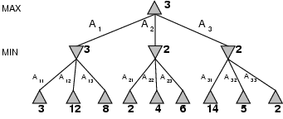
Minimax Example：2-ply game
choose move to position with highest minmax value!

Slide 81
MiniMax Example: tic-tac-toe
Evaluation function:
e(P) = e(+P)－e(-P)
Reserving only one for the symmetrical states
e(P) ＝ 6 - 4＝2

Slide 82
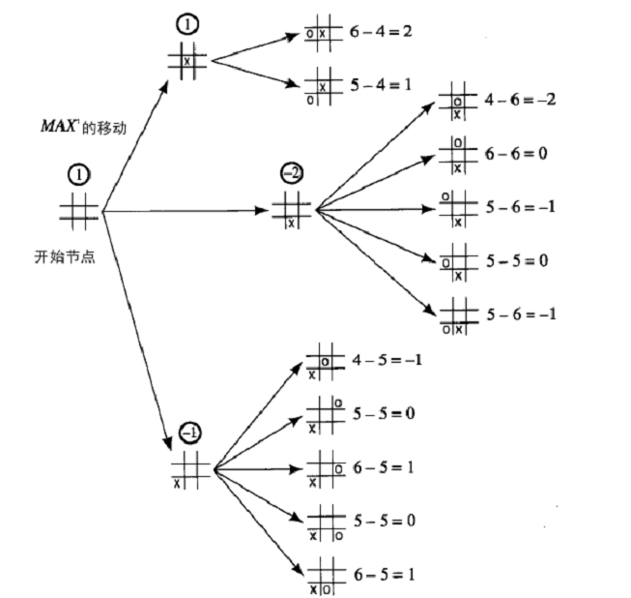
Solution of tic-tac-toe (1)
First stage

Slide 83
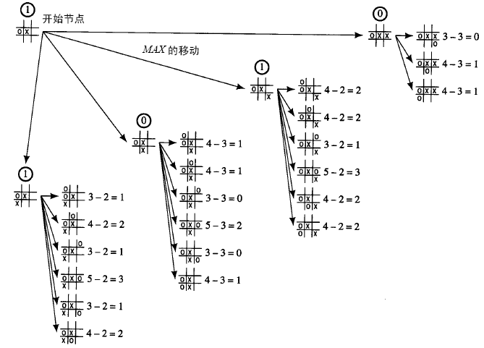
Solution of tic-tac-toe (2)
Second stage

Slide 84
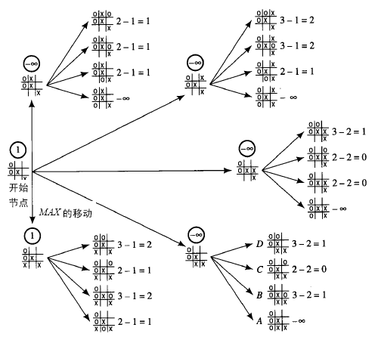
Solution of tic-tac-toe (3)
Final stage

Slide 85
4.3 α-β pruning
Improve search efficiency through pruning some unnecessary branches in the game tree
Use depth-limited search (DLS) strategy

Slide 86
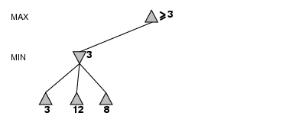
α-β pruning example1

Slide 87
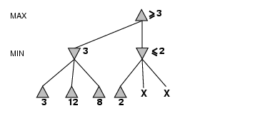
α-β pruning example1

Slide 88
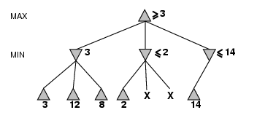
α-β pruning example1

Slide 89
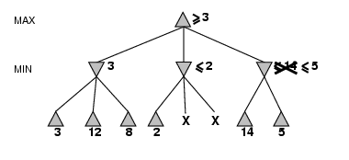
α-β pruning example1

Slide 90
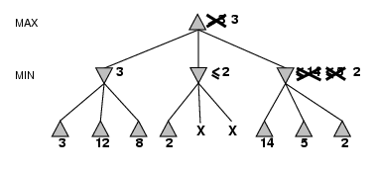
α-β pruning example1

Slide 91
α-β pruning example2
≥4
＝4
S0
≤4
＝4
≤0
A
B
＊
＊
≥4
＝4
≥5
≥0
＝0
C
D
＊
E
4
5
≤0
≤1
＝0
≤-6
F
G
H
I
J
＊
＊
＊
K
L
M
N
P
Q
R
S
4
8
6
1
5
8
0
-6

Slide 92
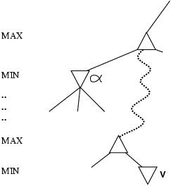
Why is it called α-β?
α is the value of the best (i.e., highest-value) choice found so far at any choice point along the path for MAX
If v is worse than α, MAX will avoid it
  → prune that branch
Define β similarly for MIN

Slide 93
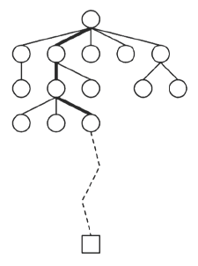
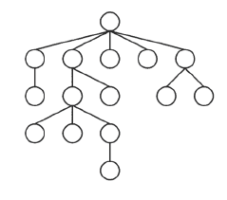
4.4 Monte Carlo Tree Search (MCTS)
No evaluation function!
Simulate from the leaf node using random moves, score the game at the end, use that as evaluation
C. Browne et al., A Survey of Monte Carlo Tree Search Methods. IEEE Trans. Computational Intelligence and AI In Games, 2012, 4(1): 1-46

Slide 94
General MCTS Algorithm
Four steps are applied per search iteration:
- Selection: a child selection policy is used from the root to reach the most urgent expandable node
- Expansion: child nodes are added to expand the tree
- Simulation: run from the new nodes according to the default policy to produce and outcome
- Backpropagation: the simulation result is backed up to update the statistics of nodes

Slide 95
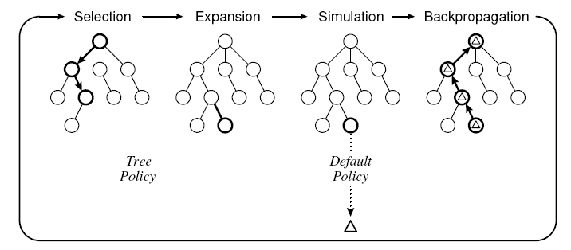

General MCTS Algorithm
Visit count is incremented and its average reward or Q value updated
Four criteria for selecting the wining action:
Max child: the highest
reward.
Robust child: the most visited
Max-Robust child: both the highest visit count and the highest reward
Secure child: maximises a lower confidence bound.

Slide 96

Upper Confidence Bounds for Trees (UCT)
Solve the tree policy based on upper confidence bounds (UCB)
Actually, a child node is selected to maximise:
Xj: the average reward
n: the number of times the current (parent) node has been visited
nj: the number of times child j has been visited
Cp: a constant

Slide 97

UCT algorithm
MCTS with UCB tree selection policy
Each node has four pieces of data: state, action, simulation reword, and visit count
It is proven that given enough time and memory, UCT allows MCTS to converge to the minimax tree

Slide 98




UCT algorithm – details
general
for two-players, zero-sum games

Slide 99


UCT algorithm – An Example
J. Bradberry. Introduction to Monte Carlo Tree Search, 2015

Slide 100


UCT algorithm – An Example

Slide 101



Deterministic games in practice
Checkers: Chinook ended 40-year-reign of human world champion Marion Tinsley in 1994.
Chess: Deep Blue defeated human world champion Garry Kasparov in a six-game match in 1997. Deep Blue searches 200 million positions per second, uses very sophisticated evaluation, and undisclosed methods for extending some lines of search up to 40 ply.
Go: In March 2016 AlphaGo won 4-1 against the legendary Lee Sedol , the top Go player in the world over the past decade.
.

Slide 102

Secret behind AlphaGO
Google Deepmin. Mastering the game of Go with deep neural networks and tree search, Nature, Jan. 2016.

Slide 103


AlphoGO Game Definition
Game State and Action

Slide 104

Key Points
Given current game state,
  how to decide next action “a”?
  How to evaluate each legal action?
Method
  Imitate Expert Moves (Supervised Learning)
  Improve through self-plays (Reinforcement Learning)
  Board Evaluation (Reinforcement Learning)

Slide 105



(1) Imitate Expert Moves
Using supervised learning to obtain a prediction model

Slide 106

Imitate Expert Moves
Convolutional Neural network (CNN) is used
Policy Network
Objectiveness: MLE
Optimization: stochastic gradient ascent

Slide 107







(2) Improve through self-plays

Slide 108

Improve through self-plays
Objectiveness: MLE
Optimization: stochastic gradient ascent

Slide 109





(3) Board Evaluation
Objectiveness: MSE
Optimization: stochastic gradient descent

Slide 110


Purpose: Reducing Search Space
Policy network: reducing action candidates (breadth reduction)
Value network (Board Evaluation): depth reduction
These moves are not common/probable
Eventually we get these values for evaluating the states

Slide 111

All-in-one: Monte Carlo Tree Search (MCTS)
a: Each simulation traverses the tree by selecting the edge with maximum action value Q, plus a bonus u(P) that depends on a stored prior probability P for that edge.
b: The leaf node may be expanded; the new node is processed once by the policy network pσ and the output probabilities are stored as prior probabilities P for each action.
c: At the end of a simulation, the leaf node is evaluated in two ways: using the value network vθ; and by running a rollout to the end of the game with the fast rollout policy pπ, then computing the winner with function r.
d: Action values Q are updated to track the mean value of all evaluations r(·) and vθ(·) in the subtree below that action.

Slide 112
UCT (MCTS) – An Example
J. Bradberry. Introduction to Monte Carlo Tree Search, 2015

Slide 113
UCT (MCTS) – An Example

Slide 114




Training pipeline
30 million self-play games
30 million games

Slide 115
End of Lecture 4
Can you represent and solve the problems by using graph search techniques now?
LIUXIABI@BIT.EDU.CN

