Slide 1
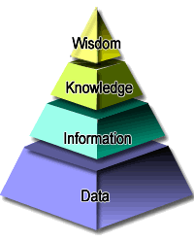
Knowledge and Reasoning
Lecture 5
Notes:
The pyramid of knowledge

Slide 2
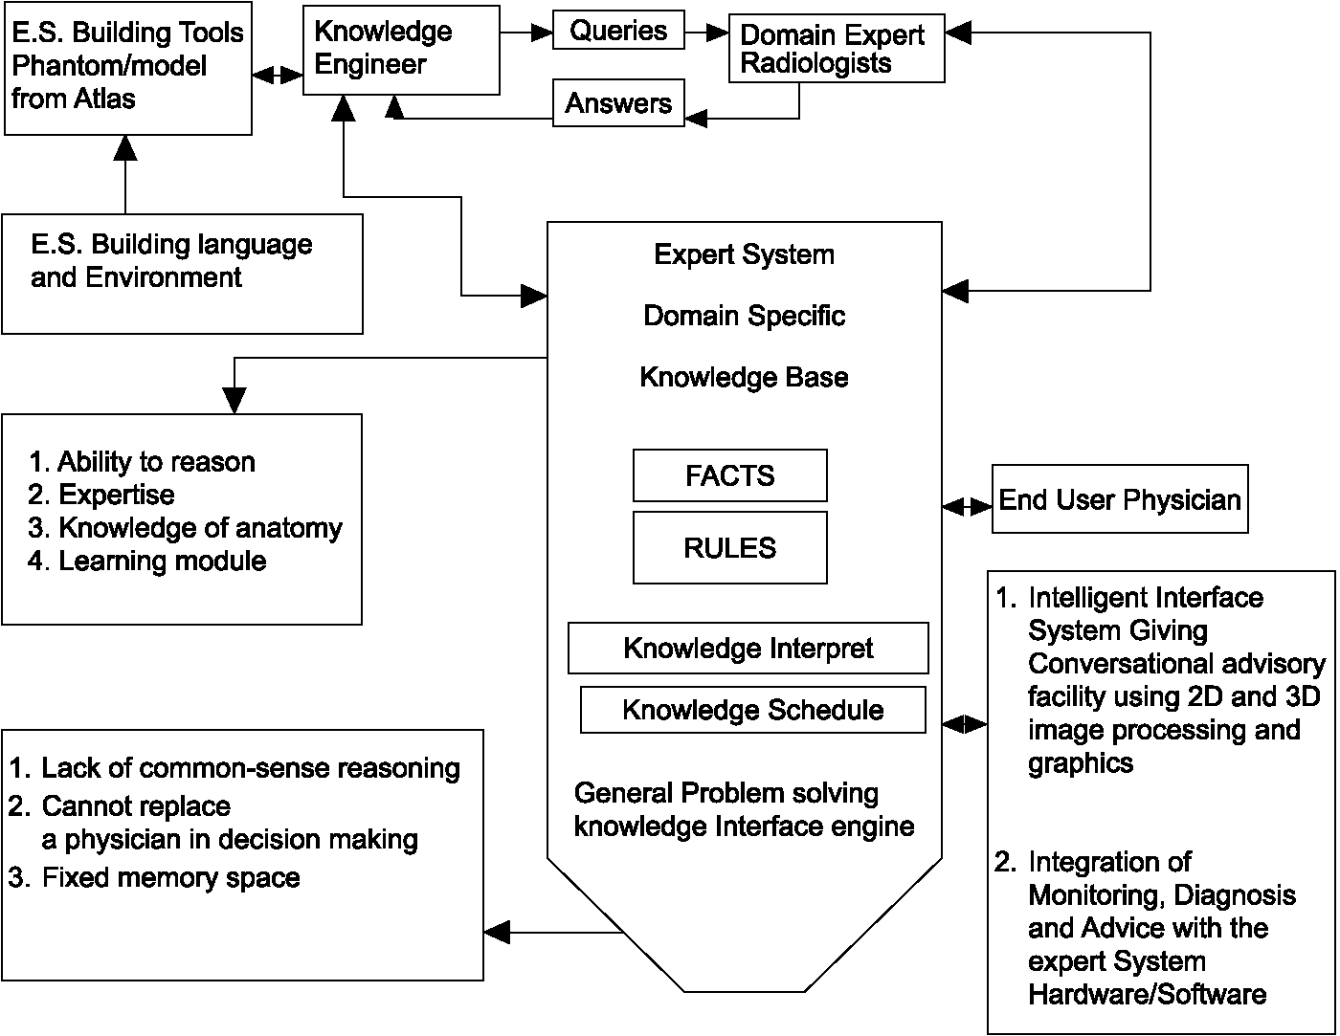
Structure of Expert Systems
From: www.emeraldinsight.com

Slide 3
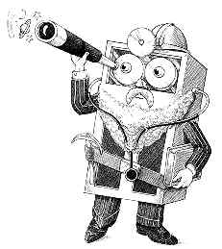
An important rule based ES
MYCIN: HAS THE PATIENT RECENTLY HAD SYMPTOMS OF PERSISTENT HEADACHE OR OTHER ABNORMAL NEUROLOGIC SYMPTOMS (DIZZINESS, LETHARGY, ETC.)?
HUMAN: YES.
MYCIN: HAS THE PATIENT RECENTLY HAD OBJECTIVE EVIDENCE ABNORMAL NEUROLOGIC SIGNS (MUSCLE RIGIDITY, COMA, SEIZURES, ETC.) DOCUMENTED BY PHYSICIAN OBSERVATION OR EXAMINATION?
MYCIN: THE CSF CULTURES WILL BE CONSIDERED TO BE ASSOCIATED WITH MENINGITIS. PLEASE GIVE THE DATE ON WHICH CLINICAL EVIDENCE (SYMPTOMS, SIGNS OR LABORATORY TESTS) OF MENINGITIS FIRST APPEARED. PLEASE ENTER CSF FINDING. IS MENINGITIS A HOSPITAL-ACQUIRED INFECTION?
HUMAN: WHY?
MYCIN: THIS WILL AID IN DETERMINING THE ORGANISMS (OTHER THAN THOSE SEEN ON CULTURES OR SMEARS) WHICH MIGHT BE CAUSING THE INFECTION. IT HAS ALREADY BEEN ESTABLISHED THAT
………….
A typical MYCIN rule:
IF
the type of x is primary bacteremia
the suspected entry point of x is the gastrointestinal tract
the site of the culture of x is one of the sterile sites
Then
there is evidence (0.8) that x is bacteroides
From: http://www.atariarchives.org/deli/expert_systems.php
Notes:
Dizziness: 眩晕；lethargy：倦怠；coma：昏迷；seizures：突然发作；MENINGITIS：脑膜炎；smear: 污点；gastrointestinal tract：胃肠道；sterile site：不育站点；bacteremia：细菌血症；bacteroides：类杆菌属

Slide 4

Sherlock Holmes
Notes:
可能的作业：用产生式规则方法给出该视频中福尔摩斯的推理过程。

Slide 5
What is reasoning ?
Ability and Process of making decision based on facts and knowledge.
- Mechanism
How to do reasoning theoretically?
- Control Strategy
How to realize the mechanism?

Slide 6
Mechanisms of Reasoning
According to logicl basis
Deduction, Induction, and Default
According to the certainty of knowledge
Reasoning under certainty vs. uncertainty
According to the monotony of reasoning process
Monotonic vs. Non-monotonic Reasoning

Slide 7
Control Strategies in Reasoning
Inference Direction
Facts → Conclusions (Forward chain, Data-driven)
Facts ← Conclusions (Backward chain, Goal-driven)
Facts ↔ Conclusions (Bi-directional)
Conflict Resolution
Sort knowledge for improving reasoning efficiency
Search

Slide 8
Outline
Production rules and system
Inference in First-order logic
- Propositional logic
- First-order logic
- Resolution
Knowledge Graphs

Slide 9
Part Ⅰ: Production Rule and System

Slide 10
Production-rule System
Facts representation
Rules representation
Reasoning control
Structure
Control System
(Inference Engine)
(Interpreter)
Rule base
Global Database (Facts)
(working memory)
Procedure
Rule Matching → Conflict Resolution → Rule Execution
Stop Conditions

Slide 11
Facts
Proposition
E.g., Snow is white. John likes AI.
Representation in computer:
Ternary:
(attribute, object, value), (relation, object1, object2)
E.g., (color, snow, white) (like, John, AI)
Quaternion:
(attribute, object, value, certification factor), (relation, object1, object2, certification factor)

Slide 12
Production Rule
P → Q
or IF P THEN Q (certainty factor )
Antecedent
Condition
Consequent
Conclusion or Action
E.g.,
IF An animal has teeth, claw, and eyes
staring into the frontage
Then the animal is carnivore (0.6)

Slide 13
Production System Example 1
You want a program that can answer questions and make inferences about food items
Like:
  What is purple and perishable?
  What is packed in small containers?
  What is green and weighs 5 kg?

Slide 14
Example 1: System Construction
WORKING MEMORY (WM)
  Initially WM = (green, weighs-5-kg)
RULE BASE
  R1. IF green THEN produce
  R2. IF packed-in-small-container THEN delicacy
  R3. IF [refrigerated OR produce ] THEN perishable
  R4. IF [weighs-5-kg AND inexpensive AND NOT perishable] THEN staple
  R5. IF [weighs-5-kg AND produce] THEN watermelon
INTERPRETER
  1. Find all productions whose condition parts are true
  2. Deactivate productions that would add a duplicate symbol
  3. Execute the lowest numbered production (or quit)
  4. Repeat until there is no rule to execute
Notes:
Working memory represents what is known about the food, both what was given at the outset and what was inferred using rules.
Nel hanged the order to the rule to make it harder to run. Its

Slide 15
Example 1: First cycle of execution
WORKING MEMORY
WM = (green, weighs-5-kg)
CYCLE 1
1. Productions whose condition parts are true: R1
2. No production would add duplicate symbol
3. Execute R1.
This gives: WM = (produce, green, weighs-5-kg)
RULE BASE
R1. IF green THEN produce
R2. IF packed-in-small-container THEN delicacy
R3. IF [refrigerated OR produce ] THEN perishable
R4. IF [weighs-5-kg AND inexpensive AND NOT perishable] THEN staple
R5. IF [weighs-5-kg AND produce] THEN watermelon
INTERPRETER
  1. Find all productions whose condition parts are true
  2. Deactivate productions that would add a duplicate symbol
  3. Execute the lowest numbered production (or quit)
  4. Repeat

Slide 16
Example 1: Second cycle of execution
WORKING MEMORY
WM = (produce, green, weighs-5-kg)
CYCLE 2
1. Productions whose condition parts are true: R1, R3, R5
2. Production R1 would add duplicate symbol, so deactivate R1
3. Execute R3 because it is the lowest numbered production.
This gives: WM = (perishable, produce, green, weighs-5-kg)
RULE BASE
R1. IF green THEN produce
R2. IF packed-in-small-container THEN delicacy
R3. IF [refrigerated OR produce ] THEN perishable
R4. IF [weighs-5-kg AND inexpensive AND NOT perishable] THEN staple
R5. IF [weighs-5-kg AND produce] THEN watermelon
INTERPRETER
  1. Find all productions whose condition parts are true
  2. Deactivate productions that would add a duplicate symbol
  3. Execute the lowest numbered production (or quit)
  4. Repeat

Slide 17
Example 1: Third cycle of execution
WORKING MEMORY
WM = (perishable, produce, green, weighs-5-kg)
CYCLE 3
1. Productions whose condition parts are true: R1, R3, R5
2. Productions R1, R3 would add duplicate symbol, so deactivate them
3. Execute R5.
This gives: WM = (watermelon, perishable, produce, green, weighs-5-kg)
RULE BASE
R1. IF green THEN produce
R2. IF packed-in-small-container THEN delicacy
R3. IF [refrigerated OR produce ] THEN perishable
R4. IF [weighs-5-kg AND inexpensive AND NOT perishable] THEN staple
R5. IF [weighs-5-kg AND produce] THEN watermelon
INTERPRETER
  1. Find all productions whose condition parts are true
  2. Deactivate productions that would add a duplicate symbol
  3. Execute the lowest numbered production (or quit)
  4. Repeat

Slide 18
Example1: Fourth cycle of execution
WORKING MEMORY
WM = (watermelon, perishable, produce, green, weighs-5-kg)
CYCLE 4
1. Productions whose condition parts are true: R1, R3, R5
2. Productions R1, R3, R5 would add duplicate symbol, so deactivate them
3. Quit.
What are the conclusions?
RULE BASE
R1. IF green THEN produce
R2. IF packed-in-small-container THEN delicacy
R3. IF [refrigerated OR produce ] THEN perishable
R4. IF [weighs-5-kg AND inexpensive AND NOT perishable] THEN staple
R5. IF [weighs-5-kg AND produce] THEN watermelon
INTERPRETER
  1. Find all productions whose condition parts are true
  2. Deactivate productions that would add a duplicate symbol
  3. Execute the lowest numbered production (or quit)
  4. Repeat

Slide 19
Production system reasoning Summary
Step1. put the facts into database
Step2. if there is no rules whose condition part can map to the facts then fail.
Step3. Choose a rule whose condition part can map to facts
Step4. perform the rule, and add a tag on the rule. If the result part is an median result, then add it into database
Step5. If the target is in the database then success; Else goto Step2.
19
Notes:
Zibra：

Slide 20
Part Ⅱ : Inference in First-order logic

Slide 21
2.1 Logic in general
Logics are formal languages for representing information such that conclusions can be drawn, can be used as a tool for knowledge representation and reasoning
- Syntax defines the sentences in the language
- Semantics define the "meaning" of sentences;
  i.e., define truth of a sentence in a world

Slide 22
(1) Propositional logic
Propositional logic is the simplest logic–illustrates basic ideas
A proposition symbol represents an atomic sentence, Each proposition symbol can be specified true/false
E. g. P_{1 :} “3>5” false
P2 : “1+1=2” true

Slide 23
An example: Lybrinth
Fact: R45
Rules: R45->R43
R43->R36&R42
……….
How to solve it through reasoning?
Notes:
作为课后练习

Slide 24
(2) First-order logic
Whereas propositional logic assumes the world contains facts
first-order logic (like natural language) assumes the world contains
  Objects: people, houses, numbers, colors, baseball games, wars, …
  Relations: red, round, prime, brother of, bigger than, part of, comes between, …
  Functions: father of, best friend, one more than, plus, …

Slide 25
Syntax of FOL: Basic elements
Constants E.g., John, 2, Sun,...
Functions E.g., Sqrt, FatherOf,...
Variables E.g., x, y, a, b,...
Predicates E.g., Brother, >,...
Connectives ¬, →, ∧, ∨, ↔
Quantifiers ∀, ∃
Term

Slide 26
Atomic sentences
Atomic sentence = predicate (term₁,...,term_{n})
E.g.
1. “Lingjian is a student”: Student(lingjian)
2. “Richard is the brother of John”: Brother(Richard, John)
3. “x>6”: Greater(x, 6)
4. “The father of Wanghong is a teacher”: Teacher(father(Wanghong))

Slide 27
Logic connectives
Complex sentences are constructed from atomic sentences using logic connectives
  If S is a sentence, ¬S is a sentence (negation)
  If S₁ and S₂ are sentences, S₁ ∧ S₂ is a sentence (conjunction)
  If S₁ and S₂ are sentences, S₁ ∨ S₂ is a sentence (disjunction)
  If S₁ and S₂ are sentences, S₁ → S₂ is a sentence (implication)
  If S₁ and S₂ are sentences, S₁ ↔ S₂ is a sentence (biconditional)

Slide 28
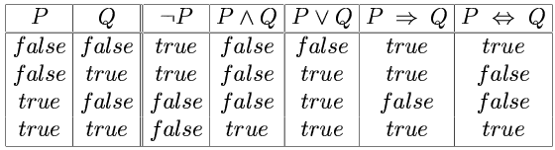
Truth tables for connectives

Slide 29
Universal quantification
∀<variables> <sentence>
E.g. “Everyone at BIT is smart”:
∀x At(x,BIT) ⇒ Smart(x)
∀x P is true in a model m iff P is true with x being each possible object in the model
Roughly speaking, equivalent to the conjunction of instantiations of P
    At(John, BIT) ⇒ Smart(John)
    ∧ At(Richard, BIT) ⇒ Smart(Richard)
    ∧ At(Alice, BIT) ⇒ Smart(Alice)
    ∧ ...

Slide 30
Existential quantification
∃<variables> <sentence>
E.g. “Someone at BIT is smart”:
∃x At(x,BIT) ∧ Smart(x)
∃x P is true in a model m iff P is true with x being some possible object in the model
Roughly speaking, equivalent to the disjunction of instantiations of P
  At(John, BIT) ∧ Smart(John)
  ∨ At(Richard, BIT) ∧ Smart(Richard)
  ∨ At(Alice, BIT) ∧ Smart(Alice)
  ∨ ...

Slide 31
Properties of quantifiers
∀x ∀y is the same as ∀y ∀x
∃x ∃y is the same as ∃y ∃x
∃x ∀y is not the same as ∀y ∃x
E.g., ∃x ∀y Loves(x,y)
  “There is a person who loves everyone in the world”
but ∀y ∃x Loves(x,y)
  “Everyone in the world is loved by at least one person”
Quantifier duality: each can be expressed using the other
E.g.
∀x Likes(x,IceCream) ¬∃x ¬Likes(x,IceCream)
∃x Likes(x,Broccoli) ¬∀x ¬Likes(x,Broccoli)

Slide 32
Complex sentences
Complex sentences are made from atomic sentences using Connectives and Quantifiers
E.g.
1. “Either Richard or John is the king”:
king(Richard) ∨ king(John)
2. “Every person has a father”:
(∀x)(∃y)(PERSON(x) ⇒ HASFATHER(x,y))
3. “Every teacher has students”:
(∀x)(∃y)(TEACHER(x) ⇒ TEACHES(x,y)∧STUDENT(y))
4. “Every integer is either even or odd”
(∀x)(I(x) ⇒ E(x) ∨O(x))

Slide 33
2.2 Inference Foundation
Sentences are true with respect to a model and an interpretation
- Model contains objects (domain elements) and relations among them
- Interpretation specifies referents for
  constant symbols → objects
  predicate symbols → relations {T, F}
  function symbols → functional relations

Slide 34
An example of interpretation
Predict:
Domain:
Interpretation 1:
P(1,1) | P(1,2) | P(2,1) | P(2,2)
T | F | T | F
P(1,1) | P(1,2) | P(2,1) | P(2,2)
T | T | F | F
Interpretation 2:

Slide 35
(1) Validity and Satisfiability
A sentence is valid if it is true in all interpretations
A sentence is satisfiable if it is true in some interpretations
A sentence is unsatisfiable if it is true in no interpretations

Slide 36
(2) Equivalence and Entailment
Two sentences are logically equivalent if they have same truth in all interpretations.
A sentence P entails another sentence Q if and only if P→Q is valid.
Logical equivalence, entailment, and other rules including P rule, T rule, CP rule, and reduction to absurdity are fundaments of inference in first-order logic

Slide 37
(3) Substitution and Unification
Substitution
xi is substituted by ti
｛a／x，c／y，f(b)／z｝√
｛g(y)/x, f(x)/y｝×
Unification
To introduce substitutions different logical expressions have to be look identical

Slide 38
An example of Unification
We can get the inference immediately if we can find a substitution θ such that King(x) and Greedy(x) match King(John) and Greedy(y)
θ = {John/x, John/y} works
Unify(α,β) = θ if αθ = βθ
p q θ
Knows(John,x) Knows(John,Jane)
Knows(John,x) Knows(y,OJ)
Knows(John,x) Knows(y,Mother(y))
Knows(John,x) Knows(x,OJ)

Slide 39
An example of Unification
We can get the inference immediately if we can find a substitution θ such that King(x) and Greedy(x) match King(John) and Greedy(y)
θ = {John/x, John/y} works
Unify(α,β) = θ if αθ = βθ
p q θ
Knows(John,x) Knows(John,Jane) {Jane/x}
Knows(John,x) Knows(y,OJ)
Knows(John,x) Knows(y,Mother(y))
Knows(John,x) Knows(x,OJ)

Slide 40
An example of Unification
We can get the inference immediately if we can find a substitution θ such that King(x) and Greedy(x) match King(John) and Greedy(y)
θ = {John/x, John/y} works
Unify(α,β) = θ if αθ = βθ
p q θ
Knows(John,x) Knows(John,Jane) {Jane/x}
Knows(John,x) Knows(y,OJ) {OJ/x, John/y}
Knows(John,x) Knows(y,Mother(y))
Knows(John,x) Knows(x,OJ)

Slide 41
An example of Unification
We can get the inference immediately if we can find a substitution θ such that King(x) and Greedy(x) match King(John) and Greedy(y)
θ = {x/John,y/John} works
Unify(α,β) = θ if αθ = βθ
p q θ
Knows(John,x) Knows(John,Jane) {Jane/x}
Knows(John,x) Knows(y,OJ) {OJ/x, John/y}
Knows(John,x) Knows(y,Mother(y)) {John/y, Mother(John)/x}
Knows(John,x) Knows(x,OJ)

Slide 42
An example of Unification
We can get the inference immediately if we can find a substitution θ such that King(x) and Greedy(x) match King(John) and Greedy(y)
θ = {x/John,y/John} works
Unify(α,β) = θ if αθ = βθ
p q θ
Knows(John,x) Knows(John,Jane) {Jane/x}
Knows(John,x) Knows(y,OJ) {OJ/x, John/y}
Knows(John,x) Knows(y,Mother(y)) {John/y, Mother(John)/x}
Knows(John,x) Knows(x,OJ) {fail}

Slide 43
Most General Unifier
To unify Knows(John,x) and Knows(y,z),
θ = {John/y, z/x} or θ = {John/y, John/x, John/z}
The first unifier is more general than the second.
There is a single most general unifier (MGU) that is unique up to renaming of variables.
  MGU = {John/y, z/x}

Slide 44
MGU example
MGU for F={ P(a,x,f(g(y))) ，P(z,h(z,u),f(u)) }
k=0: F₀=F ; σ₀=ε
D₀={a, z}，σ₁= σ₀ ·{a/z}
F₁ = F₀(a/z)= { P(a,x,f(g(y))) ，P(a,h(a,u),f(u)) }
k=1: D₁={x, h(a,u)}, σ₂= σ₁ ·{h(a,u)/x} ={a/z, h(a,u)/x}
F₂ = F₁(h(a,u)/x)= { P(a,h(a,u),f(g(y))) ，P(a,h(a,u),f(u)) }
k=2: D₂={g(y),u}, σ₃= σ₂ ·{g(y)/u} ={a/z, h(a,g(y))/x, g(y)/u}
F₃ = F₂(g(y)/u)= { P(a,h(a,g(y)),f(g(y)))， (P(a,h(a,g(y)),f(g(y))) }= { P(a,h(a,g(y)),f(g(y))) }

Slide 45
2.3 Resolution: Concepts
Literal
Atomic sentences and their negation
Clause
disjunction of literals
Empty clause (also □ or NIL )
unsatisfiable
Conjunctive Normal Form (CNF)
conjunction of clauses

Slide 46
Resolution: brief introduction
A kind of Reduction to absurdity
The problem of proving that P entail Q is converted as the problem of proving that
is unsatisfiable.
Method: continue resolving two clauses until empty clause is derived

Slide 47
(1) Conversion to CNF
Example: Everyone who loves all animals is loved by someone:
  ∀x ((∀y( Animal(y) → Loves(x,y))) → (∃y Loves(y,x)))
1. Eliminate biconditionals and implications
  ∀x (¬(∀y( ¬Animal(y) ∨ Loves(x,y))) ∨ (∃y Loves(y,x)]))
2. Move ¬ inwards
  ∀x ((∃y ¬(¬Animal(y) ∨ Loves(x,y))) ∨ (∃y Loves(y,x)))
  ∀x ((∃y(¬¬Animal(y) ∧ ¬Loves(x,y))) ∨ (∃y Loves(y,x)))
  ∀x ((∃y Animal(y) ∧ ¬Loves(x,y))) ∨ (∃y Loves(y,x)))

Slide 48
Example contd.
3. Standardize variables: each quantifier should use a different one
  ∀x ((∃y Animal(y) ∧ ¬Loves(x,y))) ∨ (∃z Loves(z,x)))
4. Skolemize: a more general form of existential instantiation.
  ∀x ((Animal(F(x)) ∧ ¬Loves(x,F(x))) ∨ Loves(G(x),x))
5. Drop universal quantifiers:
  (Animal(F(x)) ∧ ¬Loves(x,F(x))) ∨ Loves(G(x),x)
6. Distribute ∨ over ∧ :
(Animal(F(x)) ∨ Loves(G(x),x)) ∧ (¬Loves(x,F(x)) ∨Loves(G(x),x))

Slide 49
(2) Resolution Rule
Eliminate complementary literals in two sentences, the disjunction of remaining parts of two sentences construct the resolvent clause which is the entailment of two sentences above.
Literals are complementary if one is the negation of the other.
Apply resolution steps to CNF(KB ∧ ¬α); complete for inference when empty clause is reached.

Slide 50
An example of resolution
Let C1= P∨Q，C2= Q，C3=P, get the resolvent clause of C1, C2 and C3.
P∨Q
Q
P
P
What is the meaning of NIL?
NIL

Slide 51
Proof of Resolution Rule
Resolution:
Proof:

Slide 52
Example1 of FOL resolution proof
on(b,c)
￢G(x) ∨ G(y) ∨ ￢on(x,y)
a:Green
{b/x, c/y}
Prove:there is a green block directly on top of a nongreen one.
b:?
on(a,b)
￢G(b) ∨ G(c)
￢G(c)
c:Not Green
{a/x, b/y}
Facts:
G(a)
￢G(a) ∨ G(b)
Negate Conclusion :
￢G(b)
￢G(b)
From: knowledge representaotion and reasoning, Brachman & Levesque
NIL

Slide 53
Example2 of FOL resolution proof
￢p(2,3,5)
￢p(x,y,z) ∨ p(s(x),y,s(z))
Given addition properties: （1）0+x = x；（2）if x+y = z，then x+1+y=z+1
Prove：2+3=5.
{1/x, 3/y, 4/z}
￢p(1,3,4)
Facts:
{0/x, 3/y, 3/z}
p(0,x,x)
￢p(0,3,3)
{3/x}
Negate Conclusion :
NIL
From: knowledge representaotion and reasoning, Brachman & Levesque

Slide 54
Resolution Reasoning Example
Facts and Rules:
Jack owns a dog.
  Every dog owner is an animal lover.
  No animal lover kills an animal.
  Either Jack or Curiosity killed the cat, who is named Tuna.
  Problem:
  Did Curiosity kill the cat?
54

Slide 55
Resolution Reasoning Example
  Resolution Step1:
  Express the facts and Rules in FOL:
  A:(∃ x) Dog(x) ∧ Owns(Jack,x)
  B:(∀x)((∃ y) Dog(y) ∧Owns(x, y) )→ AnimalLover(x)
  C:(∀x)(∀y) AnimalLover(x) ∧ Animal(y) → ┓Kills(x, y)
  D: Kills(Jack, Tuna) ∨ Kills(Curiosity, Tuna)
  E: Cat(Tuna)
  F: ∀x Cat(x) → Animal(x)
55

Slide 56
Resolution Reasoning Example
Resolution Step2:
Conversion to CNF:
A1: Dog(D)
A2: Owns(Jack, D)
B: ┓Dog(f(x)) ∨ ┓Owns(x, f(x)) ∨AnimalLover(x)
C: ┓AnimalLover(x) ∨ ┓Animal(y) ∨ ┓Kills(x, y)
D: Kills(Jack, Tuna ) ∨ Kills(Curiosity, Tuna)
E: Cat(Tuna)
F: ┓Cat(x) ∨ Animal(x)
Resolution Step3:
negation of the result: ┓Kills(Curiosity, Tuna)
56

Slide 57
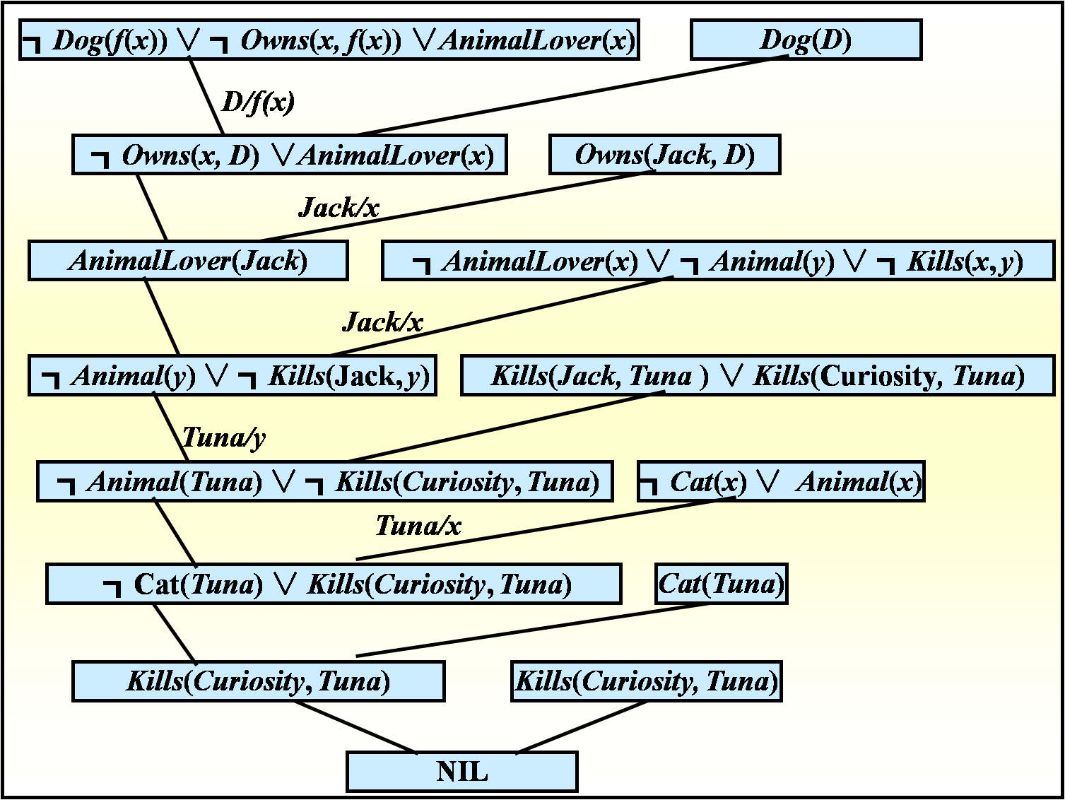
Step4: Peform Resolution
┓

Slide 58
Summary of Resolution in prove
Step1. Converse the facts and rules into clause form - a set of clauses set
Step2. Add the negation of what is to be proved, in clause form, together to the clause set
Step3. Resolve these clauses together, producing new clauses the logically follow from them
Step4. Iteratively apply resolution to the clauses and add results to either until there no more resolvent that can added or until the empty clause is produced.
58

Slide 59

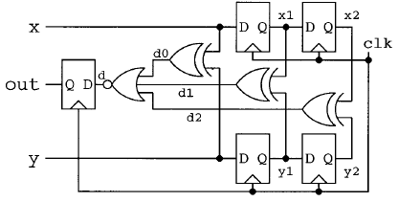
Applications of FOL
Automatic Threorem Proving
Semantic Web
Conecptural Clustering
Reason about policies
Formal Verification in hardware design
Game and Automata
……..

Slide 60
Part Ⅲ: Knowledge Graph

Slide 61
3.1. What is Knowledge Graph

Slide 62
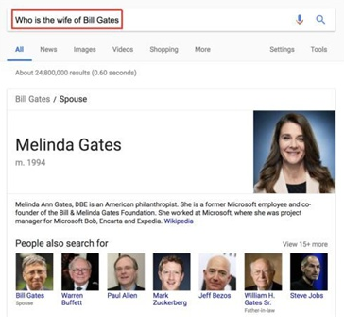
Knowledge Graph
Google announced its Knowledge Graph on May 16, 2012, as a way to significantly enhance the value of information returned by Google searches.

Slide 63
Knowledge Graph
What is a Knowledge Graph?
A knowledge graph, also known as a semantic network, represents a network of real-world entities—i.e. objects, events, situations, or concepts—and illustrates the relationship between them.

Slide 64
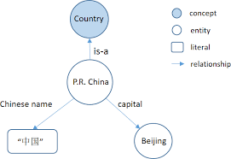
Knowledge Graphs Definition
A knowledge graph is a directed labeled graph in which the labels have well-defined meanings.
A directed labeled graph consists of nodes, edges, and labels.

Slide 65
Knowledge Graphs Definition
Anything can act as a node, for example, people, company, computer, etc.
An edge connects a pair of nodes and captures the relationship of interest between them, for example, friendship relationship between two people, customer relationship between a company and person, or a network connection between two computers.
The labels capture the meaning of the relationship, for example, the friendship relationship between two people.

Slide 66
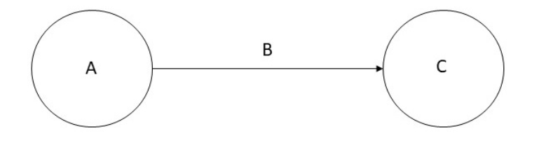
Knowledge Graphs Definition
given a set of nodes N, and a set of labels L, a knowledge graph is a subset of the cross product N × L × N. Each member of this set is referred to as a triple, and can be visualized as shown below.

Slide 67
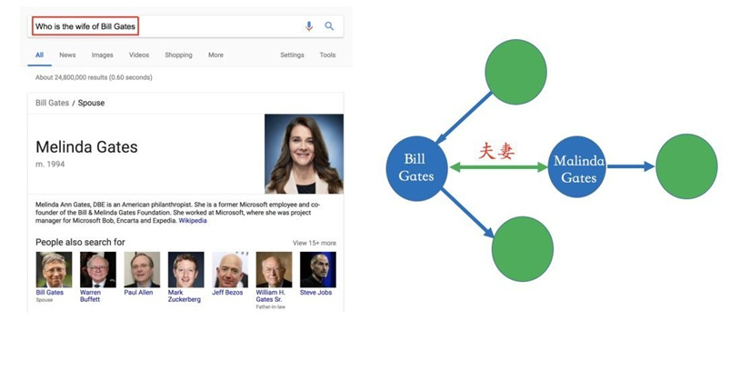
Knowledge Graph
E.g. “Who is the wife of Bill Gates?”

Slide 68
3.2. Knowledge Graph Construction

Slide 69
Knowledge Graph
Create a Knowledge Graph from Data？
Schema design
  Relating the schema of sources to the knowledge graph schema
Record linkage
  Recognizing if two instances refer to the same object in the real-world

Slide 70
Knowledge Graph Construction
Create a Knowledge Graph from Unstructured Input? (Hard)
4 Steps:
  1. Entity Extraction
  2. Relation Extraction
  3. Entity Resolution
  4. Coreference Resolution

Slide 71
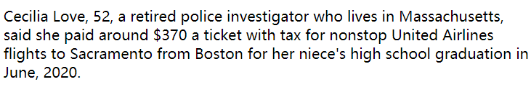
Knowledge Graph Construction
Entity Extraction
Consider the following piece of text:

Slide 72
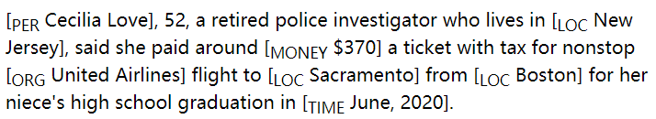
Knowledge Graph Construction
A named entity is anything that can be referred to with a proper name: a person, a location, an organization, etc.
The definition of a named entity is commonly extended to include things that are not entities per se, including dates, times, and other kinds of expressions involving time, and even numerical expressions, for example, prices.

Slide 73
Knowledge Graph Construction
Relation Extraction
There are three broad approaches to relation extraction:
  syntactic patterns
  various forms of supervised machine learning
  unsupervised machine learning.
The unsupervised machine learning has limited use in practice.

Slide 74
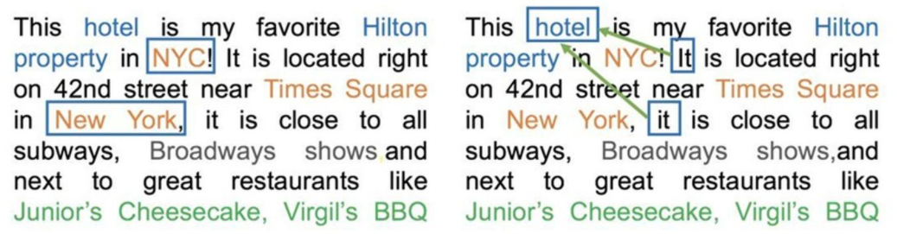
Knowledge Graph Construction
Entity Resolution & Coreference Resolution

Slide 75
3.3. Typical Application of Knowledge Graph

Slide 76
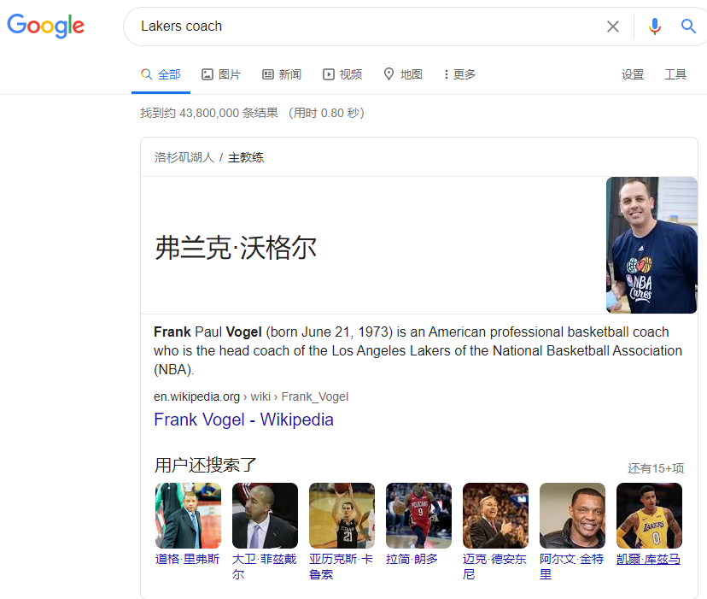


Knowledge Graph Application
1. Search engines

Slide 77
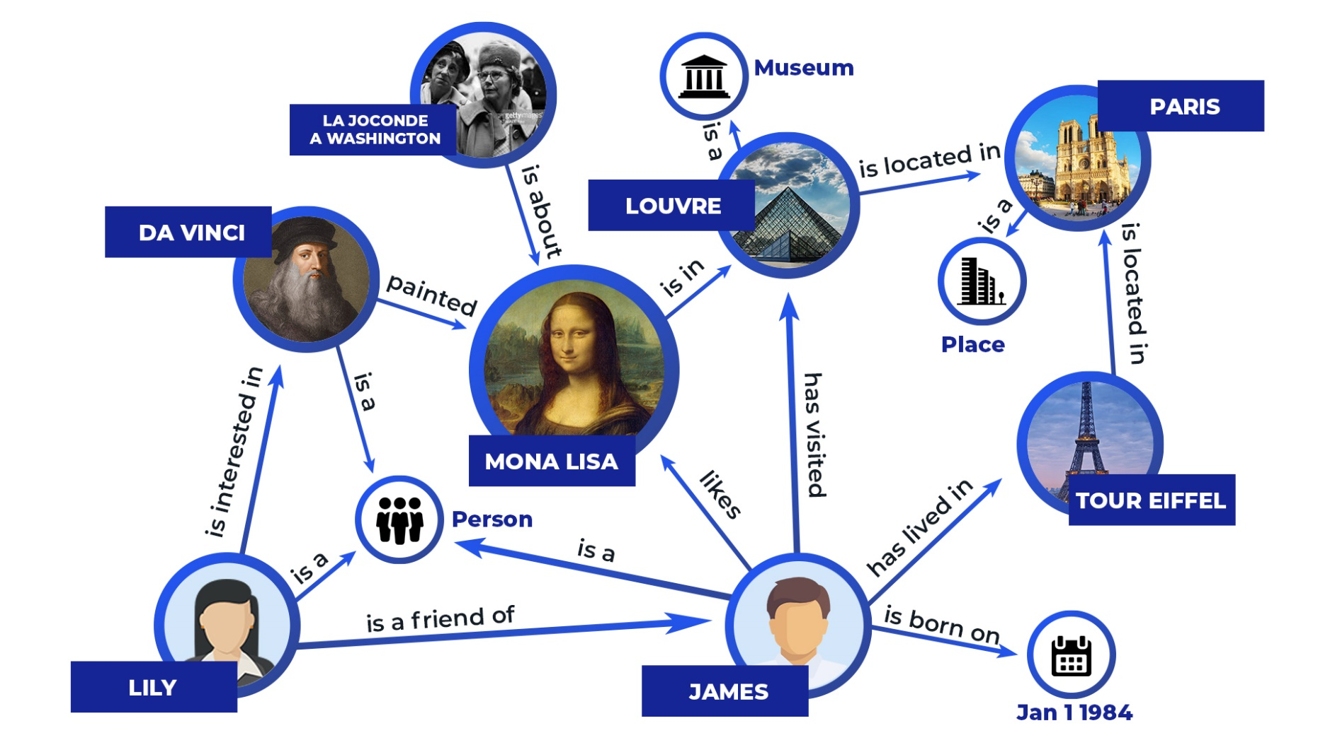
Knowledge Graph Application
2. Question Answering

Slide 78
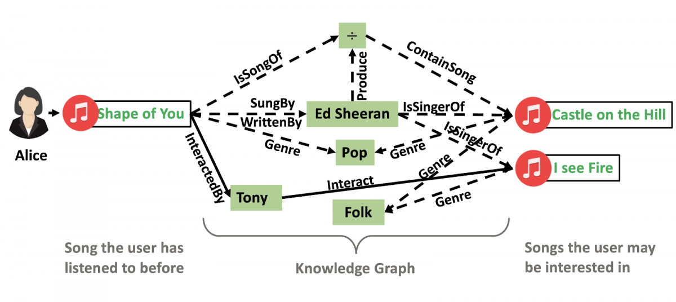
Knowledge Graph Application
3. Recommendation Engine

Slide 79
Knowledge Graphs enhanced Learning

Slide 80
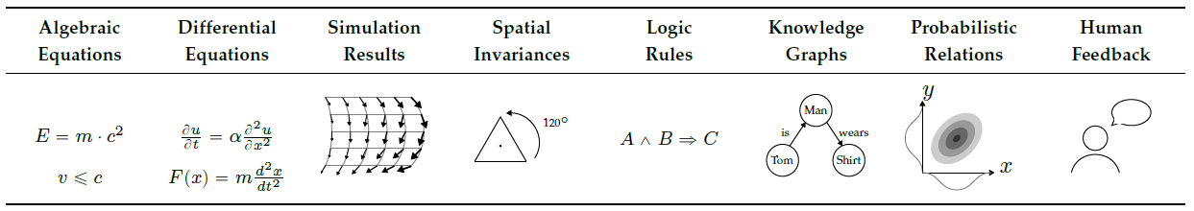
How to Think?
Hypothesis Set
Objectiveness
Optimization
Training Data
Key Elements in Learning

Slide 81
Approach: Integration into the Hypothesis Set
Inference about a particular object is facilitated by using relations to other objects in an image.
Graph neural networks operate on graphs and thus feature an object-and relation-centric bias in their architecture.
A graph reasoning layer can be inserted into any neural network: Enhance representations in a given layer by propagating through a given knowledge graph.

Slide 82
Symbolic Graph Reasoning Meets Convolutions
How to harness various external human knowledge for endowing the networks with the capability of semantic global reasoning?
Propose a new Symbolic Graph Reasoning (SGR) layer, which performs reasoning over a group of symbolic nodes whose outputs explicitly represent different properties of each semantic in a prior knowledge graph.
The SGR layer can be injected between any convolution layers and instantiated with distinct prior graphs.
Liang et al., “Symbolic graph reasoning meets convolutions,” in Neural Information Processing Systems (NIPS), 2018.

Slide 83
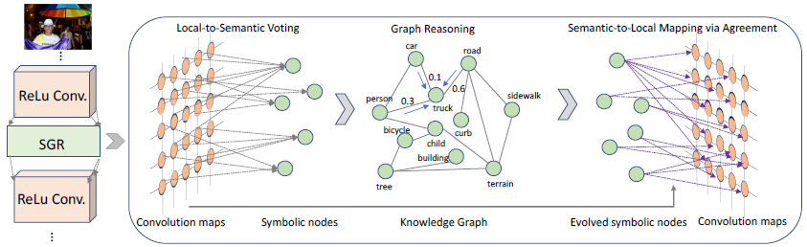
Symbolic Graph Reasoning
To leverage global graph reasoning to enhance local features with external structured knowledge
Consists of three modules:
local-to-semantic voting: local features that are correlated to a specific semantic meaning (e.g. cat) are aggregated to depict the characteristic of its corresponding symbolic node.
graph reasoning: leverage semantic constraints from human commonsense to evolve global representations of symbolic nodes.
semantic-to-local mapping: the evolved global representations of symbolic nodes can be used to further boost the capability of each local feature representation.

Slide 84
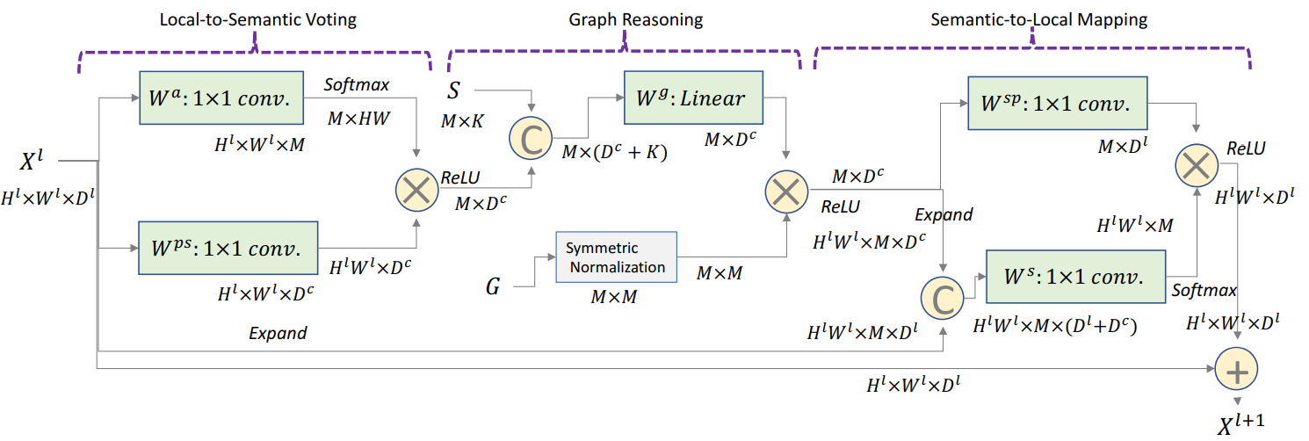
Symbolic Graph Reasoning
The SGR layer is instantiated by specific knowledge graph with different numbers of symbolic nodes and distinct node connections.
Combining multiple SGR layers with distinct knowledge graphs into convolutional networks can lead to hybrid graph reasoning behaviors.

Slide 85
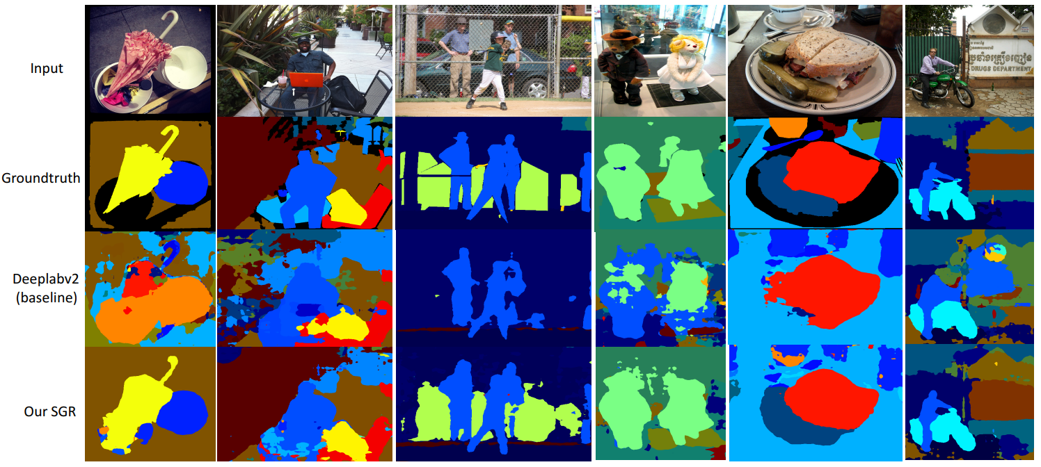
Example: Image Segmentation
Use a universal concept hierarchy: starting from the label hierarchy of COCO-Stuff that includes 182 concepts and 27 super-classes, we manually merge concepts from the rest two dataset together by using WordTree. It results in 340 concepts in the final concept graph.

Slide 86
End of Lecture 5
Can you develop an intelligent software for reasoning with knowledge?
LIUXIABI@BIT.EDU.CN

